Slide 1
Clinical Risk Assessment, Formulation and Management

Slide 2
BEFORE BEGINNING
If you are using a mobile device or laptop, please ensure that it is fully charged.
You should also have a pen and notepad ready.
Ensure you are in a quiet area with minimal distractions.
In addition to the above please make yourself familiar with some of the tools available above such as;
Resource Bank
Here you will find useful documents that will be relevant to the course you are undertaking but also you will have access to a CPD reflective learning template which you can download and complete to gain your points.
Highlighter/Pen tool
This feature allows to highlight, circle and write notes on parts of the material wherever you feel necessary.
Presenter Function
Selecting this function will give you instant access to our contact details without having to leave the course should you require support with the system or any assistance from one of our qualified trainers.
Audio Dictation
Please note this feature is auto-enabled. If this isn’t required simply select the mute function or decrease the volume.
Hyperlinks
Should you click on a hyperlink within the course material you will be required to click your back button on your browser or device once you are ready to resume.

Slide 3
INTRODUCTION
This session will help practitioners to recognise and put into practice the key elements of a thorough risk assessment when working with children and young people.

Slide 4
Learning Objectives
By the end of this session you will be able to:
Explain what is meant by ‘risk’ and ‘risk assessment’
Identify the different risks and risk factors for children and young people
Describe the steps involved in the risk assessment process, the associated challenges and their solutions
Outline the action that needs to be taken after the risk assessment
This session uses self assessments that help you check what you have learnt. You do not have to use them and your answers are not seen by anyone else.

Slide 5
Introduction
Risk assessment and management are complex issues that can understandably evoke anxiety within clinicians. Risk is not static, so its assessment and management must be continually revisited in light of new information and/or changing circumstances.
Although there are no universal standardised definitions of risk or risk assessment, there are national policies regarding the management of self-harm and suicidal ideation, the recognition and reporting of suspected abuse and neglect, and detailed guidance regarding information sharing around risk.
In addition, each NHS Trust will have its own set of policies or best practice guidelines that should guide risk assessment and management across services. All clinical staff working within Child and Adolescent Mental Health Services (CAMHS) should know what these are.

Slide 6
What is Risk?
The nature, severity, frequency/duration and likelihood of harm
An estimation of the likelihood of harm occurring under particular circumstances,
within a specific period of time
Any features of illness, behaviour, or circumstances that lead to an increase in risk
The identification and implementation of appropriate actions to reduce harm

Slide 7
Many children and young people experience temporary difficulties in one or more aspects of their life. These are caused by exposure to specific sources of risks.
Sources of risk:
If a child is at risk in some way, that child will have needs related to their well-being. With the risks shown here, the children and young people involved will have complex needs. Sources of risk are just one side of the coin – we also need to consider the type of risk.
Self-vulnerability
Some may face more serious risks from vulnerabilities within themselves, such as mental health problems or learning difficulties.
People close to them
Some are placed at risk by those close to them, such as children at risk of neglect or abuse.
Socio-economic disadvantages
The life opportunities of some children are affected by living in continuing poverty and dangerous communities.
Own behaviour
There are also children who place themselves at risk through their own behaviour. This will include children who present a risk of serious harm to themselves and others.
Violence or discrimination
Children may also become victims of bullying, other violence from peers or discrimination.

Slide 8
Types of risks to self include:
Deliberate self-harm (with and without suicidal ideation) such as cutting, burning, hitting or head-butting walls or doors, and taking overdoses of medication
Risk-taking behaviour including unsafe promiscuity, absconding, and the use of solvents, drugs and alcohol
Self-neglect (including refusal to eat and drink as seen in anorexia nervosa)

Slide 9
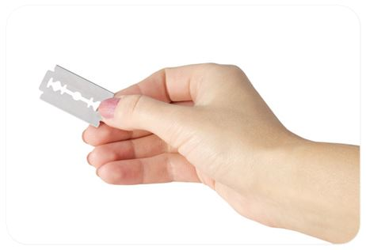
Self Harm
Self-harm often represents an attempt by children or young people to manage or regulate their emotional distress by:
Inflicting physical pain on themselves to control emotional hurt
Engaging in self-punishment to reduce feelings of guilt
Using self-harm to provide a sense of release from anger or frustration
Self-harm should be taken seriously; its occurrence is an identified risk factor of death by suicide as well as accidental death. The nature of the self-harm behaviour (for example, depth of cutting) does not predict underlying intent or levels of emotional distress.
Prevalence of self-harm
In a UK survey of over 6000 15-16 year olds, 15% of adolescents reported thoughts of
suicide and just over 13% had engaged in self-harm. Approximately 80-90% of self
harm occurrences were not known about by professionals.
Wherever possible, risk from self-harm and the presence of any suicidal ideation
should be assessed during a one-to-one interview. Immediate medical attention may
be required.

Slide 10
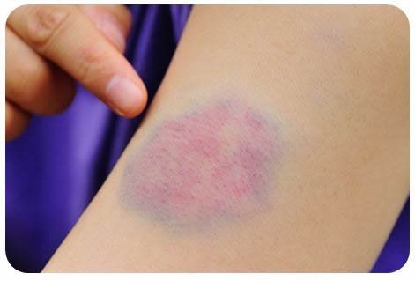
Physical Abuse
Examples of physical abuse include hitting, punching, throwing of objects, kicking, and burning.
Possible indicators of physical abuse include:
Regular and unexplained bruising or injuries
Bruises that appear to have been caused by fingers or an object
Numerous GP and accident and emergency visits

Slide 11
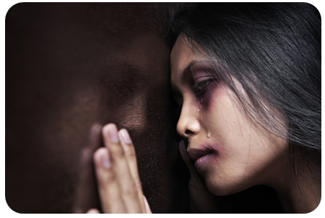
Sexual Abuse
Sexual abuse includes sexual touching, penetrative sex, deliberately engaging in sexual activity in front of a child or young person, and the offer or exchange of money/protection/shelter/food for the sexual services of a child or young person (sexual exploitation).
Indicators of possible sexual abuse include:
Behaviour which is suddenly out of character or unusual
Sexually-inappropriate behaviour
The child or young person persistently avoiding being alone with a particular adult
Physical symptoms of sexual abuse include anal or vaginal soreness,
sexually-transmitted disease and pregnancy.

Slide 12
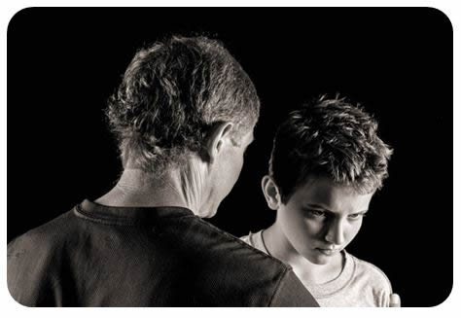
Emotional Abuse
Criticising, the use of demeaning and humiliating punishments, and a parent/carer never expressing positive feelings or showing any emotions towards a child or young person (emotional neglect) are all examples of emotional abuse.
Possible indicators of this include:
Severe and persistent negative interactions between the parent/carer and the child or young person
A fearful, distant or unaffectionate relationship between the parent/carer and the child or young person
Reports of the child or young person's persistent isolation from their peers at school
An actual demonstration by the parent/carer of high levels of criticism
The child or young person having difficulty expressing positive emotions

Slide 13
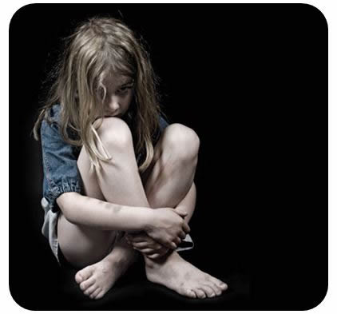
Neglect
Examples of neglect include lack of adequate food, water, shelter, warmth, attention, and emotionally-positive interactions.
Neglect can be indicated by:
The presence of sores, rashes or flea bites
Poor personal hygiene
Unwashed or inadequate clothing
Missing school
Anti-social behaviour
Early sexual activity
Absent parents/carers
The child taking on the role of carer for another family member
(for example, a sibling)

Slide 14
Bullying
Bullying by others can also be a significant risk: almost half (46%) of children report having experienced bullying at some point in their lives, whilst almost 40% of young people reported that they had been affected by online bullying on a highly frequent basis.
Online bullying
Practitioners need to be sensitive to issues of cyber-bullying, online grooming and sexual exploitation and explicitly discuss these topics with children or young people where there are concerns about their internet use. As with all forms of abuse, it is better to ask direct questions rather than wait for the child or young person to volunteer information about bullying.

Slide 15
Risk to Others
The assessment of risk presented by children or young people to other people is not a familiar aspect for many practitioners outside of a forensic CAMHS setting. However, children or young people with conduct disorder commonly present with anti-social behaviour, which may include verbal and/or physical aggression and violence towards others.
Giving a child or young person the opportunity to talk first about violence done to him or her can help explain why they behave in a violent or aggressive way to others. It can also be less threatening to the child or young person who may be ashamed or embarrassed about their behaviour.
Practitioners should discuss problems of risk to other people with colleagues in other organisations (for example, youth offending teams).

Slide 16
Risk Factors
Question: What is a risk factor?
Answer: A risk factor is anything that increases the likelihood of harm occurring.
When assessing risk factors present in children or young people, there is also the important context of normal developmental changes (for example, physical, cognitive, social and emotional) to consider.
Particularly during adolescence, practitioners should identify aspects of impulsivity, risk-taking, emerging personality traits and the more significant impact of peer/social influences that are considered
age-appropriate at this time of life.

Slide 17
Risk Factors Examples
Risk factors can be considered with regards to their changeability (static or dynamic) and their location (personal or environmental). Most risk factors are dynamic and therefore changeable; it is important that risk assessments are reviewed in light of changing circumstances and mood states.
Risk Factor | Examples
Static/historical (i.e. unchangeable) | Gender, a history of being abused during childhood
Dynamic but chronic (i.e. changeable over a long period of time) | Social deprivation and homelessness
Dynamic and acute (i.e. change rapidly but future risk prediction is difficult) | Conflict with family/peers, suicidal intent, access to means of self-harm
Personal (i.e. located within the child or young person) | Hopelessness, depression or anger, current suicidal ideation
Environmental or contextual (i.e. located around the child or young person) | Recent loss, insufficient access to money, housing and work, absence of family/peer support

Slide 18
Protective Factors
Protective factors are things that decrease the potentially harmful effect of a risk factor. Examples of protective factors include a high IQ, commitment to school, warm and supportive relationships with parents/carers or other adults, and supportive peer relationships with adaptive shared interests (for example, sport rather than drug misuse).
When considering risks to self, protective factors include:
Having clear future plans
Citing reasons for living
Having religious views that consider suicide a sin
Having thoughts about the negative impact of suicide on others
A thorough risk assessment should seek to establish the presence of risk and protective
factors in order to further the practitioner’s, the child or young person’s and the system’s
understanding and managementof the risks present.

Slide 19
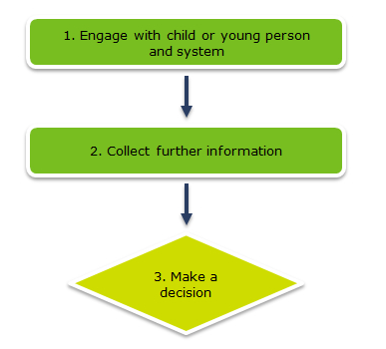
The different steps in the risk assessment process are as follows:
Engage with the child or young person and the system
Collect further information
Make a decision
1. Engage with the child or young person and the system
During the risk assessment, the practitioner will seek to establish the presence of risk and protective factors in order to better understand and manage the risks present. They will keep detailed notes of the discussion, as well as their own observations regarding the child or young person. The key to the most effective risk assessment and management is a good relationship between the child or young person and the practitioner.
2. Collect further information
The Department for Education document ‘Working together to safeguard
children’ describes how important it is when assessing risk to collate
information from a range of sources. These include: Parents, Other health
professionals, Voluntary agency staff, Educational staff, Children’s services
professionals.
3. Make a decision
The purpose of the risk assessment is to gain a shared understanding of the
context, nature, frequency, duration and extent of any risk to self, to others
and from others. The practitioner needs to decide who to share the
information with; this needs to be done in accordance with the local and
national risk management and child protection guidelines.

Slide 20
Promoting Collaboration
The first step in promoting collaboration between the clinician and child or young person is to explain what will happen during the risk assessment process.
The scope and limits of confidentiality should be clearly explained to both children or young people and parents/carers at the earliest opportunity.
Whilst the therapeutic alliance(read a full definition of this term) is very important when working with children and young people, it is secondary to the safe management of identified risks.

Slide 21
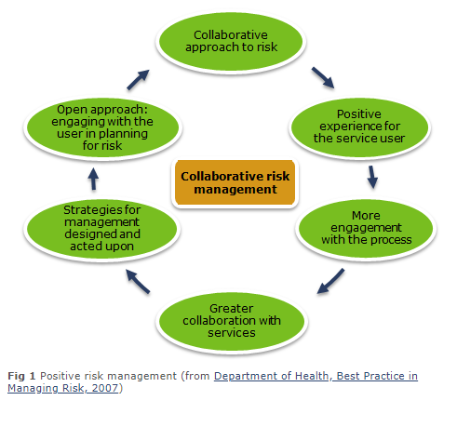
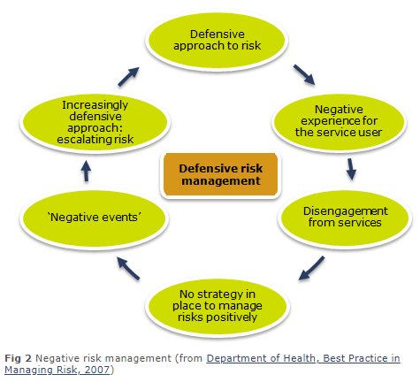
Collaboration & Transparency
As you can see in Fig 1 and Fig 2, collaboration and transparency on behalf of the practitioner promotes safer practice through increased transparency from the client. Engagement of the child or young person in a conversation about risks requires all of the clinician's engagement skills including warmth, validation, empathy and positive regard. The therapeutic relationship supports the client in discussing risk in a contained and safe way. However, it is important to remember that the explanation of the scope and limits of confidentiality should be given before any discussion of risk.

Slide 22
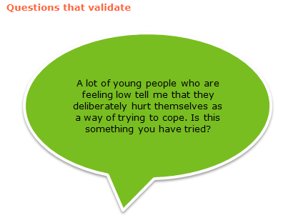
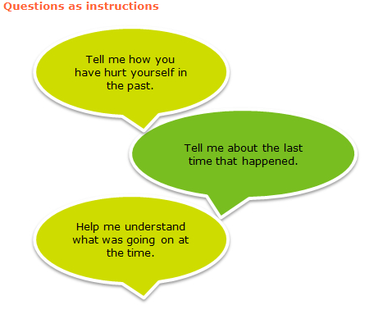
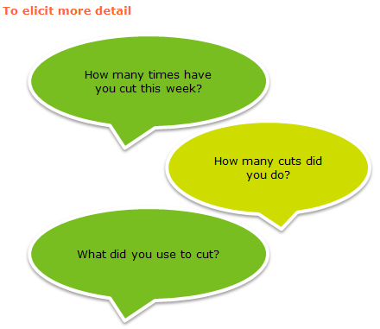
Questioning the Child or Young Person
Sensitive, empathic and confident questioning is needed to support children or young people in sharing information regarding risk. It should be made clear to the child or young person that risk is an important area to be discussed and that the therapist is able to contain the distress it can cause. The therapist must ask the difficult questions; a child or young person will rarely volunteer risk information unless asked.
Appropriate question types
To introduce the topic, use questions that validate the child or young person’s experiences, normalise and encourage discussion. Then, to help get the child or young person talking, pose open follow-up questions as instructions. After you have done this, the questions can then move on to elicit more detail.

Slide 23
Collating Information
The information is collated and considered according to the practitioner's judgement, whilst assisted by guidelines that reflect current views of best practice.
Most organisations will have some form of in-house structured risk assessment template that will be based on evidence-based risk factors.
Standardised screening measures that explore particular risk factors (such as depression or hopelessness) can also usefully inform clinical decision-making. An example of one of these measures is the Children’s Depression Inventory (CDI-2). This is a self-report assessment for 7-18 year olds which explores the key symptoms of depression, including a child or young person’s feelings of worthlessness and loss of interest in activities.

Slide 24
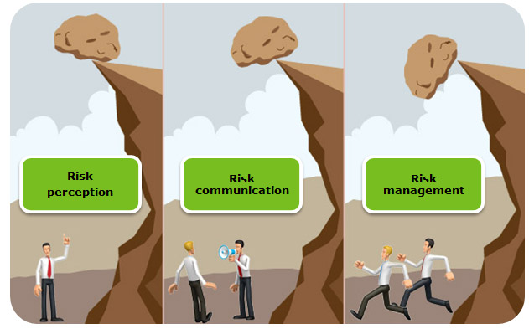
Information Sharing
Without effective communication and planning, the identification of risk serves no meaningful purpose (Fig 1).
In all cases, it is essential that you communicate with the right people.

Slide 25
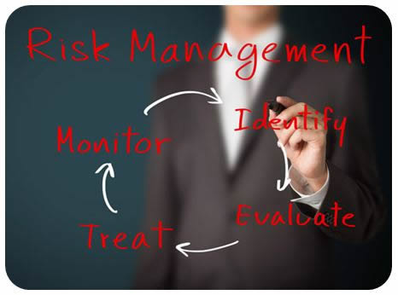
Risk Formulation and Management
Once risk is identified, action to eliminate or, more commonly, manage that risk must be taken.
In order to make sense of the assessment information and to inform a clear, individualised risk management plan, risk formulations should be devised with the child or young person and the professionals involved in their care. The risk formulation and management plan should include:
A summary of all identified risks and protective factors
Details of the situations in which risks may occur
Early warning signs of escalating risk
Actions to be taken by the practitioner, child or young person and others in response to these signs
Risk assessments, formulations and management plans should be reviewed
regularly (every 6 months at a minimum) and updated accordingly.

Slide 26
Looking After Yourself
Working with children or young people who are at risk can be both challenging and rewarding. It is important to consider how to look after yourself to maintain your own emotional health and well-being, as well as preventing it from affecting your work with children or young people.
It is important to:
Have supervision regularly and at a scheduled time
During supervision, take space to reflect on the work and its impact on you
Consider and raise any gaps in your training
Avoid trying to manage risk on your own
Accept that you alone are not responsible for the well-being of that child or young person
Remember that your colleagues are likely to be working with similarly
challenging cases; be mindful of others and how they are coping

Slide 27
Session Key Points:
Clinicians working with children or young people should be aware of current standards, guidance and policies regarding risk
A full assessment should always include an assessment of risk
Thorough and collaborative assessment and formulation of identified risk and protective factors informs best management
Levels of risk change over time; risk assessment and management are ongoing and require regular review
Risk assessment is only as good as the shared risk management plan that it informs
Risk assessment and management, details of information sharing, and the actions taken should be documented in a secure and timely manner

Slide 28
TIME TO TAKE YOUR TEST
Good Luck!

