Slide 1


Slide 2
Dysphagia Care

Slide 3
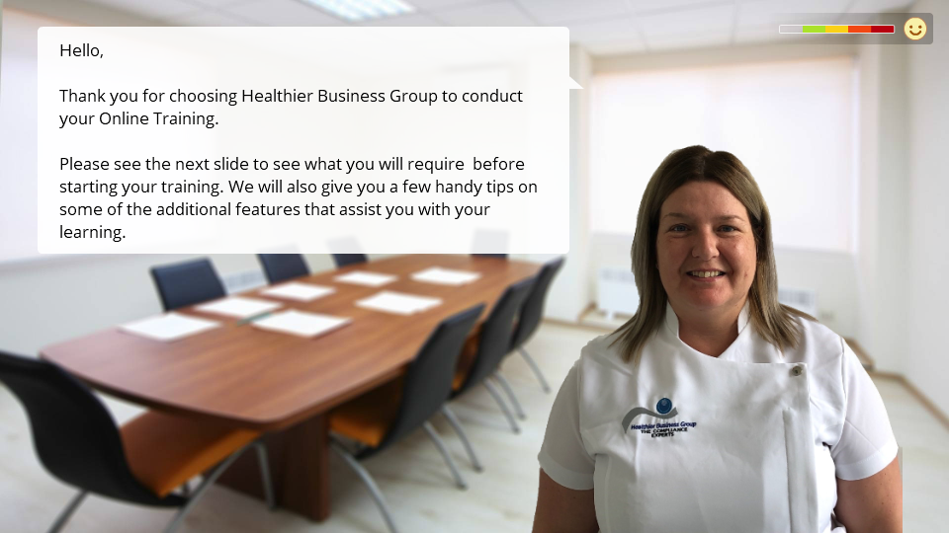

Slide 4



BEFORE BEGINNING
If you are using a mobile device or laptop, please ensure that it is fully charged.
You should also have a pen and notepad ready.
Ensure you are in a quiet area with minimal distractions.
In addition to the above please make yourself familiar with some of the tools available above such as;
Resource Bank
Here you will find useful documents that will be relevant to the course you are undertaking but also you will have access to a CPD reflective learning template which you can download and complete to gain your points.
Highlighter/Pen tool
This feature allows to highlight, circle and write notes on parts of the material wherever you feel necessary.
Presenter Function
Selecting this function will give you instant access to our contact details without having to leave the course should you require support with the system or any assistance from one of our qualified trainers.
Audio Dictation
Please note this feature is auto-enabled. If this isn’t required simply select the mute function or decrease the volume.
Hyperlinks
Should you click on a hyperlink within the course material you will be required to click your back button on your browser or device once you are ready to resume.

Slide 5
LEARNING OBJECTIVES
- How to follow safe swallow recommendations
- It will explain the IDDSI framework to you, and how to use it
- Gain an understanding of dysphagia
- Understand the normal swallow
- Know what happens in a swallow assessment
- Recognise and be able to use the IDDSI framework
- Know how to thicken fluids, and how to recognise food textures
- Know safe feeding principles and strategies

Slide 6

THE NORMAL SWALLOW
Swallowing is something that we do automatically, we do this hundreds of times a day without any thought.
Even though it is automatic, it is a very complex process involving over thirty nerves and muscles.
The swallow can be divided into four phases;
Oral Preparatory Phase
Oral Phase
Pharyngeal Phase

Slide 7
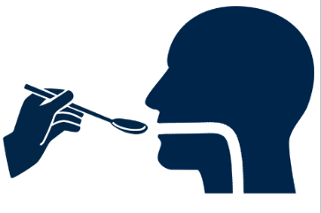
ORAL PREPARATORY PHASE
This process begins before any food or drink enters the mouth
We use our senses of smell, sight and touch
Our salivary glands begin to work
We activate our jaw, lip and tongue muscles
We breathe evenly
We then prepare to open our mouths
ORAL PHASE
Here is where the food and drink enters the mouth:
Food and fluid is prepared into a cohesive mouthful known as “bolus” where it is broken down by saliva. Our lounges are essential for this phase, not only for taste but also to control it.
We then use our tongue to move the bolus around our mouths to ensure that we can chew it.
We bunch the back of our tongue so that they bolus remains in our mouths until we are ready to swallow.
Also we are using our teeth, jaw and cheeks to chew as well as our soft palate to prevent food from entering the nasal cavity.

Slide 8
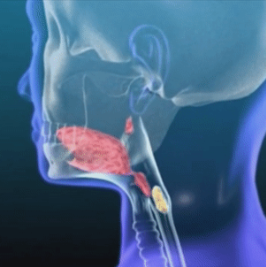
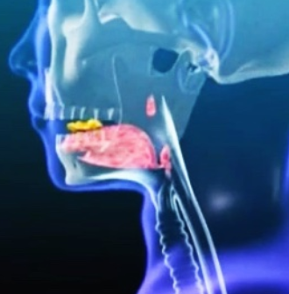
PHARYNGEAL PHASE
Here the food and drink enters the throat:
When the bolus is ready and been broken down sufficiently, we move it to the back of our tongue towards our throat where it triggers a swallow reflex.
The swallow reflex causes a complex of series of muscle and nerve reactions that occur to safely transfer the food or drink down the pharynx into the oesophagus and into the oesophageal phase.
There are two tubes in the throat:
Trachea – Which goes to our lungs
Oesophagus – Which goes to our stomach
At rest, the trachea is open, because we are breathing, and the oesophagus is closed because we are not eating and drinking.
When a swallow is triggered the trachea closes and the oesophagus opens.

Slide 9
HOW DYSPHAGIA CAN OCCUR
Dysphagia can occur at any of these swallowing phases;
Oral Preparatory Phase
EXAMPLE: If our salivary glands don’t activate then our mouths can become very dry making chewing much more difficult and the bolus more difficult to breakdown.
Oral Phase
EXAMPLE: A weak tongue could lead to difficulties chewing or difficulties moving the bolus to the back of the throat to trigger the swallow. A lack of adequate dentition can mean that food isn’t broken down and chewed properly increasing the risk of it getting stuck.
Pharyngeal Phase
EXAMPLE: Any disruption in the sequence of nerve and muscle reaction could lead to dysphagia.
Put simply, if the trachea doesn’t close properly, food or drink can enter the
airway. This is called aspiration and can have major health consequences.
Likewise if the oesophagus doesn’t open properly the food or drink can’t pass out of the throat and therefore can get stuck or enter the airway.

Slide 10


HOW COMMON IS DYSPHAGIA?
Swallowing problems are a common complaint worldwide.
8% of the world's population have a swallowing difficulty. Studies have shown
that dysphagia can occur in many populations and conditions.
While it is difficult to obtain exact numbers it is estimated that:
Dysphagia is seen in 30 to 50% of cases of stroke.
80% of those with Parkinson's disease have dysphagia.
Dysphagia also affects 33% of people who suffer from Multiple Sclerosis.
Dysphagia has been found to affect 30 to 100% of those how have Motor Neuron Disease.
In between 13 and 56% of individual who suffer from Dementia are found to be effected by dysphagia.
Dysphagia also occurs in 33% of individuals with an intellectual disability.

Slide 11
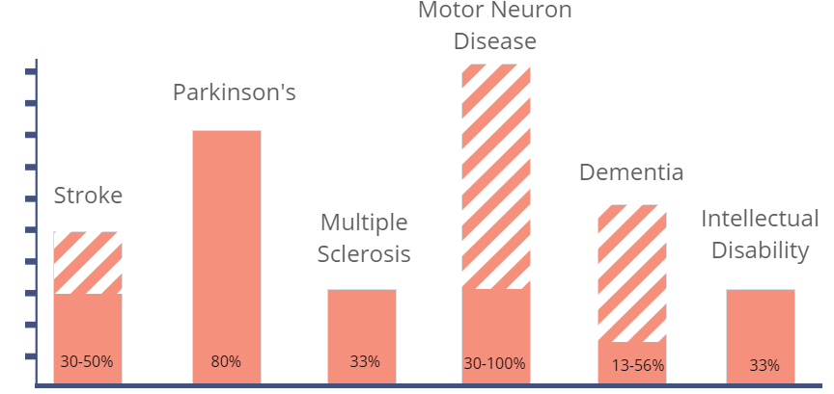
30-50%
80%
33%
30-100%
13-56%
33%

Slide 12


INCIDENTS OF DYSPHAGIA IN PAEDIATRICS
Studies have shown that between 25% and 45% of typically developing children have
a feeding difficulty.
The instance may be higher in some populations:
Cerebral Palsy
Intellectual Disability
Genetic Syndromes
It is important to note that dysphagia is seen as common occurrence during the
aging process.
Up to 15% of people over 65 living independently have signs and symptoms of dysphagia.
The most common factor in most cases are the muscles in the throat weaken with age.

Slide 13
THE CONSEQUENCES OF DYSPHAGIA
Consequences of dysphagia range from mild to severe.
If food or drink were to enter an airway, the natural reaction would be to cough. This is a mild consequence of dysphagia.
Now imagine that the cough is too weak to help push the food or drink out of airway and the food or drink enters the lungs and stays there which will result in a chest infection or Pneumonia particularly if this happens often. This is a serious consequence of dysphagia.
Now imagine that the food that went down the wrong way is a large chunk of food that blocks the airway. This is a dangerous and potentially fatal consequence of dysphagia called chocking.
Coughing
Clears Airway
Coughing too week to clear
Food or drink enters lungs
Chest infection or Pneumonia
Food or drink enters lungs
Choking

Slide 14
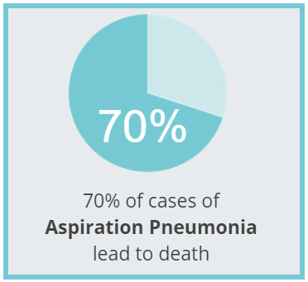
THE CONSEQUENCES OF DYSPHAGIA
There are also many indirect consequences that include:
Weight loss or malnutrition
Dehydration
Depression and anxiety
Social isolation
Many instances where it may appear an individual is suffering from a mild consequence of dysphagia can in fact become fatal.
Research has shown that up to 70% of cases of aspiration Pneumonia lead to death.
Potential Scenario where a mild consequence of dysphagia can in fact become fatal:
Chest Infection
Aspiration
Pneumonia
Hospital Stay
DEATH
Further Infection
IMPORTANT
SEEK MEDICAL ADVICE IF YOU
NOTICE SIGNS OF DYSPHAGIA

Slide 15


SIGNS AND SYMPTOMS
It is vital that you are able to identify the signs and symptoms of an individual suffering from dysphagia in order to know when to seek medical help or refer to speech and language therapy or pathology.
Signs of Dysphagia:
Coughing
Throat clearing
Choking
Eye tearing
Change in face colour (Red face/Lips Blue?)
Difficulty chewing
Spitting out
Pocketing food in mouth
Regurgitation
Complaints of pain
Feeling of food stuck in the throat
Difficulty taking medication
Less obvious signs of Dysphagia:
Shortness of breath
Malnutrition
Dehydration
Weight loss
Recurrent chest infection
Less Obvious Signs of Dysphagia: Shortness of breath Malnutrition Dehydration Weight loss Recurrent chest infection

Slide 16
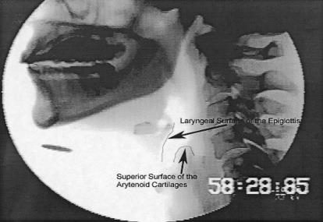
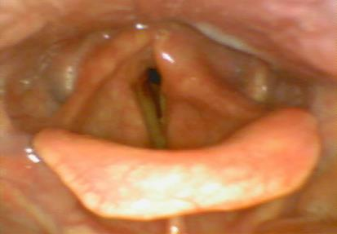
SWALLOW ASSESSMENT
What is a swallow assessment?
A speech and language therapist or pathologist carries out the assessment:
Investigates medical history
Consults with medical team
Conducts physical examination
Further medical examinations may be necessary where the language therapist or pathologist would refer the patient for a videofluoroscopy. A videofluoroscopy is a moving x-ray which can show if any food or drink is entering the airway instead of the stomach | They may also be sent for Flexible Endoscopic Evaluation of Swallowing with Sensory Testing (FEES Exam). A FEES Exam is a fibro endoscopic evaluation. The patient is asked to eat food and drink and then a camera is passed through the nose to identify if anything food debris is found in the airway.

Slide 17


VIDEOFLUOROSCOPY AND FEES EXAMS ARE IMPORTANT
You can’t always tell if an individual is aspirating from a bedside assessment. Not everyone displays obvious symptoms e.g. coughing, throat clearing and eye tearing. This is know as Silent Aspiration (because you cannot see it).
Look out for less obvious signs of dysphagia e.g. recurrent chest infections
These can indicate that the individual needs to be sent for a videofluoroscopy or FEES examination.
SPEECH AND LANGUAGE THERAPIST’S RECOMMENDATIONS
Once a swallow assessment is complete, there are a wide variety of recommendations which might be made. Recommendations will need to be strictly followed.
The first is food and fluid consistency modification.
A person having difficulty chewing may benefit from softer foods.
It may be helpful to thicken liquids to slow down the swallowing process.

Slide 18

Thicker fluids aren't necessarily safer fluids.
Your Speech and Language therapist will tell you exactly how thick your fluids should be using the International Dysphagia Diet Standardisation Initiative (IDDSI) framework.

Slide 19
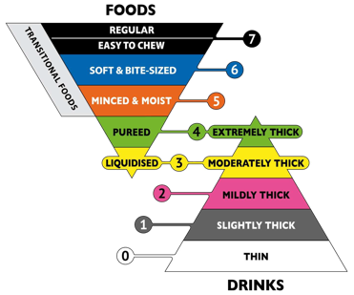
THE IDDSI FRAMEWORK
The International Dysphagia Diet Standardisation Initiative (IDDSI) was a global initiative which created consistent terminology to describe modified food and fluids.
This framework can be used for individuals with dysphagia of all ages, in all care settings and for all cultures.
THE IDDSI FRAMEWORK - There are 8 Levels ( 0 - 7)
Each level represents a consistency of food or drink
The process starts before any food or drink enters the mouth
We use our senses of smell, sight and touch
Our salivary glands begin to work
We activate our jaw, lip and tongue muscles
We breathe evenly
We prepare to open our mouths
Food and fluid is prepared into a cohesive mould called bolus.
The IDDSI Framework and Descriptors are licensed under the Creative Commons license as follows: (c) The International Dysphagia Diet Standardisation Initiative 2016 @www.iddsi.org/framework. Attribution is NOT PERMITTED for derivative works incorporating any alterations to the IDDSI Framework that extend beyond language translation.

Slide 20
LEVELS OF THE FRAMEWORK
The IDDSI framework is identified by text labels, numbers and colour codes.
Click here to visit the IDDSI website: www.iddsi.org
Level 7 represents a normal diet
Level 6 represents a soft & bite sized diet
Level 5 represents a minced & moist diet
Level 4 also represents a pureed diet
Level 4 represents extremely thick fluids
Level 3 also represents liquidised diet
Level 3 represents moderately thick fluids
Level 2 represents mildly thick fluids
Level 1 represents slightly thick fluids
Level 0 represents thin fluids

Slide 21
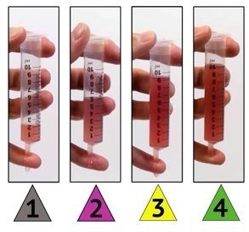
RECOGNISING AND USING THE IDDSI FRAMEWORK - FLUIDS
In this section we are going to get comfortable with recognising and using the IDDSI framework levels for fluids.
Thickness of fluids was developed using a flow test designed by the IDDSI.
The IDDSI flow test is based on using a 10ml syringe and letting it flow freely for 10 sec.
The amount of liquid left in the syringe at the end of 10 seconds tells you what level the fluid is.
This is a clear and assessable way of determining what level of fluid it is. Please see example video demonstration on the next slide.

Slide 22


Slide 23
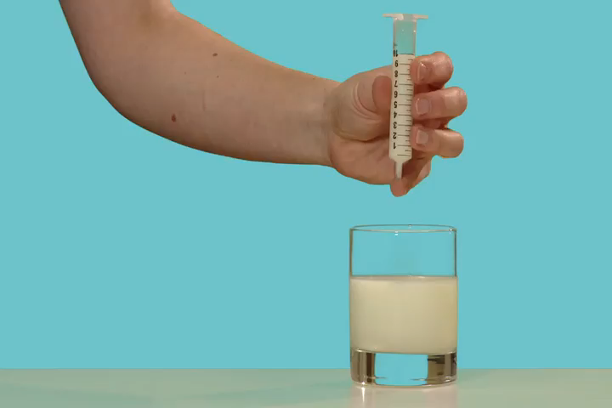
RECOGNISING AND USING THE IDDSI FRAMEWORK - FLUIDS
Step by step instruction on how to do the a flow test;
Use a 10 mL slip tip syringe for the flow test, ideally a BD(tm) syringe (manufacturer code 301604), ensuring the barrel length is 61.5mm from to zero line to the 10 mL line. Please click on video demonstration below.

Slide 24


IDDSI FRAMEWORK - LEVELS
Let's have a closer look at the levels:

Slide 25
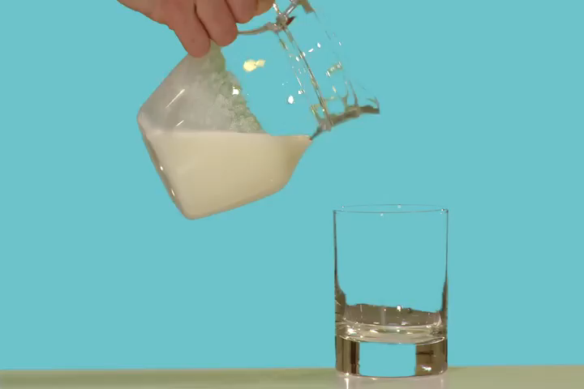


Slide 26
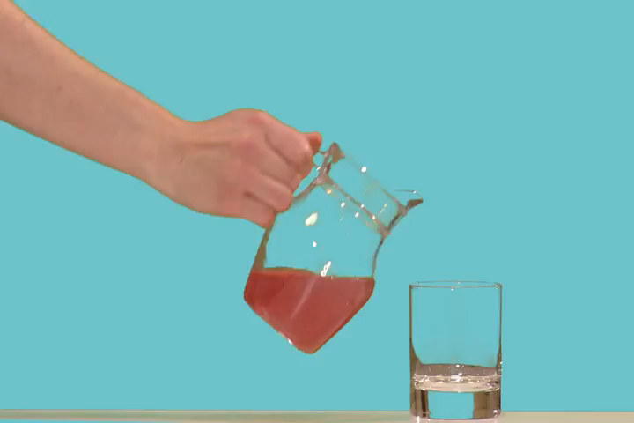


Slide 27
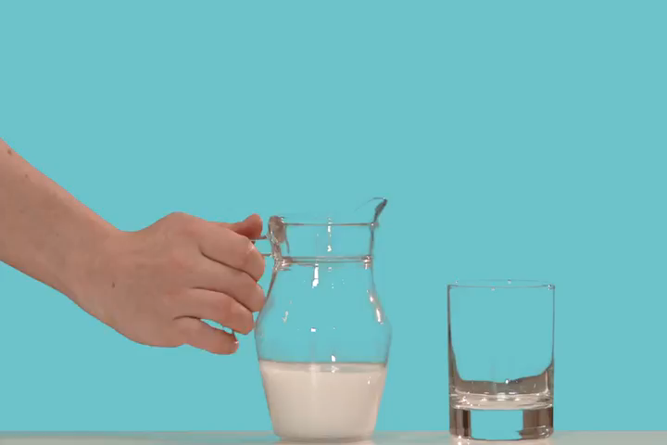
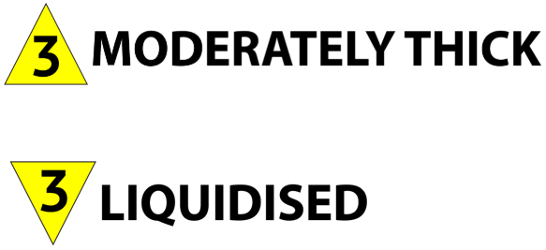

Slide 28

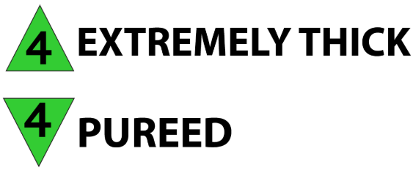

Slide 29
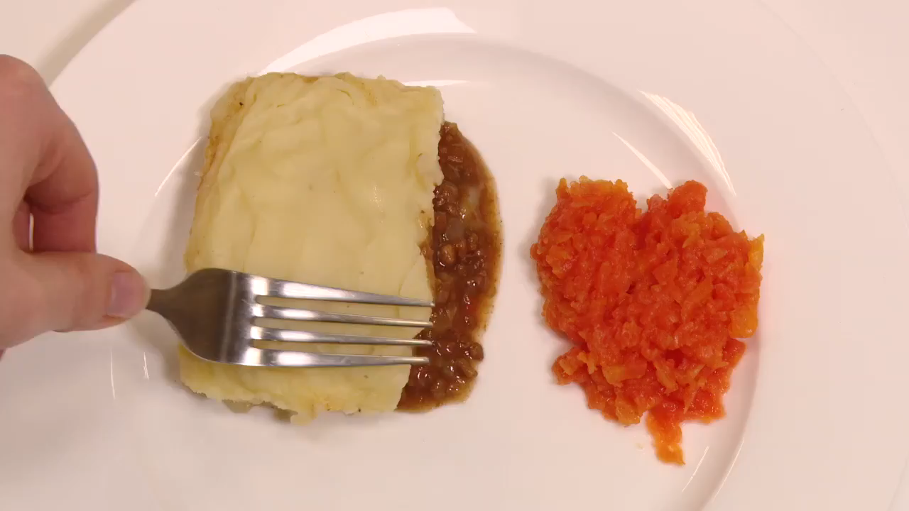


Slide 30
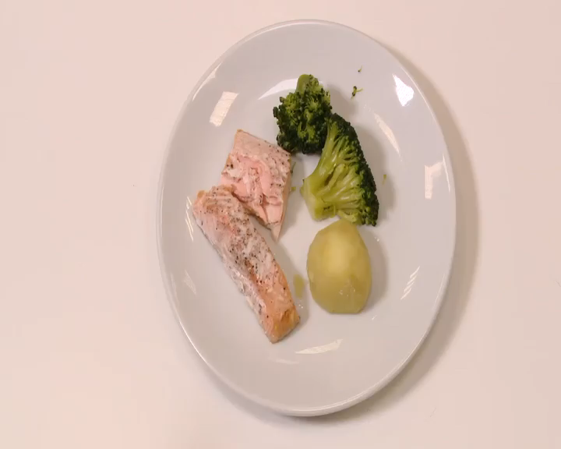


Slide 31

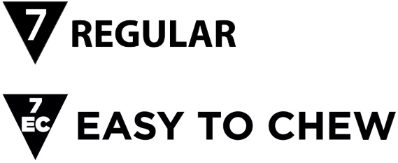

Slide 32

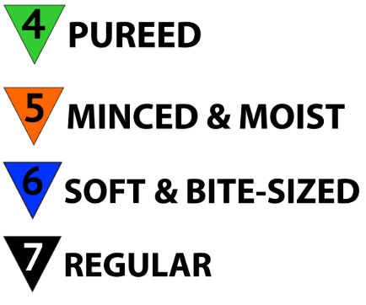

Slide 33
!
If you are not sure what level a food or fluid belongs to, use a testing method such as the flow test or the fork pressure test so that you are sure

Slide 34

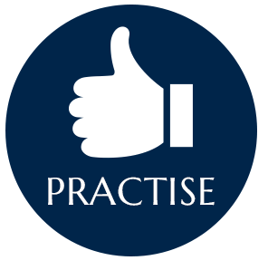
USING THE IDDSI
We have now looked at each individual level, it is now important to:
Be able to tell what level a food or fluid is.
You should feel confident that the food conforms to the Speech and Language Therapist's recommendations.
Ensure thickening products provide exact guidelines
Always read the instructions
Here are some tips to help with the preparation of thickened fluids:
Practice making thickened fluids
Try drinking them yourself
Ensure there are no lumps
Use a shaker, whisk, fork or spoon
Allow the correct time for the thickener to work
Never make a batch to use later in the day
Hot drinks or drinks with a high fat content may require more thickener or standing time than cold clear fluids

Slide 35


If in doubt about a consistency you should use one of the testing methods to guide your judgement.
However on a day to day basis it is also important to make yourself familiar with the natural appearance of the different levels of foods and fluids.
For example if you add thickener to a cup of tea you need to be able to visually recognise what level you have thickened it to as well as using the syringe test.
TRANSITIONAL FOODS
Not all foods can fit neatly into one level. Some foods start on one level but change level when moisture (like saliva) or temperature
(like heat) is added. These are known as Transitional Foods.
Some require very little chewing once they have changed.
EXAMPLE
Wafer, when saliva is added, becomes soft.
These foods are less effortful to eat and are less likely to cause fatigue.
Other Transitional Foods may melt in the mouth or disintegrate with moisture or heat.
Ice cream
Jelly
(Melt to a liquid form if held in the mouth). We must be particularly aware of these for individuals on thickened fluids.

Slide 36
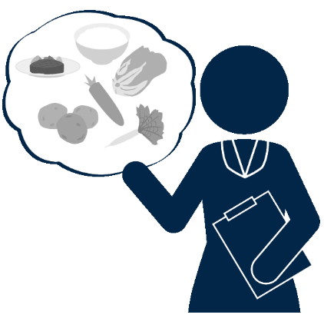
IDENTIFYING LEVELS
Now we are going to practice identifying the different levels.
Here is a handy summary of the testing methods, If you would like to download and print this out to help with this section, please do so now.
CLICK HERE TO DOWNLOAD
If there is any concern about a person’s nutritional intake, weight, or diet requirements, or to create a full balanced menu, please liaise with a dietitian.

Slide 37


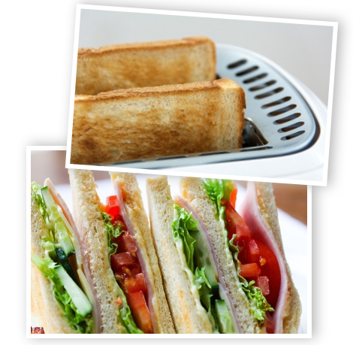


What Level is Bread?
A common question asked is what level would bread appear?
Bread is a level 7 food , bread and sandwiches require the ability to both bite and chew and although it may look and feel soft bread is fibrous meaning that it cannot be easily broken down making it unsuitable as a level 6 food.
Bread sandwiches and toast are all suitable for level 7 Regular
Bread that is soft enough to be cut or broken apart with the side of a folk
can be provided at level 7 easy to chew.

Slide 38
SPEECH AND LANGUAGE THERAPIST’S RECOMMENDATIONS (PART 2)
Now that we are familiar with the IDDSI Framework it is important to remember all of the other elements involved in Dysphagia Care. It is easy to focus heavily on food and fluid modification but there is often more to a Speech and Language Therapist’s or pathologists' recommendations.
Examples of possible recommendations:
Allow 2-3 swallows per mouthful
Encourage a chin tuck when swallowing
Encourage a voluntary cough after each swallow
Alternate mouthfuls of food and drink
Give frequent drinks during meals
Ensure the mouth is empty at the end of the meal
End the meal with fluids
NOTE: Although the Speech and Language Therapist’s or pathologists’ is recommended food and fluids within the IDDSI Framework, it is often on the condition that additional above recommendations are followed simultaneously.
Example: Where a person may be safe for level 5 foods (mined and moist) it would be on the condition that they also had their dentures in and had frequent drinks throughout the meal.
Safe for level 5 foods
(Mined and Moist)
AS LONG AS
Dentures are in and has
Frequent drinks

Slide 39
The additional recommendations are just as important as the levels themselves in Dysphagia Care.
If you need more help or advice on the recommendations you have been given for a person under your care, contact the Speech and Language Therapist or Pathologist who made the recommendations.
Recommendations are made specifically for the individual.
Please see example of swallow care plan template that has been provided which could be completed during Language Therapist or Pathologist assessment.
CLICK HERE TO DOWNLOAD

Slide 40

ENHANCING THE MEALTIME ENVIRONMENT
Mealtimes should be:
Enjoyable
Sociable
Safe
To ensure safety, always check what food and fluid consistencies are recommended for a person as well as other specific recommendations before giving any food or drink. If you are worried or notice any signs of Dysphagia seek help and consult the speech and language therapist or pathologist.
It is important that those caring for a person with Dysphagia have easy access to that persons safe swallow recommendations. There are different systems in use for this that you could consider for your setting, these include:
Bed signs
Colour coding systems
Recommendation sheet folders
Personalised or coloured placemats
Respect privacy and dignity in terms of who can see these recommendations.

Slide 41
To help make mealtimes more enjoyable and sociable for someone with Dysphagia you should involve them in the mealtime process as much as possible. Examples of ways to do this could be:
Use picture menus
Allow the person to select preferred foods
Dedicate the time to mealtime
Reduce other activities at mealtime
Reduce other distractions and background noise
Ensure the person is seated comfortably in an up right position.
Remember – Mealtimes are often an extremely important activity in a person's daily routine
Here is safe list of swallow practices for someone assisting a person with Dysphagia, this would typically be printed off and kept in the dining room.
Please make yourself familiar with this document as this may come up in the questions later.
CLICK HERE TO DOWNLOAD

Slide 42

ADULTS WITH INTELLECTUAL DISABILITY
Individuals with intellectual disability (ID) often present with dysphagia, in particular sensory related dysphagia. This can be very challenging to manage both from a clinical perspective and on a practical day to day level.
Some of the more common traits of sensory related dysphagia can include:
Over filling the mouth
Impulsive or rapid rate eating with minimal chewing before the swallow
A rapid rate of drinking (Often whole glasses of fluids as one continuous drink)
Voluntary regurgitation
Food remaining in mouth or throat after meals
Spitting
Nasal regurgitation
Chocking episodes
Eating non-food items
These traits are particularly more difficult to manage given addition of a disability however it is important to try and manage these. Mealtime strategies although not for everyone may be useful here.

Slide 43

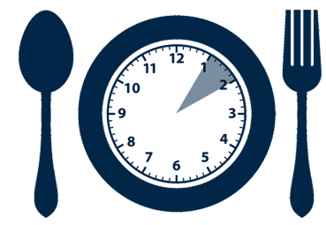




Food and fluid modification is very common in the management of dysphagia in the adult ID client group, but there are alternative strategies which can be useful.
It is VERY important to consult your speech and language therapist or pathologist before implementing any strategies.
Example strategies may be:
Maintain a calm, quiet environment.
A visual timetable of when meals are due.
Reduce or remove distractions at mealtimes.
Use visual prompts to eat slowly and take small mouthfuls.
Fast or impulsive eaters could be given small portions which are replenished throughout the meal.
Hand over hand guidance can encourage slower eating.
Volume control beakers or valved straws (to ensure control) can help towards smaller sip sizes.
Other utensils, plates or place settings can help with specific needs.
- For example – Non-slip mats or plates, weighted cutlery and so on.

Slide 44
OTHER TIPS
Offer a small spoon to reduce the size of mouthfuls
Giving an empty spoon between mouthfuls can trigger a swallow
Give extremes of taste or temperature to increase a person's awareness of the food or drink in the mouth e.g. cold, sweet, warm etc.
A cold spoon can heighten oral awareness of the mouthful.
End the meal with fluids to wash down any remaining food.
After the meal ensure the mouth is completely empty including the cheeks.
Remaining upright for 30 minutes after a meal can help reduce reflux.
Individuals with intellectual disability (ID) often present with dysphagia, in particular sensory related dysphagia.
Additional Information
If a person is at high risk of choking or dysphagia, they will need supervision for all their food and drink.
Specific guidelines on what to do in the event of choking should be readily available.
It is sometimes necessary to limit or restrict free access to food if there is a very high risk of choking.
Restrictions to a person's environment should only be put in place in very extreme circumstances, in consultation with healthcare staff and the family.

Slide 45

INDEPENDENCE, AUTONOMY AND CHOICE MAKING
A lot of these strategies involve controlling or limiting a person's interaction with their food or drink. This must be balanced with opportunities for independence.
When assisting with a meal:
Try waiting for an induction from the person that they are ready for the next mouthful. This allows them to be more involved in their meal and give them a sense of independence during the process.
Try to encourage and promote the person’s own abilities, skills and independence wherever possible.
Picture Menus
Picture menus are an important part of working with adults with ID.
They need to be easy for everyone involved to use including those with different ways of communicating.
Take photographs of real-life menu items over a period and collating them into sections so that you have a picture bank for each individual mealtime.
If the options available are limited, or if too many pictures would be confusing, relevant pictures could be given as a choice.
Choice making for adults with ID may be verbal, point/hand signals , eye gaze or via a communication device/choice board.
It is important that the menu format matches that of the persons communication style and ability.

Slide 46
The impact of dysphagia and the things we do to manage it on the quality of a person's life is an issue that should be at the forefront of the minds of those working with the adult ID client group.
Mealtimes should be a social and pleasurable activity.
Mealtime should not be viewed simply as a task for the caregiver.
Mealtime should be as close to what is considered normal as possible.
Protect the persons safety and respect the persons autonomy.

Slide 47

MEDICATION & DYSPHAGIA
Medication & Swallowing Risks
Medication for some conditions can cause:
Dry mouth
Drowsiness
Muscle fatigue
Irritation of the mouth
Weakness of the muscles in the throat
It may be necessary to consider the timing of medication. E.g. It may be advisable to avoid eating or drinking directly after taking
tablets if they make a person drowsy. Some medications can effect a person's swallow function or safety.
Supplements & Swallowing Risk
Supplements are often available ready-made at the different fluid or food levels. Make sure that you check the supplement is the right level. If you are thickening a supplement to a different level, then refer to manufacturer guidelines if available or you can use the testing methods summary that we provided earlier.

Slide 48
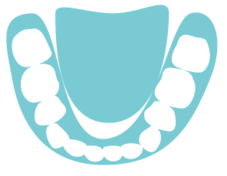
ORAL CARE AND DYSPHAGIA
A clean healthy mouth is not only important generally but also for eating comfortably and safely.
Healthcare staff may need to assist a person with cleaning their mouth to make sure that the whole mouth remains healthy. This prevents bacteria growing in the mouth which can be harmful and lead to further health problems.
An unclean mouth may contain harmful bacteria or may have an altered Ph level.
If aspiration does occur, it is more likely to result in infection or pneumonia because it travelled through an unclean mouth.
Dental health should be maintained to ensure:
Teeth are clean
There are no broken or loose teeth
Dentures are worn if required
A common complaint for people with dysphagia is dry mouth or xerostomia:
As a result of dehydration
As a side effect of some medications
As part of a medical condition
Dry mouth can lead to:
Discomfort
Mouth Ulcers
Difficulty chewing or swallowing
Increased risk of infection

Slide 49
TIPS TO COMBAT DRY MOUTH
Oral Care and Dysphagia.
Take very small regular sips of water - These tiny sips expand the existing salvia rather than larger sips that wash saliva away.
Sugar free lozenges and gum can increase saliva flow – Please ensure that these are suitable for each particular person.
Cutting down or eliminating smoking and alcohol.
Reducing caffeine that is drunk. i.e. Tea/Coffee/Soft Drinks.
Check with GP for alternative medication options that do not include side effects such as dry mouth.
Try to maintain a relatively sugar free diet.
Saliva substitute products are available.
Saliva enhancing products are also available.
Fluoride rinses can prevent decay.
Oral mousse can remineralise damage tooth enamel.
Desensitising fluoride gels and mouthwashes can ease discomfort.

Slide 50
CONCLUSION
Congratulations! You have now finished this course.
Dysphagia Care Provision in the Context of the IDDSI Framework
We have explored:
Dysphagia, and why dysphagia care training is so important.
The mechanisms involved in a normal swallow, and how to recognise dysphagia.
What happens during a swallow assessment.
The IDDSI framework for modified fluids and textured diets.
How to thicken fluids, and how to recognise food textures.
How to carry out safe feeding principles and strategies to enhance the mealtime experience.
We hope that this course has given you the knowledge and skills to provide person-centred dysphagia care, confidently and safely in your care environment.
GOOD LUCK!

Slide 51

TIME TO TAKE YOUR TEST
Please click on the button below to begin.
Good Luck!
TAKE TEST

