Slide 1
Essentials of Pressure Ulcer Prevention

Slide 2
BEFORE BEGINNING
If you are using a mobile device or laptop, please ensure that it is fully charged.
You should also have a pen and notepad ready.
Ensure you are in a quiet area with minimal distractions.
In addition to the above please make yourself familiar with some of the tools available above such as;
Resource Bank
Here you will find useful documents that will be relevant to the course you are undertaking but also you will have access to a CPD reflective learning template which you can download and complete to gain your points.
Highlighter/Pen tool
This feature allows to highlight, circle and write notes on parts of the material wherever you feel necessary.
Presenter Function
Selecting this function will give you instant access to our contact details without having to leave the course should you require support with the system or any assistance from one of our qualified trainers.
Audio Dictation
Please note this feature is auto-enabled. If this isn’t required simply select the mute function or decrease the volume.
Hyperlinks
Should you click on a hyperlink within the course material you will be required to click your back button on your browser or device once you are ready to resume.

Slide 3
INTRODUCTION
This session discusses how to identify and manage some of the risk factors which can cause pressure ulceration.
The session is appropriate for any health and care practitioner who provides care in any setting. If you have a role providing direct care to people then it is important you have the knowledge and skills to prevent pressure ulceration.
By the end of the session you should be able to:
identify risk factors associated with impaired skin integrity including: disease, surface, mobility, incontinence and nutrition
describe reasons why these factors contribute to risk
refer to appropriate members of the interprofessional team when required throughout the patient journey
identify appropriate interventions to reduce and manage risk of pressure ulcer development
implement appropriate prevention and management strategies

Slide 4
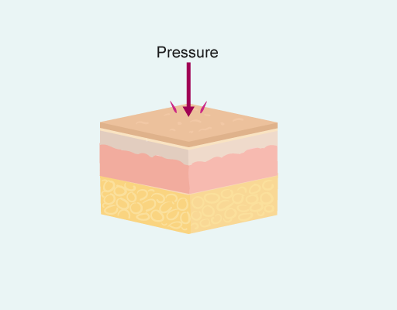
What is a pressure ulcer?
A pressure ulcer is defined as:
“...localised damage to the skin and/or underlying tissue as a result of pressure or pressure in combination with shear. Pressure injuries usually occur over a bony prominence but may also be related to a medical device or other object.” International Guideline, 2019
Pressure ulcers can vary in size and intensity.
How pressure ulcers develop
Pressure is a force acting perpendicularly against the skin and soft tissues, such as muscle (Figure 1)
Figure 1 Pressure is a force acting perpendicularly against the skin and soft tissues

Slide 5
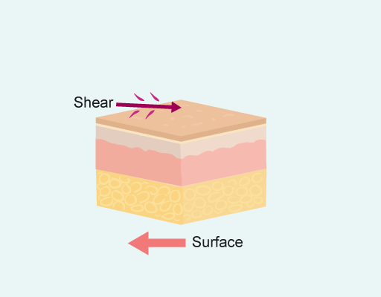
How pressure ulcers develop
Shear is a force that acts parallel to the skin (Figure 2), such as when a patient is sliding down in a bed or chair.
Figure 2 Shear is a force that acts parallel to the skin
Pressure, often with shear, occurs when a patient is sitting or lying against a surface, because of gravity.
When a bony prominence is pushing down through the skin and soft tissue against a surface for a long enough period of time this can lead to tissue damage. This can also happen when a medical device is pressing against the skin with enough force.
This is more likely to happen if a patient is not moving or the medical device is not being moved.
The harder the surface, the higher the pressures.

Slide 6
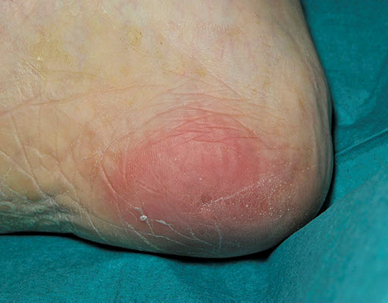
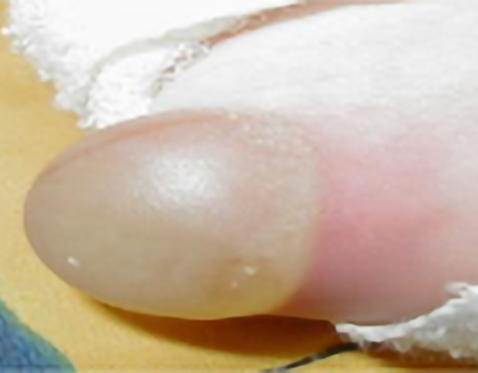
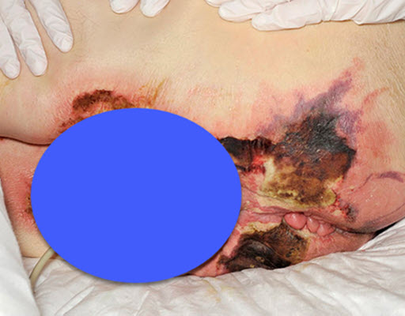
Examples of pressure ulcers
1 of 4: Category 1 pressure ulcer, non-blanching erythema
Figure 4 shows a category 1 pressure ulcer, non-blanching erythema; this
redness would not blanche when pressed.
2 of 4: Category 2 pressure ulcer
An intact, open or ruptured serum-filled blister (Figure 5) is defined as a category 2 pressure ulcer. The top half of the blister is more transparent and the fluid is pooling in the lower portion of the blister.
3 of 4: Category 3 pressure ulcer
Figure 6 shows a category 3 pressure ulcer (previously known as an unstageable
pressure ulcer). The true depth of the damage is not visible due to the presence
of slough and necrosis but it is most likely to be the depth of at least a category 3.
Once the wound has debrided the true extent of the damage will be visible.

Slide 7
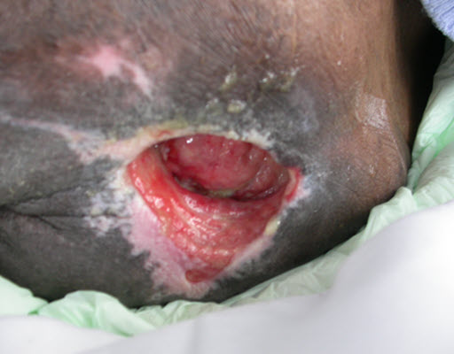
Examples of pressure ulcers (cont.)
4 of 4: Category 4 pressure ulcer
Figure 7 shows a healing category 4 pressure ulcer. There is full-thickness
tissue loss and bone was visible in the lower portion of the wound
(on the left as you look at the image). You can see from the pale pink
areas of newly epithelialised tissue around the wound that this has
been bigger and is starting to heal by both contraction and granulation.
Who do pressure ulcers affect?
Pressure ulcers can affect anyone, young or old, physically or mentally unwell. They are a true birth to death experience.
As well as causing pain and increasing the risk of infection they can have a significant impact on the quality of life.

Slide 8
Quality of life
Pressure ulcers may affect someone's quality of life due to:
pain
the need to stay in bed to relieve pressure – can't go to work, care for family or participate in normal activities
isolation
the smell from the wound, which can result in reduced appetite, be embarrassing and may also put people off visiting
How do we prevent pressure ulcers?
What are the things we can do to prevent pressure area breakdown?
To prevent pressure area breakdown you should:
assess pressure ulcer risk regularly
help people to keep moving
inspect the skin
use an appropriate pressure-relieving aid
help people to keep their skin clean and dry
help people to keep hydrated and to have a nutritious diet

Slide 9
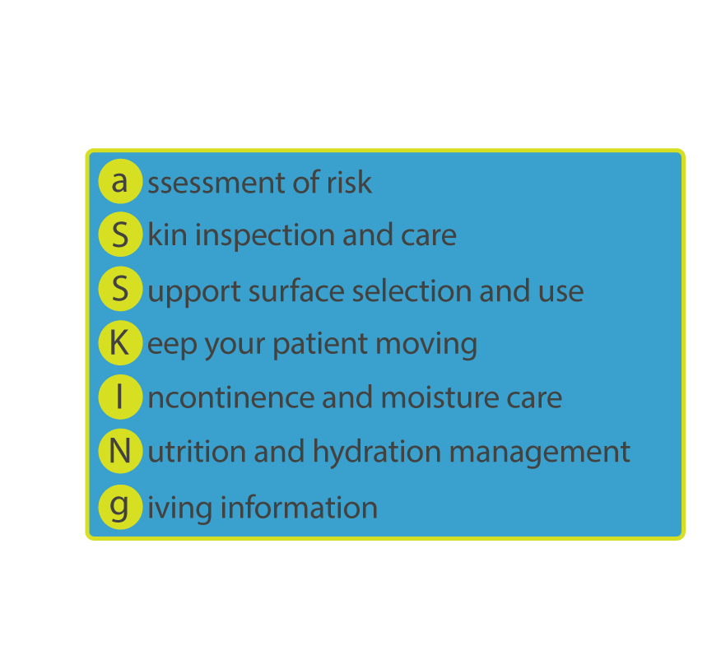
How do we prevent pressure ulcers? (cont.)
Rubbing the skin can cause further damage to the tissues, breaking superficial blood vessels and causing further distortion to the tissues.
Water-filled gloves provide inconsistent pressure reduction and there is no guidance on how much water to put in. There needs to be enough to support the foot but not too much or it increases pressure. It is incredibly difficult to keep the gloves under the heel. The water-filled glove can easily be burst exposing the patient to increased risk of moisture damage.
aSSKINg framework
Pressure areas should be cared for using the aSSKINg framework, which stands for:
a-Assessment of risk
S-Skin inspection and care
S-Support surface selection and use
K-Keep your patient moving
I-Incontinence and moisture care
N-Nutrition and hydration management
g-Giving information

Slide 10
Assessment of risk
Assessing the risk of pressure area breakdown is the cornerstone of preventing pressure ulceration, as this allows the action to be taken based on the risks identified. There are many different risk assessment tools used around the country. In England it is recommended that the PURPOSE T risk assessment tool is used.
Risk assessment
Certain population groups are at an increased risk of developing pressure ulcers:
People in critical care
These people are often immobile due to medications such as sedation and connection to machines such as mechanical ventilation, haemofiltration, heart monitors and infusion pumps.
Blood flow to skin and peripheries can be impaired due to blood loss, trauma, reduced heart function and drugs such as adrenaline.
The presence of medical devices such as urinary catheters, nasogastric tubes, endotracheal tubes, central lines and arterial lines increases the risk.
Neonates
A neonate's head is approximately one-third of their total body mass, this is an abnormal weight with a large bone (the skull) and very small babies have very limited movement.
Neonates, particularly those born prematurely, will sleep a lot which means they are immobile for long periods.
The skin of neonates is very thin and fragile.
The presence of medical devices such as urinary catheters, nasogastric tubes, endotracheal tubes and invasive lines increases the risk for neonates.

Slide 11
Risk assessment (cont.)
People in operating theatres
The majority of people undergoing surgery in an operating theatre will be on medication to sedate and or paralyse and will be mechanically ventilated.
Some surgical operations can take many hours.
Focus is on the surgery and the need to keep the patient in one position, and not on relieving pressure areas.
Blood flow to skin and peripheries can be impaired due to blood loss, reduced heart function and drugs such as adrenaline.
The presence of medical devices such as urinary catheters, endotracheal tubes and invasive lines increases the risk.
People who are immobile and living alone
Immobility is the greatest risk factor for pressure ulcer occurrence. The inability to move results in localised pressure being sustained for long periods. Where the person is alone there is no opportunity for assistance in repositioning.
These people are often reliant on others to support their mobility and skin assessments.
Depending on their package of care or informal carer arrangement, there could be long periods during the day and night when there is sustained pressure as they are unable to move independently.
People who have lost sensation in parts of their body
People who cannot feel over a pressure area will not notice any discomfort or pain that someone with sensation might feel.
This will mean their body does not prompt them to move themselves or seek help to move.
Pressure can subsequently remain over bony prominences and under devices for longer.

Slide 12
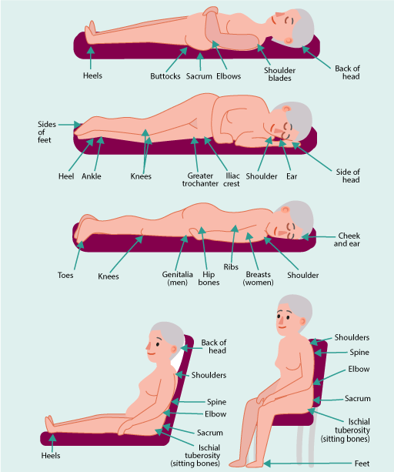
Skin inspection and care
How do we assess the skin?
An assessment of the skin includes more than just what you can see.
Figure 1 shows where the greatest pressure occurs when a person
is in different positions.
Use your senses of sight, touch, hearing and smell when performing a top-to-toe examination of the skin, including between and under skin folds. Ensure you lift and inspect under any devices.
Focus on bony prominences where pressure most commonly occurs.
Ask the person if they have any areas which are sore or which are causing pain.
If the person is immobile ensure you use the correct equipment and number of people to move them in order to assess their skin.

Slide 13
Assessing skin in dark skin tones
One of the most obvious first signs of pressure damage in lighter skin tones is the appearance of a red or discoloured area. In people with dark skin tones, the discoloured area may go undetected, as the early stage of skin damage (category 1) is often harder to see and therefore preventative action is not instigated.
1 of 3: Higher categories of pressure ulcers
Evidence shows that people with dark skin tones are more likely to develop higher categories of pressure ulcers when compared with people presenting with light skin tones.
2 of 3: Where pressure damage most commonly occurs
If someone has a dark skin tone, check the skin where pressure damage most commonly occurs and compare it to the skin in other areas. As skin tone may vary across different anatomical locations on the body, it is important to inspect a similar area of skin for comparison. You may notice the skin is darker when pressure damage is starting to occur.
3 of 3: Skin texture and temperature
Remember to also check the skin texture for hardness (early inflammation) or softness (may indicate tissue death) and temperature. Warmer than surrounding skin may indicate early inflammation, coolness may indicate tissue and/or cell death.
Also ask the patient about any pain or discomfort over any sites under pressure.

Slide 14
Skin care
Skin care is an important part of preventing pressure area breakdown. Where people can, enable them to care for their own skin.
The skin can be protected by:
keeping it clean and dry
using an appropriate skin barrier
keeping the skin moisturised
keeping hydrated
Keep moving
If the person is able, encourage them to move regularly and not to sit or lie in the same position for prolonged periods of time.
1 of 5: Assistance
If people need assistance to move then we can support them to mobilise or reposition regularly. This should be an individual plan of care based on their risk level. In some cases, this is reliant on the availability of care support.
Ensure you use the appropriate moving and handling equipment, such as hoists and slide sheets, to prevent damage to the skin.

Slide 15
Keep moving (cont.)
2 of 5: What a reposition means
Think about what a reposition means. Moving the patient from sitting in a chair to sitting up in bed is not a reposition, although they have moved, the same area of their body is supporting their weigh
3 of 5: Immobile
If someone is immobile, try to plan repositions around the person's routine:
when do they eat? (a good time to sit up or in a chair)
when do they need to go to the toilet?
if they are in bed, think about the direction they face and what they can see or do
4 of 5: Comfortable
Use pillows or other devices to ensure the person is well supported and comfortable or they will move from the position you put them in
5 of 5: Immobile in bed
Evidence has shown the most effective position for preventing pressure ulcers is the 30 degree tilt. This is preferable in most cases to lying at 90 degrees right on the hip
Some people may have too much movement, for example, if they are fidgety, have a tremor, or are confused.
This can also cause skin damage and appropriate precautions need to be taken:
ensure limbs are well supported
consider the use of anti-friction fabrics
inspect skin more frequently to identify skin changes early

Slide 16
Incontinence and increased moisture
Increased moisture increases the risk of skin damage and makes the skin more susceptible to localised infection.
Sources of moisture include:
urinary incontinence
faeces
wound exudate
sweat
dribble (saliva)
stoma output (including tracheostomy)
Long-term exposure of the skin to moisture is harmful and can lead to moisture-associated skin damage (MASD).
The first step is to identify the cause of the moisture.
1 of 4: Incontinence
If the moisture is due to incontinence, the cause of incontinence should be considered and an appropriate plan to manage this incontinence developed. Involve other members of the team to do this where necessary.
2 of 4: Source
Where possible reduce, remove or contain the source of moisture.
3 of 4: Cleanse and protect
Protect the skin. Wash the skin with a non-irritant, pH-balanced soap substitute (skin cleanser). Applying a moisturiser (an emollient) rehydrates the skin. Using a barrier cream or film protects the skin.
4 of 4: Incontinence materials
Make careful use of incontinence materials, such as pads.

Slide 17
Pressure ulceration
What should you do if a pressure ulcer occurs?
You should:
review the preventative care and increase this if necessary
report to the team or person in charge and refer on to another team if necessary
categorise the wound
document the wound on the patient record
Categorising a pressure ulcer
Blanching erythema
This component is an accordion comprised of collapsible content panels containing display text. Select the item titles to toggle the visibility of these content panels.
Healthy skin may develop transient redness with hyperpigmentation (increased pigmentation) when subjected to pressure, for example, if the legs are crossed. To test if damage has occurred, light finger pressure should be applied to see if the skin blanches (goes white). This is not a pressure ulcer, it is an early warning sign that pressure damage might occur if no action is taken.
In darker skin tones redness may not be present, but skin may appear darker in colour to usual colour. In darker skin tones, blanching erythema is rarely visible. The skin over the pressure area may feel harder and warmer to touch than surrounding skin, it may appear shiny and the patient may be experiencing pain or discomfort in that area. It may not be possible to know if this is transient response to pressure or equivalent to non-blanching erythema category 1, or worse.

Slide 18
Category 1 pressure ulcer / non-blanchable erythema
The ulcer appears as a defined area of persistent redness (erythema) in lightly pigmented skin tones, whereas in darker skin tones, the ulcer may appear with persistent red, blue or purple hues, without skin loss. The patient may report pain or discomfort over the area.
Category 2 pressure ulcer
Pressure ulcer with abrasion, blister, partial thickness skin loss involving epidermis and or dermis.
Category 3 pressure ulcer
Pressure ulcer with full thickness skin-loss involving damage or necrosis of subcutaneous tissue. Undermining and tunnelling may occur, fascia, muscle, tendon, ligament, cartilage and or bone are not exposed.
Category 4 pressure ulcer
Full thickness skin and tissue loss with exposed or directly palpable fascia, muscle, tendon, ligament, cartilage and or bone in the ulcer. There is an increased risk of osteomyelitis.
Slough or eschar may be present on some parts of the wound bed and it will often include undermining and tunnelling.
Unstageable: depth unknown
This category is no longer being used in England. These pressure ulcers should initially be recorded as category 3 but immediately re-categorised and re-recorded in the patient's records if debridement reveals category 4.

Slide 19
Vulnerable skin
Any area of skin discolouration with associated changes in skin texture and temperature or patient reports of pain and discomfort that does not fit the above categories should be clearly documented with a full description of the clinical signs, and recorded as vulnerable skin so that the pressure ulcer prevention pathway (Orange pathway in PURPOSE T) is triggered. If this area of discolouration breaks down and can be fully categorised, it should be.
It is important to note that whilst in many situations, the level of tissue injury can be accurately assessed with visual inspection the tissue surrounding the 'visible injury' should also be assessed for changes in sensation (for example, pain), temperature (for example, warmer from inflammation, colder as tissues die), firmness (firmer or boggy with tissue destruction and oedema), colour (signs of inflammation consistent with skin tone) and drainage expressed from surrounding tissues as they are palpated. This more thorough assessment of surrounding tissue may alert the clinician to more extensive damage than is readily visible.
Medical device-related pressure ulcers
Device-related pressure ulcers should be categorised as per any other pressure ulcer where possible. If the pressure ulcer is on a mucosal membrane, it should not be categorised, but recorded as a mucosal pressure ulcer.
Details of the device that caused the wound should also be recorded and if a cause (for example, ties too tight, incorrect securement system, tubing underneath the patient) is known, that should also be documented.
Device-related pressure ulcers can often be observed over challenging anatomical sites, for example, bridge of the nose (continuous positive airway pressure (CPAP)), top of ear (oxygen tubing). Therefore, careful consideration of tissue depth is needed prior to categorisation.

Slide 20
Mucosal pressure ulcers
Mucosal membrane pressure ulcers occur in the moist membranes that line the respiratory, gastrointestinal, and genitourinary tracts. They do not have the same anatomical structures as the skin, therefore it is not possible to categorise them. They are usually caused by devices. Locally record them as an uncategorisable mucosal pressure ulcer and identify the device that caused it.

Slide 21
Session Key Points:
Pressure ulcers are a complex problem that challenge staff and people across all areas of health and care.
Simple preventative actions based on the aSSKINg bundle can help reduce the risk of occurrence.
Working with a multidisciplinary approach supports prevention, recognition and treatment of pressure ulceration.
References
Emily Haesler (ed). Prevention and Treatment of Pressure Ulcers/Injuries: Clinical Practice Guideline. The International Guideline. Pressure Injury Alliance. EPUAP/NPIAP/PPPIA 2019:203-205
Gefen A, Brienza DM et al. Our contemporary understanding of the aetiology of pressure ulcers/pressure injuries. Int Wound J 2022;19(3):692-704.
Nixon J, Nelson EA, Rutherford C at al. Pressure UlceR Programme Of reSEarch (PURPOSE): using mixed methods (systematic reviews, prospective cohort, case study, consensus and psychometrics) to identify patient and organisational risk, develop a risk assessment tool and patient-reported outcome Quality of Life and Health Utility measures. Southampton (UK): NIHR Journals Library 2015.
Pressure Ulcer Recommendations and Clinical pathway. NWCSP 2023.
Oozageer Gunowa N, Hutchinson M, Brooke et al. Pressure injuries in people with darker skin tones: A literature review. J Clin Nurs 2018. Wiley Online Library.
National Institute for Health and Care Excellence (NICE). Clinical guideline 179. Pressure ulcers: prevention and management. London: NICE, 2014.
The British Association for Parenteral and Enteral Nutrition (BAPEN) 'MUST' calculator.
Best Practice Statement: Addressing skin tone bias in wound care: assessing signs and symptoms in people with dark skin tones. Wounds UK, London 2021.
National Wound Care Strategy Programme: Pressure Ulcer Categorisation Tool. NWCSP, 2024.

Slide 22
TIME TO TAKE YOUR TEST
Good Luck!

