Slide 1

Hyponatraemia

Slide 2



BEFORE BEGINNING
If you are using a mobile device or laptop, please ensure that it is fully charged.
You should also have a pen and notepad ready.
Ensure you are in a quiet area with minimal distractions.
In addition to the above please make yourself familiar with some of the tools available above such as;
Resource Bank
Here you will find useful documents that will be relevant to the course you are undertaking but also you will have access to a CPD reflective learning template which you can download and complete to gain your points.
Highlighter/Pen tool
This feature allows to highlight, circle and write notes on parts of the material wherever you feel necessary.
Presenter Function
Selecting this function will give you instant access to our contact details without having to leave the course should you require support with the system or any assistance from one of our qualified trainers.
Audio Dictation
Please note this feature is auto-enabled. If this isn’t required simply select the mute function or decrease the volume.
Hyperlinks
Should you click on a hyperlink within the course material you will be required to click your back button on your browser or device once you are ready to resume.

Slide 3
What is Hyponatraemia?
Hyponatraemia is the most common disorder of fluid and electrolyte imbalance in clinical practice
Hyponatraemia occurs when serum sodium is below 135 mmol/L.
Mild: serum sodium 130–134 mmol/l
Moderate: serum sodium 125–129 mmol/l
Severe: serum sodium <125 mmol/L

Slide 4
Common Symptoms
Mild symptoms include:
Headache
Confusion
Nausea
Fatigue
Moderate - severe symptoms include:
Vomiting
Seizures
Reduced consciousness
Cardiorespiatory distress
Low GCS

Slide 5
Nursing Responsibilities
Monitor fluid balance charts
Record intake and output accurately
Observe neurological changes
Escalate deterioration promptly
Always review previous results and duration of hyponatraemia:
Acute hyponatraemia is defined as <48 hours duration
Chronic hyponatraemia is >48 hours duration
If it cannot be classified, it is assumed to be chronic unless clinical features suggest otherwise
If chronic, it might represent "reset osmostat" which is a common phenomenon in the elderly.
These patients regulate their serum osmolality around a reduced set point but are also able to dilute their urine in response to a water load to keep the serum osmolality around this set point.
Assuming other causes have been excluded e.g. hypothyroidism, hypoadrenalism etc. decide on an acceptable adjusted range for that individual’s sodium target based on past results and symptoms

Slide 6
Escalation
Escalate immediately if patient develops:
Sudden confusion
Reduced consciousness
Seizures
Sodium <130 mmol/L with symptoms
Refer patient

Slide 7
Who to refer
If the cause is likely hypervolaemic hyponatraemia e.g. cirrhosis, heart failure, nephrotic syndrome, consider referral to the relevant specialty
Mild (sodium 130-135mmol/l) asymptomatic hyponatraemia can usually be managed in primary care. Advise:
Repeat sodium to ensure not falling rapidly
Stop/switch any potential causative medications as below
Treat any underling concurrent illnesses that could be contributory e.g. diarrhoea, lower respiratory tract infection, fluid overload
After doing the above, repeat the sodium in 2 weeks and if it remains low despite the above measures, send a routine eRS referral
For the following situations, send a routine ERS referral for further management advice or to establish whether secondary care review is needed
If the person has moderate (sodium 125-129mmol/l) asymptomatic hyponatraemia or the cause of the hyponatraemia is unclear
There is suspicion of adrenal insufficiency as a cause
When the biochemistry suggests SIADH with either moderate hyponatraemia or persistent mild hyponatraemia (>2 weeks)

Slide 8
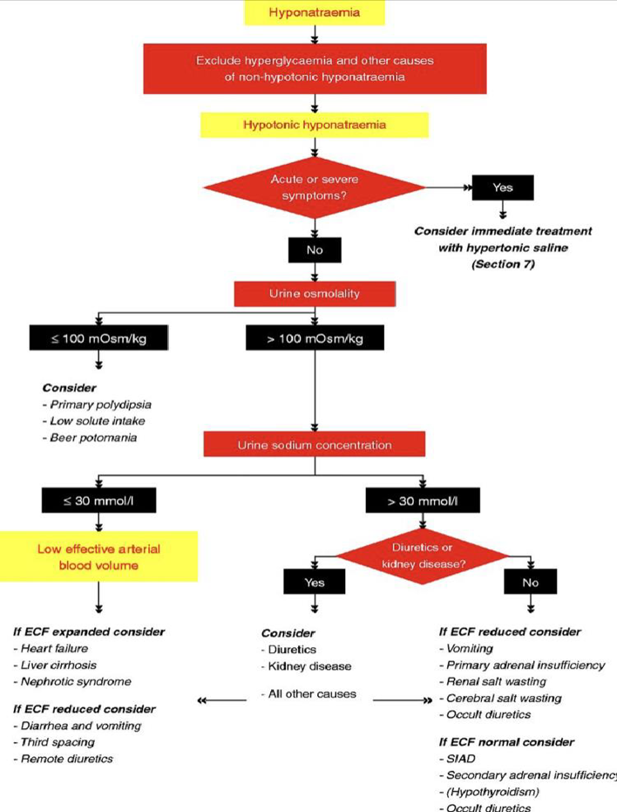

Slide 9
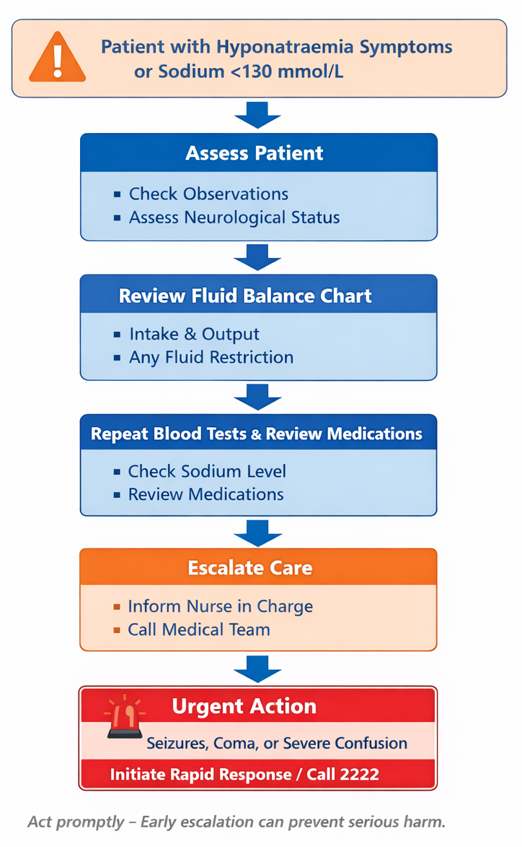
Hyponatraemia Monitoring & Escalation Flowchart
Patient symptoms or abnormal sodium result
↓
Check observations and neurological status
↓
Review fluid balance chart
↓
Repeat bloods / review medication
↓
Escalate to nurse in charge or medical team
↓
Urgent response if seizures or severe neurological symptoms

Slide 10

TIME TO TAKE YOUR TEST
Good Luck!

