Slide 1
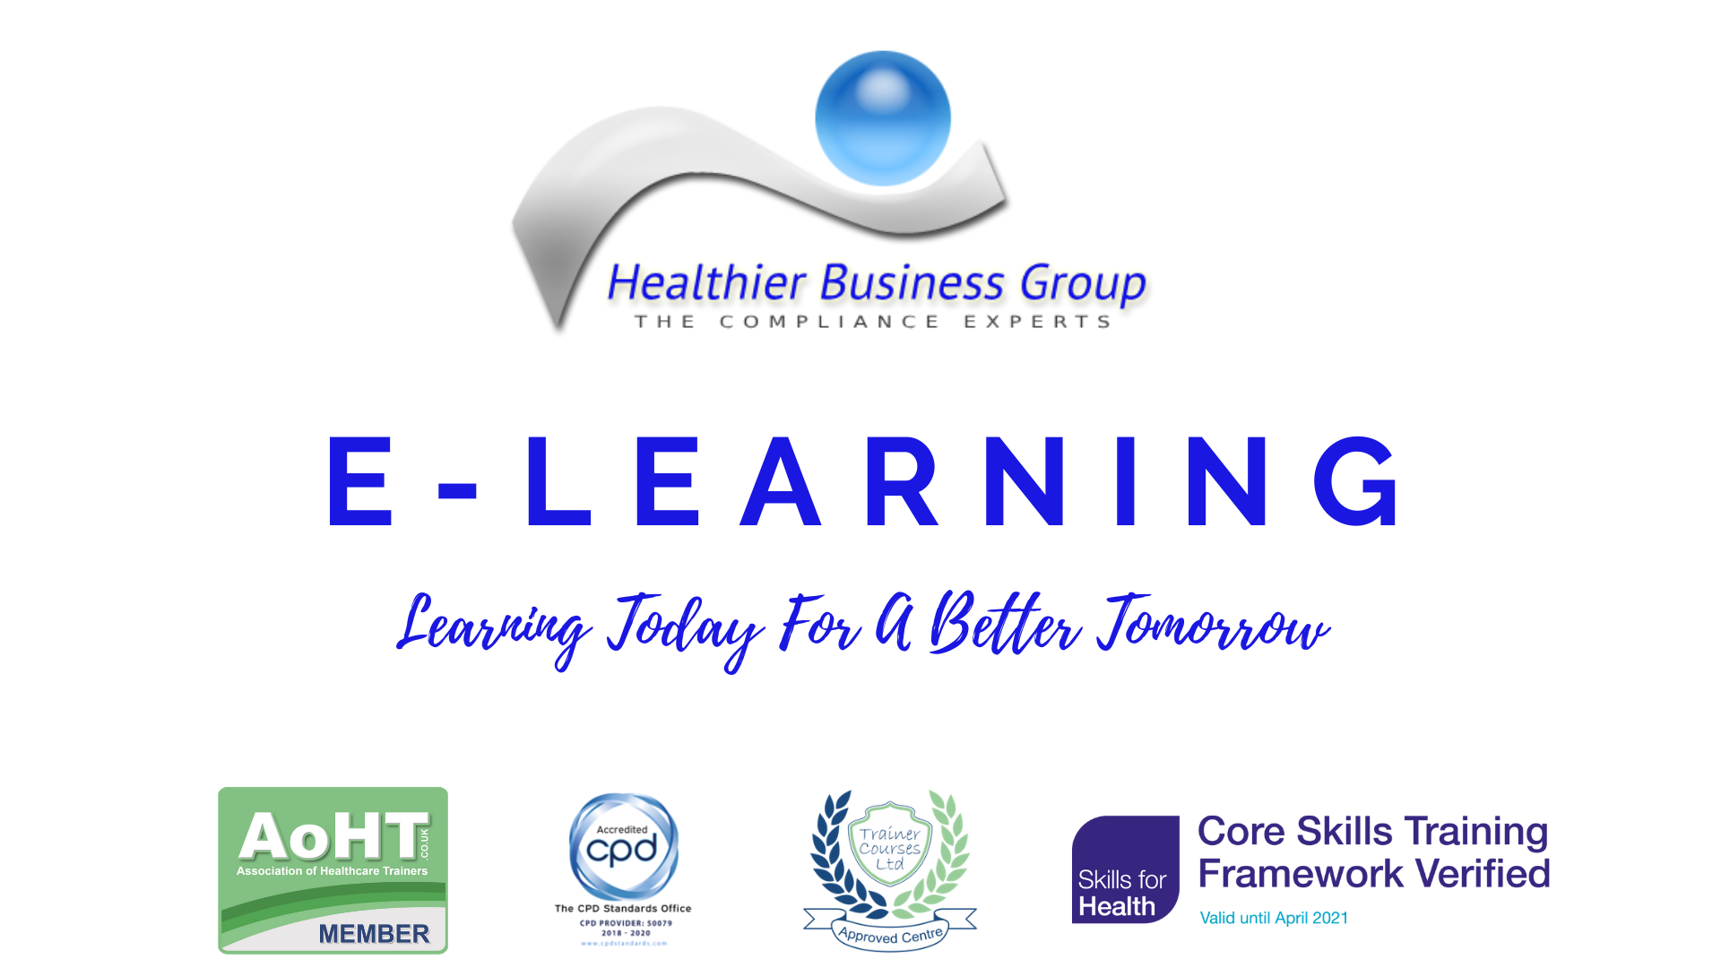

Slide 2
Learning Disability Awareness

Slide 3
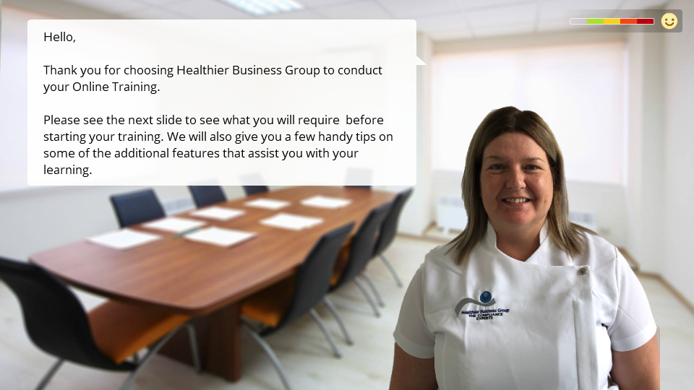

Slide 4



BEFORE BEGINNING
If you are using a mobile device or laptop, please ensure that it is fully charged.
You should also have a pen and notepad ready.
Ensure you are in a quiet area with minimal distractions.
In addition to the above please make yourself familiar with some of the tools available above such as;
Resource Bank
Here you will find useful documents that will be relevant to the course you are undertaking but also you will have access to a CPD reflective learning template which you can download and complete to gain your points.
Highlighter/Pen tool
This feature allows to highlight, circle and write notes on parts of the material wherever you feel necessary.
Presenter Function
Selecting this function will give you instant access to our contact details without having to leave the course should you require support with the system or any assistance from one of our qualified trainers.
Audio Dictation
Please note this feature is auto-enabled. If this isn’t required simply select the mute function or decrease the volume.
Hyperlinks
Should you click on a hyperlink within the course material you will be required to click your back button on your browser or device once you are ready to resume.

Slide 5
INTRODUCTION
The purpose of this e-learning module is to provide learners with an understanding of the issues surrounding learning disabilities. It will discuss the relationship between learning disabilities and autism spectrum disorder (ASD) and attention deficit hyperactivity disorder (ADHD) with the aim of helping learners reflect on and improve how they care for people with learning disabilities.
The Learning Disabilities Awareness course has been designed to provide staff, both clinical and non-clinical, with an introduction to learning disabilities.
By the end of this module, the learner should be able to:
Describe the difference between a learning ‘disability’ and learning ‘difficulties’.
Discuss learning disabilities, autism spectrum disorder (ASD) and attention deficit hyperactivity disorder
Describe difficulties people may face
Describe some of the ways health and social care staff can support people who have learning disabilities
Describe what can go wrong in care
Reflect on attitudes and including people in their own care
Discuss what 'reasonable adjustment' means and how to adjust the way that care is delivered to people with learning disabilities
Explain the benefits of early detection of learning disabilities
Explain the legislation and policies including the concepts of capacity and consent
Discuss reporting structures according to local policies and guidelines

Slide 6
DEFINING LEARNING DISABILITY AND LEARNING DIFFICULTIES - WHAT'S THE DIFFERENCE?
The terms ‘learning disability’ and ‘learning difficulty’ are often used interchangeably, particularly in the education sector.
LEARNING DISABILITY
- ‘where people find it harder to learn certain life skills. The problems experienced vary from person to person but may include aspects such as learning new things, communication, managing money, reading, writing, or personal care. Some people are born with a disability, whereas others may develop one as a result of an accident or illness in childhood.’
(Mental Health Foundation, 2018).
Characteristics
For a person to have a learning disability, three key factors must be present:
• Impaired intelligence (an IQ below 70)
• Impaired social functioning
• These must have started before adulthood (i.e. before the age of 18)
Learning disabilities cannot be cured with intensive or specialised teaching and people will not grow out of a learning disability. Many individuals with learning disabilities still have the ability to communicate their needs and preferences, and they will be able to make informed decisions about many different aspects of their lives but require support for other aspects.
Health and social care providers have a statutory duty to make reasonable adjustments to accommodate the needs of a person with a learning disability.

Slide 7
LEARNING DIFFICULTY
‘significant reduced ability to understand new or complex information, to learn new skills (impaired intelligence), with a reduced ability to cope independently (impaired social functioning), which started before adulthood.’ (Dept. Health, 2001)
Learning difficulties do not have the first two factors of learning disabilities but many people will be diagnosed with a learning difficulty in childhood. Others may go through most of their life not knowing they have a learning difficulty. Learning difficulties can often be overcome with intensive and/or specialised teaching.
There are several different types of learning difficulties, some of which may be familiar to you. Examples of learning difficulties include:
Dyslexia - A term used to describe the difficulty in learning to read or interpret words, letters and other symbols but which does not affect general intelligence.
Dyspraxia - A developmental disorder of the brain in childhood causing difficulty in activities requiring coordination and movement.
Dyscalculia - A severe difficulty in doing mathematical calculations as a result of a brain disorder.
Specific language impairment - A difficulty processing language, for example, understanding complex instructions, grammar or vocabulary.

Slide 8
CAUSES OF LEARNING DISABILITIES
Learning disabilities are caused by abnormalities or something affecting the development of the brain. It is thought that learning disabilities may be caused by some of the following:
Teratogenic factors such as Foetal Alcohol Syndrome or other misuses of substances (for instance heroin or cocaine use during pregnancy)
A congenital (inherited) disorder or syndrome for example Fragile X, Down’s syndrome, Turner syndrome etc.
Medical factors (premature birth, diabetes, meningitis of mother or offspring)
Complications during birth resulting in a lack of oxygen to the brain (Birth Asphyxia)
Very premature birth
Trauma or serious illness in early childhood affecting brain development
Exposure to damaging material (like radiation).
Child abuse, neglect, and/or a lack of mental stimulation early in life.
Infection or injury to the brain or nutritional deficiency before the age of 16
In over 50% of cases, the cause of the learning disability is simply unknown.
There is an increased prevalence of sensory impairments within the learning disabilities population and where it has been demonstrated that visual and hearing impairments are frequently unrecognised and under-reported.

Slide 9
DEFINING LEARNING DISABILITY RELATIONSHIP TO OTHER DISORDERS
Approximately 1.5million people in the UK have a learning disability.
It is estimated that in England in 2011- 1,191,000 people have a learning disability.
905,000 adults aged 18+ (530,000 men and 375,000 women).
It is estimated that there are 286,000 children (180,000 boys, 106,000 girls) age 0-17 in the UK with a learning disability.
Approximately 1% of the population has an autism spectrum condition.
It is possible for people with learning disabilities to also have ADHD and ASD:
Between 20-30% of people with learning disabilities will also have ASD
Between 60-70% of people with an autistic spectrum disorder will also have a learning disability (Source: Foundation for people with learning disabilities

Slide 10
ATTENTION DEFICIT HYPERACTIVITY DISORDER (ADHD)
ADHD stands for attention deficit hyperactivity disorder, a condition with symptoms such as inattentiveness, impulsivity, and hyperactivity. The symptoms differ from person to person. ADHD was formerly called ADD, or attention deficit disorder. Both children and adults can have ADHD, but the symptoms always begin in childhood. ADHD is the most commonly diagnosed mental disorder of children.
Children with ADHD may be hyperactive and unable to control their impulses or they may have trouble paying attention. These behaviours interfere with school and home life. Adults with ADHD may have trouble managing time, being organized, setting goals, and holding down a job.
Inattentiveness
The main signs of inattentiveness are:
Having a short attention span and being easily distracted
Making careless mistakes – for example, in schoolwork
Appearing forgetful or losing things
Being unable to stick to tasks that are tedious or time-consuming
Appearing to be unable to listen to or carry out instructions
Constantly changing activity or task
Having difficulty organising tasks

Slide 11
Hyperactivity and impulsiveness
The main signs of hyperactivity and impulsiveness are:
Being unable to sit still, especially in calm or quiet surroundings
Constantly fidgeting
Being unable to concentrate on tasks
Excessive physical movement
Excessive talking
Being unable to wait their turn
Acting without thinking
Interrupting conversations
Little or no sense of danger
These symptoms can cause significant problems in a child's life, such as underachievement at school, poor social interaction with other children and adults, and problems with discipline.

Slide 12
AUTISM SPECTRUM DISORDERS (ASD)
ASD is a neurodevelopmental disorder which is part of an umbrella group of conditions known as Pervasive Developmental Disorders. The conditions are more common in boys than girls. Boys are three to four times more likely to develop an ASD than girls
ASD can cause a wide range of symptoms, which are grouped into three categories, sometimes referred to as the 'Triad of Impairment':
Social Interaction- including a lack of understanding and awareness of other people's emotions and
feelings (difficulty with social relationships, for example, seem distant and indifferent to
other people, like to be alone);
Social Communication- have difficulties with interpreting both verbal and non-verbal language like
gestures or tone of voice. Many have a very literal understanding of language and think people always mean exactly what they say. They may find it difficult to use or understand:
facial expressions
tone of voice
jokes and sarcasm.
Imagination- (difficulty in the development of interpersonal and imaginary play, for example, have limited imaginative abilities, possibly copied and developed in a rigid and repetitive manner). Unusual patterns of thought and physical behaviour – including making repetitive physical movements, such as hand tapping or twisting. There is currently no cure for ASD. However, a wide range of treatments, including specialist education and behavioural programmes, can help improve symptoms.

Slide 13
ASPERGER’S SYNDROME
Asperger’s syndrome is a type of autism but people with Asperger’s have an IQ above 70 and are often referred to as ‘high functioning’.
Symptoms of Asperger’s syndrome include:
Limited or inappropriate social interactions
Repetitive speech
Difficulty using or interpreting non-verbal communication (e.g. facial expressions) but will have above average verbal skills
Obsession with specific, often unusual, topics
One-sided conversations
Tendency to discuss themselves rather than have conversations with others that involve turn-taking and asking questions about other people’s points of views
Difficulty understanding social or emotional issues and figurative language. It is not possible to have Asperger’s and a learning disability as a learning disability is defined as having an IQ below 70
OVERLAP
It is possible for people with learning disabilities to also have ADHD and ASD:
Between 20-30% of people with learning disabilities will also have ASD
Between 60-70% of people with an autistic spectrum disorder will also have a learning disability (Source: Foundation for people with learning disabilities)
In other words, a small number of people with a learning disability will also have ASD or ADHD.
Many people with ASD or ADHD will also have a learning disability.
This means that they not only have impaired intellectual and social functioning which begins in childhood but will also have the communication difficulties and behavioural difficulties associated with ASD and ADHD. This affects their care needs and the requirements of staff to respond to those needs.

Slide 14
LEARNING DISABILITIES | Impaired intellectual functioning Impaired social functioning Onset before adulthood (i.e. before 18 years of age) Learning disabilities cannot be cured with intensive or specialised teaching and people will not grow out of a learning disability
ATTENTION DEFICIT HYPERACTIVITY DISORDER (ADHD) | Developmental disorder with symptoms including inattentiveness, impulsiveness, short attention span or being easily distracted, restlessness or constant fidgeting. Can occur in anyone irrespective of intellectual ability. It is most frequently diagnosed in childhood often between the ages of 6-12. Symptoms can be managed with medication and behavioural support
AUTISM SPECTRUM DISORDER (ASD) | Autism spectrum disorder is a neurodevelopmental disorder. A neuro-developmental ‘spectrum’ disorder because people with the condition can experience the symptoms more intensely People with ASD will have difficulties with the following: Non-verbal and verbal communication Social understanding and social behaviour Imagining and thinking/behaving flexibly Does not affect the person’s intellectual functioning and is therefore not a learning disability. People with ASD will need support tailored to their specific needs to enable them to lead an active life
ASPERGER’S SYNDROME | A type of autism but people with Asperger’s have an IQ above 70 and are often referred to as ‘high functioning’.

Slide 15
DEFINING LEARNING DISABILITY - CORE DIFFICULTIES
Each person with a learning disability will experience their disability as a unique individual – no two people are alike and they must be treated as individuals with a unique set of needs.
There are, however, a common core set of difficulties people with learning disabilities will experience.
1. Understanding what is said or meant (comprehension)
2. Making themselves understood (expression)
3. Attention – which may be limited
4. Coping with change – this is often a challenge
5. Perception of events, language and the world we live in may differ
DEFINING LEARNING DISABILITY - EARLY DETECTION
The early detection of a learning disability and associated ASD and ADHD or sensory problems (e.g. vision, hearing) can lead to early intervention, which can then reduce the impact of these conditions.
The intervention may include one or more of the following (this also not an exhaustive list):
  Help with communication
  Help with managing the environment
  Help with medication (effective for ADHD)
  Activity planning
  Help with relationships
Failure of early detection and intervention can lead to increased levels of withdrawal, behavioural problems, ill mental health and the person failing to realise their full potential.

Slide 16
COMMUNICATION - DEFINITIONS
One of the key difficulties people with learning disabilities have is with communication.
Communication is defined as;
‘The imparting or exchanging of information by speaking, writing or using some other medium’
(Oxford, 2018)
Another definition reveals the complex nature of communication;
‘The speaker’s problem is to express their communicative intentions and the hearer’s problem is to attribute them correctly’
(Leudar in Beveridge, Conti-Ramsden and Leudar 1989).
This second definition reveals that a person must intentionally communicate a message and that the intention behind it must be correctly interpreted by the person receiving the message. This presents many challenges for people with learning disabilities and for the people who care for them.
Impaired ability to transmit and receive information
For people with learning difficulties, the ability to transmit or receive information and to understand it, is impaired. This does not mean, however, that they cannot communicate, but it does means that staff need to pay particular attention to everything the person with learning disabilities says and does.

Slide 17
CHALLENGES FOR CARERS
People caring for people with learning disabilities, including health and social care staff, will not only have to pay close attention to all behaviour that may communicate a message but they will also need to adjust how they communicate.
There are two types of communication that are important to consider.
Unintentional Communication
The notion of ‘unintentional’ communication comes from early communication development theory. In a learning disability context, it means that someone with quite a severe learning disability and who appears passive might react to an internal or external stimulus. In doing so they send ‘a signal’ which another person might see and/or hear which they interpret and then respond to. However, the person who sent the signal did not do so in order to get the other person to act in some way (hence ‘unintentional’) they were simply responding to the stimulus.
It is a valuable theory because it provides a way of allowing people who are viewed as ‘non-communicators’ to be seen in a more constructive way. It is the consistency with which carers interpret and respond that can shape the signals into something more deliberate, or ‘intentional’.
Intentional Communication
Intentional communication is the ability to use language (spoken, written, or symbolic) and non-verbal means to communicate using non-verbal cues. For example, giving a ‘thumbs up’ or nodding.

Slide 18
There are two important elements of intentional communication:
Expressive Language- the ability to use words to form sentences in order to communicate with other people.
Difficulties occur when people struggle to:
Learn words
Find the right word at the right time
Say words
Put words in the right order to make a sentence
Put sentences together to form a narrative
Difficulties with expressive language can lead to frustration as the person struggles to make themselves understood and expressing their needs and preferences.
People may have no difficulty with expressive language until, for example, they have a stroke or head injury which damages part of their brain although many learning disabilities or difficulties with expressive language will have been present since childhood.
Receptive Language
Receptive language is the ability to understand other peoples' expressive language.
It is not essential to be able to use expressive language to be able to understand it.
In other words, it may be possible for people to understand what is being said even though they may struggle to use expressive language in response.

Slide 19
People may be able to use language quite well and may appear to be able to express themselves well, but this does not necessarily mean their receptive language is as sophisticated.
This will present challenges for carers of people with learning disabilities as it may appear the learning-disabled person has fully understood a conversation when in actual fact, they haven’t.
To try and accommodate the individual you should;
Be able to adapt your methods of communication to meet the needs of the individual with learning disabilities.
Utilise a variety of communication tools since many people with learning disabilities will communicate well using methods they have created for themselves with their family or carers.
Pay particular attention to how they convey information. For example, using long complex sentences which give a lot of instructions all in one go may not be appropriate.
Many people with learning disabilities also communicate well using specialised communication techniques or a combination of different types of communication.

Slide 20
ADAPTING COMMUNICATION
It’s essential for health and social care staff caring for people with learning disabilities to be able to adapt their own communication and use different tools where necessary.
Verbal economy
Using a few words or simpler explanations (verbal economy) can be really helpful.
For example, instead of saying: ‘Could you please hop up onto the bed and take off your shirt so I can examine your tummy.’
You might break this up into step-by-step instructions and you might avoid using language such as ‘hop up on’ which could be taken literally.
For example:
1. ‘Could you take off your shirt please?’
2. ‘Could you get on the bed please?’
3. ‘Could you lie down on the bed please?’
4. ‘I’m going to look at/feel your tummy, is that okay?’

Slide 21
SIGN LANGUAGE AND KEY WORD SIGNING
Sign language (for example Standard British Sign Language) is widely used by people with hearing and speech impairments to communicate.
There are other forms of signing, such as key word signing Makaton™, which is a vocabulary of signs and symbols that are used to support speech.
Some users of Makaton™ stop using the signs as their speech (expressive language) develops but others will continue to use them along with speech.
PICTURE EXCHANGE COMMUNICATION SYSTEMS™ (PECS™)
Picture Exchange Communication System™ (often referred to as PECS™ ) is a system by which people with learning disabilities request things they want using pictures or symbols.
People can learn to use more than one picture to make a sentence.
PECS™ is a form of Augmentative and Alternative Communication (AAC).
There are a number of clinical tools which are aimed at assessing the needs of patients with learning disabilities/autism who are unable to effectively communicate their own needs.

Slide 22
AUGMENTATIVE AND ALTERNATIVE COMMUNICATION (AAC)
There are many different forms of Augmentative and Alternative Communication (AAC) and Picture Exchange Communication Systems™ (PECS™) and Makaton™ are two examples.
As technology has advanced, so have the variety of AAC and many people with learning disabilities will use tablets with software that is designed to replace speech, and use, for example, images to help them express their thoughts, needs, ideas and wants.
MY HOSPITAL PASSPORT OR TRAFFIC LIGHT ASSESSMENT FORM
The hospital passport is designed to capture essential information about the unique needs of vulnerable patients; including how the person communicates, information on assessing pain and supporting the person to consent.
The passport is set out in an accessible manner using a traffic light coded system. The first pages in red cover the things you must know about the person. This is followed by yellow pages addressing issues that are important to the person. And, finally, the green pages cover their likes and dislikes.
This provides a good overview of the whole individual. The passports are filled in by people with learning disabilities and their supporters before or on admission. Passports have been distributed widely to people with learning disabilities by local community learning disability teams, various voluntary organisations, day services, residential services and GPs.

Slide 23
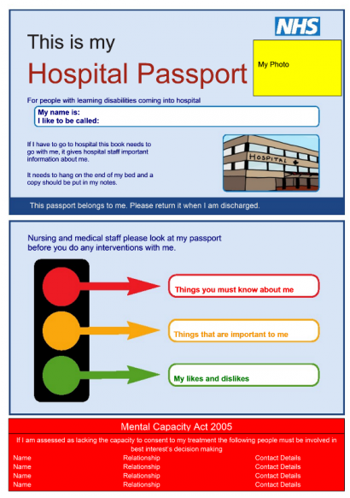
THE HOSPITAL COMMUNICATION RESOURCE TOOL
This comprises a comprehensive resource for those with limited communication or those needing support with communication; it includes drawings, photographs and diagrams. Additionally, some patients may have their own communication tools or aids; which they should be encouraged to bring into hospital:

Slide 24
WORKING WITH PEOPLE WITH LEARNING DISABILITIES - GOOD PRACTICE
How could you adjust your communication so that you are able to communicate better with people with learning disabilities?
Think about your replies to the following statements and whether you would reply yes, no or maybe.
Be more aware of my own non-verbal communication and the messages I may be communicating
Become more familiar with the different methods of communication such as Makaton™ or PECS™ and look for ways to use this
Become more familiar with the different communication needs of the people
Learn how to simplify language without being patronising
Think about the language you use and whether it is appropriate or whether it is unsupportive or potentially derogatory
Use short, simple sentences giving one instruction at a time and allowing for the person to think about and act on what is said
Use methods such as demonstrating and encouraging the person to copy you, for example, ‘Do like I’m doing’
WORKING WITH PEOPLE WITH LEARNING DISABILITIES - POOR PRACTICE
The following behaviour is always inappropriate:
Using a mocking tone of voice, patronising, teasing or making fun of the person
Talking to the person as if they were a child and this includes using parental techniques such as ‘If you’re a good boy and put your coat on, you can have an ice cream at the park’
Talking over the person and addressing questions and conversations to the person’s carers or families rather than them directly
Not making reasonable adjustments to accommodate the person’s needs
Assuming any behaviour which is difficult, or challenging is a deliberate attempt to aggravate staff – when it is in fact an attempt to communicate a need. Health and social care staff will need to pay particular attention to how they convey information. For example, using long complex sentences which give a lot of instructions all in one go may not be appropriate.

Slide 25
WORKING WITH PEOPLE WITH LEARNING DISABILITIES - LEGISLATION
People with learning disabilities have the same rights as all other people and their life has the same value as other people. This means that staff working in the health and social care sector must make sure that they work in a way that is not discriminatory (directly or indirectly) or which does not adversely affect the health or well-being of people with learning disabilities. There are a number of Acts which protect the rights of all individuals, but which also specifically cater for the rights of people with learning disabilities.
Human Rights Act 1998
The Human Rights Act 1998 covers the fundamental rights and freedoms that all individuals in the UK have access to.
For example, the right to:
Education
Marry and have a family
Liberty and security
Freedom of expression
Freedom from slavery or forced labour
Equality Act 2010
The Equality Act 2010 lists nine protected characteristics including race, gender, age, pregnancy, religion and belief, sexual orientation, and disability, and identifies different types of discrimination and how employers and public organisations need to make reasonable adjustments for people with disabilities.
This could include, for example, providing a ramp so that people using wheelchairs or walking aids can get into a building, or providing sign language interpreters for people with a hearing impairment, or providing easy read materials for people with learning disabilities.

Slide 26
Mental Capacity Act 2005
The Mental Capacity Act 2005 contains five principles relating to a person’s mental capacity:
1. A person must be assumed to have capacity unless it is previously established that they lack capacity.
2. A person is not to be treated as unable to make a decision unless all steps to help them to do so have been taken without success.
3. A person is not to be treated as unable to make a decision merely because they making an unwise decision.
4. An act done, or decision made, under this Act for or on behalf of a person who lacks capacity must be done, or made, in their best interests.
5. Before the act is done, or the decision is made, regard must be had to whether the purpose for which it is needed can be as effectively achieved in a way that is less restrictive of the person's rights and freedom of action.
Not having mental capacity can be a temporary event (such as when someone has been knocked unconscious during an accident) or it can happen from time to time (such as when someone has dementia and they may be unable to make decisions every now and then because they are more confused one day than the next) or people can have difficulty understanding information about specific things (like finances) but are able to make decisions about everyday things like what to wear or eat.

Slide 27
Mental Health Act 1983
The Mental Health Act (MHA) 1983 must be used to minimise the undesirable effects of mental disorder by maximising the safety and the mental and physical well-being of people with a learning disability, protecting their recovery and protecting other people from harm.
Application for detention can be made either under section 2 (up to four weeks) or section 3 (up to six months although renewable) of the MHA for assessment and treatment of a mental disorder.
Learning disabilities and autism spectrum disorders are forms of mental disorder as defined in the Act. However, someone with a learning disability and no other form of mental disorder may not be detained under the Act unless their learning disability is accompanied by abnormally aggressive or seriously irresponsible conduct on their part. It is possible for someone with autism spectrum disorder without any other form of mental disorder to be detained even if not associated with abnormally aggressive or seriously irresponsible behaviour.
The guiding principles are:
Purpose – to treat a mental disorder
Least restrictive – attempt to keep to a minimum the restrictions imposed on the person’s liberty
Participation – provide opportunities for the person to be involved in planning, developing and reviewing their own treatment
Effectiveness, efficiency and equity – decisions taken under the Act must seek to use available resources in the most effective, efficient and equitable way to meet the needs of the person detained

Slide 28
Care Act 2014
The Care Act 2014 (England) and Social Services and Wellbeing (Wales) Act 2014, Social Care (Self-directed Support) (Scotland) Act 2013 set out how people’s care and support needs should be met and introduces the right to an assessment for anyone.
The Act’s ‘well-being principle’ explains how a local authority’s duty to ensure that people’s well-being is at the centre of all that it does. The Care Act aims to help people have more control over their own lives.
NHS and Community Care Act 1990
The first major reform of the NHS since it began in 1948.
Based on the 2 white papers 'Working for Patients' (1989) and 'Caring for People' (1991), this was the first legislation to try to bridge the gap between health boards and local council social services.
Under the Act, social care departments were given the responsibility for community care for older people. These services would be geared to what the older person needed rather than what was actually available. These needs were learnt following a community care assessment.
Home care, day care and respite care were to be developed to help people live in their own homes wherever possible.
This legislation was the first time that the needs of carers were considered.

Slide 29
LEGISLATION IN SCOTLAND:
Clear legislative frameworks are in place in Scotland that individually and collectively seek to support people to protect their rights and have control over their lives and enable access to assessment, treatment and supports required. All Scottish legislation applies equally to people with learning disabilities and there are specific Acts of relevance due to the nature of their disability and need for special consideration.
Adults with Incapacity (Scotland) Act 2000
Scottish legislation that provides a legal framework to safeguard the welfare and manage the finances of adults, aged 16 and over, who lack capacity due to mental illness, learning disability or a related condition, or due to an inability to communicate. The main care groups covered by the Act include people with dementia, people with a learning disability, people with an acquired brain injury, people with severe and long-term mental illness, and people with a severe sensory impairment. Part 5 of the Act is important in relation to medical treatment, and allows treatment to be given that safeguards or
promotes the physical or mental health of an adult who is unable to consent.
Mental Health (Care and Treatment) (Scotland) Act 2003
Legislation that applies to people who have a mental illness, learning disability or related condition. Usually when patients are unwell they consent to their assessment and treatment, however in some cases when someone is mentally unwell and unwilling or unable to consent, it is necessary to intervene.
Adult Support and Protection (Scotland) Act 2007
Legislation that enables the protection of adults who may be at risk of harm. The Act requires councils and a range of public bodies to work together to support and protect adults who are unable to safeguard themselves, their property and their rights. Central to the legislation is that any intervention in the affairs of an individual must provide benefit and be the least restrictive option as the means to meet the purpose of the intervention.

Slide 30
The Equality Act 2010 and the Public Sector Equality Duty
A UK-wide legislation that provides the legal framework to protect the rights of individuals and advance equality of opportunity for all, including those with disabilities. Under the legislation, people are protected from discrimination based on their protected characteristics in employment, education, access to goods and services and membership of clubs and associations. The characteristics specified in the Act are, age, race, religion or belief, disability, sex, sexual orientation, gender reassignment, pregnancy and maternity and marriage and civil partnerships. There is a specific requirement for public bodies to make 'reasonable adjustments' for people with a disability. The Public Sector Equality Duty in the Equality Act 2010 came into force in April 2011 and places an obligation on public authorities, including health
services, to act to eliminate unlawful discrimination, harassment and victimisation, advance equality of opportunity between different groups and foster good relations between different groups.
The Social Care (Self-Directed Support) Scotland (Act 2013)
Legislation that provides the right for the people of Scotland to receive direct payment in lieu of services thereby affording greater control over the decisions about the types of services and supports they receive. The self-directed support act places a statutory duty upon social work services to fund direct payment options and make them available to people in receipt of care and support services.

Slide 31
The Public Bodies (Joint Working) (Scotland) Act 2014
Legislation that provides the framework for integrating adult health and social care. Bringing together adult health and social care services aims to provide a consistent level of quality and sustainable care services for the aging and increasing Scottish population, many of whom will require care and support from both health and social care services due to their multiple, complex, long-term conditions. A major policy initiative, the integration of adult health and social care services brings together budgets for care services to create a single commissioning budget. This enables the partner health and social care
organisations to commission services that will improve.
Patient Rights (Scotland) Act 2011
Supports the Scottish Government's plans for a high-quality NHS that respects the rights of patients as well as their carers and those who deliver NHS services.
Included in the Act was the establishment of a Patient Advice and Support Service (PASS). This service provides free, accessible and confidential information, advice and support to patients, their carers and families about NHS healthcare.

Slide 32
PATIENT CENTRED CARE
Person-centred care is about:
Focusing on you and your individual needs and views
Promoting your independence and autonomy
Providing you with more choice and making you central to the decision-making process
Giving you more control
A collaborative team approach
Good communication
Building a strong relationship with you and your family members
Providing support with compassion, dignity and respect
People with learning disabilities have the same rights as all people and need to be treated with respect and compassion.
Staff caring for someone with learning disabilities need to behave in a way that:
Values the person and sees them as an individual
Tries to see things from their perspective – even if it doesn’t make sense to them or they think it’s a bad decision, for example
Sees the person with learning disabilities as part of a wider social group with relationships that are important to them and as being capable of having relationships with others
Makes reasonable adjustments to accommodate the person’s needs

Slide 33
REASONABLE ADJUSTMENTS
Employers must make reasonable adjustments to make sure workers with disabilities, or physical or mental health conditions, aren’t substantially disadvantaged when doing their jobs. This also applies to all workers, including trainees, apprentices, contract workers and business partners as it is to ensure that people with learning disabilities can receive the level of care they need. Reasonable adjustments are required wherever the learning-disabled person would otherwise be at a substantial disadvantage compared with non-disabled people.
Examples of reasonable adjustments include:
Changing the recruitment process so a candidate can be considered for a job
Doing things another way, such as allowing someone with social anxiety disorder to have their own desk instead of hot-desking
Making physical changes to the workplace, like installing a ramp for a wheelchair user or an audio-visual fire alarm for a deaf person
Letting a disabled person work somewhere else, such as on the ground floor for a wheelchair user
Providing information in different formats such as easy read documents, DVDs, CDs, or using images
Providing double appointments so that the person with learning disabilities has longer with the healthcare provider to talk through things where necessary
Allowing employees who become disabled to make a phased return to work, including flexible hours or part-time working
Offering employees training opportunities, recreation and refreshment facilities

Slide 34
WHEN THINGS GO WRONG - DYSPHAGIA
It is generally accepted that people with learning disabilities are more likely to have dysphagia than other people. As far back as 2004, the National Patient Safety Agency (NPSA) identified it as a significant health risk for people with learning disabilities. Dysphagia can result in choking and may lead to death. A multi-agency review in Hampshire was commissioned following 5 cases of choking resulting in death. This review noted the difficulty in obtaining national figures for premature deaths of people with learning disabilities caused by choking and concluded that there is a lack of understanding of the issue. Research analysing both locally and nationally reported choking incidents concluded that many choking incidents in people with learning disabilities are being missed, leading to an underestimate of choking episodes (Gov, 2018).
What is dysphagia?
Dysphagia means difficulty swallowing. Some people find it difficult to swallow specific kinds of food or drink.
What are the characteristics?
Dysphagia is characterised by many signs and symptoms including:
Coughing or choking when eating or drinking
Bringing food back up, sometimes through the nose
A sensation that food is stuck in your throat or chest
Persistent drooling
Why is dysphagia a problem?
Dysphagia is associated with a variety of illnesses (for example, stroke, head injuries and dementia) but it can be a significant problem for people with learning disabilities because they are often reliant on other people to feed them and help them to drink.

Slide 35
Problems associated with dysphagia
Choking
Aspiration – where food or drink goes into the person’s lungs which can cause infections such as pneumonia
Malnutrition and dehydration because the person fears choking
Can cause death
Treating dysphagia
Dysphagia can be treated by:
Helping the person with swallowing which may involve a number of practitioners working collaboratively, for example a speech and language therapist, occupational therapist, dietician and physiotherapist
Changing the consistency of food and liquids to make them easier and safer to swallow – this would need to be done in consultation with a clinical team including the person’s GP and a dietician
Using alternative types of feeding methods such as a PEG feeding tube (feeding tube directly into the stomach) – this would be done in consultation with a wider clinical team

Slide 36
Dysphagia - Your Role
Assisting someone with feeding or being present when someone is being helped with their meal may not be part of everyone’s role, but it is important that all staff are aware of the signs and symptoms of dysphagia.
Things to be aware of that may suggest an individual has symptoms of dysphagia;
Whether someone is struggling to eat or is coughing when eating or drinking
The individual is showing a reluctance to eat or drink or may find eating or drinking difficult
Someone who gets frequent chest infections may be having difficulty swallowing and should be assessed
Fluctuating weight weigh fluctuates, and/or they show signs of being dehydrated
Get help if you suspect someone has dysphagia
Being aware of dysphagia and the complications it causes requires all staff in all types of health and social care settings to be vigilant. It’s also important that you are aware of the different treatment options available and find out what help there is in your local area for people with learning disabilities who experience dysphagia.

Slide 37
RAISING CONCERNS - YOUR RESPONSIBILTIES
There have been a number of high profile cases in the media in recent years which have brought to light the terrible abuse suffered by people with learning disabilities.
These cases are not that common and were extreme examples but people with learning disabilities are more likely to experience very subtle forms of abuse and/or discrimination.
This can include:
Talking to the person as if they were a child (infantilising) or using a parental tone or manner
Not supporting the person to make their own decision
Disagreeing with the person’s choice and staff imposing their own values or beliefs
Not seeking the person’s consent
Assuming the person does not have the capacity to make a decision because they have a learning disability
It is really important that health and social care staff feel comfortable with raising and reporting any concerns they have about how a person with learning disabilities is being cared for or treated.
It is not acceptable to ignore your concerns and it is not acceptable to assume that someone else will report the concerns.
It is also not acceptable for staff to feel threatened or intimidated if they do raise concerns.

Slide 38
RAISING CONCERNS - YOUR ORGANISATION AND LOCAL AREA
How much do you know about raising concerns in your organisation and your local area?
It is your responsibility to;
Know who to report to if you have any concerns within your organisation
Know what the processes for reporting concerns are within your organisation
Understand what you should do if you meet barriers to reporting concerns within your team or organisation
Know where in your local area you can get advice if you have concerns about how a person with learning disabilities is being treated
Know the contact information for your local safeguarding adults board
Know that you have a duty of care to the people with learning disabilities and should report any concerns as soon as possible
If you are not sure about any of the policies and procedures for reporting your concerns in your organisation or your local area, speak to your line manager or seek advice from the local authority adult’s social care or look at the processes and procedures provided by your local safeguarding adults board.
Should you feel that your concerns are not being taken seriously, you should be able to challenge and escalate them to the appropriate person or organisation.

Slide 39

TIME TO TAKE YOUR TEST
Please click on the button below to begin.
Good Luck!
TAKE TEST

