Slide 1



Slide 2

Ligature Training
Start Course

Slide 3



BEFORE BEGINNING
If you use a mobile device or laptop, please ensure it is fully charged and turned landscape.
It would be best to have a pen and notepad ready.
Ensure you are in a quiet area with minimal distractions.
In addition to the above, please make yourself familiar with some of the tools available above, such as;
Resource Bank
Here, you will find helpful documents relevant to the course you are undertaking, but you will also have access to a CPD reflective learning template that you can download and complete to gain points.
Highlighter/Pen tool
This feature allows you to highlight, circle and write notes on parts of the material wherever necessary.
Presenter Function
Selecting this function will give you instant access to our contact details without having to leave the course should you require support with the system or any assistance from one of our qualified trainers.
Audio Dictation
Please note that this feature can be turned on and off using the volume button.
Hyperlinks
If you click on a hyperlink within the course material, you must click your back button on your browser or device once you are ready to resume.

Slide 4




Hello
This online course aims to equip learners with the theory knowledge to comprehend Ligature Training. Upon the successful completion of this module, learners will be familiar with:
Define Ligature
Review Examples Of Ligature Risks In Different Settings
Review Key Components Of Risk Assessment
Learn Tools And Techniques For Identifying Ligature Risks
Explain Designing Safer Environments
Implementing Immediate Responses To Ligature Risks
Understand Compliance With Regulations
Understand Ethical Responsibilities In Ligature Prevention

Slide 5
Module 1:
Understanding Ligature Risks

Slide 6
Introduction To Ligature Training
In the realm of self-harm, ligature use involves the deliberate application of pressure to the body using materials like belts, ropes, or cords, often to cope with emotional distress or regain a sense of control. This behaviour manifests through tying or binding ligatures around specific body parts, exerting pressure and constricting blood flow. Despite offering temporary relief or distraction, ligature self-harm carries significant risks, including unintentional injuries, infections, and life-threatening consequences like asphyxiation or vascular compromise.
The motivations behind ligature self-harm are complex, driven by a desire to manage overwhelming emotions or assert control over one's body. However, this coping mechanism perpetuates a dangerous cycle of dependence and escalation, increasing the risk of severe harm over time. Addressing ligature self-harm requires a multifaceted approach that combines immediate interventions to mitigate risks with long-term strategies aimed at addressing underlying psychological factors and promoting healthier coping mechanisms.

Slide 7

Statistics
WHO globally estimated 800,000 people die by suicide every year, and for each suicide, there are many more self-harm incidents
In the UK, self-harm and suicide are serious concerns. According to the Office for National Statistics (ONS), in 2020, there were 5,224 suicides registered, with rates higher in males than females.
Self-harm hospital presentations have also increased over the years, with a higher prevalence among young people. These issues highlight the importance of mental health awareness and support services in the UK.
800,000

Slide 8



Review Examples of Ligature Risks in Different Settings
Understanding ligature risks across various healthcare settings is crucial for ensuring patient safety. Here are examples of these risks:
Inpatient Psychiatric Units: Patients in psychiatric units may use everyday items like bed sheets or personal belongings as ligatures. Ligature points such as door hinges or bed frames pose risks, especially during distress or agitation. Shared spaces increase the likelihood of unsupervised ligature use.
General Hospital Wards: Even in general wards, equipment like oxygen tubing or IV lines can become ligatures if not adequately secured. Loose fixtures or furniture with protruding edges in patient rooms also pose risks.
Emergency Departments: In emergency departments, patients in acute psychiatric crises require close monitoring for ligature risks. Common hazards include stretcher rails, medical equipment, and fixtures in examination rooms.
Outpatient Clinics and Behavioural Health Centres: Outpatient settings carry ligature risks, albeit to a lesser extent. Furniture with ligature points should be carefully selected or modified. Clinicians should also be attentive to items brought in by patients that could be repurposed as ligatures.
Home Environments: Caregivers must consider ligature risks in patients' homes, particularly for those with a history of self-harm. Everyday household items like electrical cords or belts can present dangers if accessible. Thorough safety assessments and preventive measures are crucial.
Enhanced awareness and proactive mitigation of ligature risks contribute to patient-centred care, ensuring the safety of individuals across care settings.

Slide 9
Module 2:
Assessing Ligature Risks

Slide 10
Learn Tools And Techniques For Identifying Ligature Risks
Effectively identifying and mitigating ligature risks is crucial in healthcare. Here's how to do it:
Checklists
Utilise ligature risk assessment checklists tailored to specific settings
Collaboration
Encourage open communication among healthcare team members to address ligature risks comprehensively
Audits and Reviews
Implement regular audits to assess compliance and identify areas for improvement
2
4
6
1
3
5
7
Environmental Assessments
Conduct thorough assessments of healthcare facilities, looking for potential ligature points
Training and Education
Provide comprehensive training to recognise ligature risks and prompt reporting of concerns
Patient-Specific Assessments
Conduct individualised assessments considering patients' psychiatric history and current mental health status
Utilisation of Technology
Leverage technology, such as electronic medical records, to enhance monitoring and communication

Slide 11
Explain Designing Safer Environments
Creating safer healthcare environments is paramount for patient safety. Beyond fulfilling a fundamental responsibility, it directly impacts patient outcomes and experiences. Safe environments foster trust, encouraging active patient engagement and better treatment outcomes. Additionally, they prevent avoidable harm, such as falls or infections, aligning with ethical and regulatory standards. Investing in safety minimises financial costs and enhances organisational reputation and community trust. Ultimately, prioritising safety reflects healthcare providers' commitment to promoting healing and dignity for every patient.
Here are the key steps:
Ligature-Resistant Fixtures and Furniture
Clear Lines of Sight
Controlled Access
Anti-Ligature Hardware
Eliminate Ligature-Capable Materials
Surveillance Systems
Safety Inspections
Staff Training
Collaborate with Design Professionals
Continuous Improvement

Slide 12
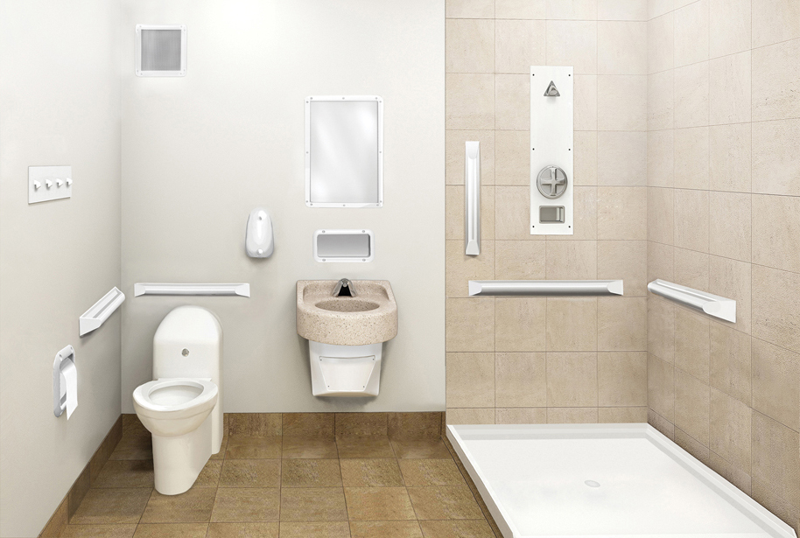
Explain Designing Safer Environments
Click on the points in the image below to reveal their safer environment design.
Shatter Proof Mirror
Ligature Resistant Shower
Ligature Resistant Towel Hooks
Ligature Resistant Sink
Ligature Resistant Grab Bar
Ligature Resistant Toilet

Slide 13
Module 3:
Preventative Measures And Interventions

Slide 14
Implementing Immediate Responses To Ligature Risks
Implementing Immediate Responses to Ligature Risks
When faced with ligature risks in healthcare settings, swift and effective action is crucial to ensure patient safety. Here's how to implement immediate responses:
Assess the Situation: Immediately assess the severity of the ligature risk and the patient's condition. Determine if the patient is in imminent danger and requires immediate intervention.
Ensure Patient Safety: If the patient is in immediate danger of self-harm, take steps to ensure their safety. Remove the ligature if possible or intervene to prevent further harm while awaiting assistance.
Call for Assistance: Notify relevant staff members, such as nurses, security personnel, or mental health professionals, to provide assistance and support in managing the situation.
Provide Emotional Support: Offer reassurance and emotional support to the patient, acknowledging their distress and validating their feelings. Stay with the patient to provide comfort and prevent escalation of the situation.
Document the Incident: Record details of the ligature risk incident, including the circumstances, actions taken, and any observations of the patient's behaviour or emotional state. Ensure accurate documentation in the patient's medical record.

Slide 15
Implementing Immediate Responses To Ligature Risks
6. Conduct a Debriefing: Following the resolution of the immediate risk, conduct a debriefing session with staff involved in the incident. Discuss the response, identify areas for improvement, and reinforce best practices for managing ligature risks.
7. Review and Update Policies: Review existing policies and procedures related to ligature risk management, incorporating lessons learned from the incident—update protocols to enhance safety measures and ensure staff readiness to respond effectively in similar situations.
8. Provide Training and Education: Offer additional training and education to healthcare staff on recognising and responding to ligature risks. Ensure staff are familiar with protocols and procedures for managing these incidents.
9. Follow Up with the Patient: After the immediate risk has been addressed, follow up with the patient to assess their ongoing safety and well-being. Offer continued support and resources to address any underlying issues contributing to the risk.
10. Collaborate with Multidisciplinary Teams: Engage with multidisciplinary teams, including mental health professionals, social workers, and risk management, to develop comprehensive strategies for addressing ligature risks and supporting patient safety.
By implementing immediate responses to ligature risks, healthcare providers can effectively manage incidents and safeguard patient well-being in healthcare settings. These proactive measures are essential to a comprehensive ligature risk management and patient safety approach.

Slide 16

Inpatient Psychiatric Unit Scenario
Scenario:
A 28-year-old female patient with a history of depression and suicidal ideation is admitted to an inpatient psychiatric unit. During a routine room check, a nurse discovers that the patient has fashioned a ligature using bed sheets and has tied it to the top of the door frame.
Question:
What immediate actions should the nurse take to address this ligature risk?
Answer
Immediate actions to address this ligature risk include:
Assessing the patient's immediate safety and removing the ligature if possible.
Notifying the unit's staff and seeking assistance from mental health professionals.
Providing emotional support to the patient and staying with them to prevent further harm.
Documenting the incident thoroughly in the patient's medical record.
Conducting a debriefing session with staff involved in the incident to discuss response strategies and identify areas for improvement.

Slide 17
Module 4:
Responding, Complying, And Ethical Considerations

Slide 18




Understand Compliance With Regulations
Compliance with UK regulations regarding ligature risks is essential for ensuring patient safety in healthcare settings. Regulatory bodies like the Care Quality Commission (CQC) establish guidelines for mitigating ligature hazards. Compliance involves thorough risk assessments to identify potential ligature points and implementing policies for ligature-resistant fixtures, regular inspections, and staff training.
Staying informed about updates to regulatory standards is crucial. Healthcare providers must review guidelines regularly and participate in training to ensure compliance with evolving requirements. Adhering to regulations demonstrates a commitment to patient safety and lays the groundwork for continuous improvement in ligature risk management practices.
Compliance with UK regulations regarding ligature risks is integral to providing safe and high-quality care in healthcare settings and fostering trust among patients, staff, and regulatory agencies.

Slide 19

Understand Ethical Responsibilities In Ligature Prevention
Understanding ethical responsibilities in ligature prevention is crucial for healthcare professionals in the UK:
•Prioritise patient safety and welfare, ensuring environments are free from unnecessary risks and aligning with the ethical duty of care.
•Promote well-being and minimise harm through proactive measures beyond regulatory compliance, reflecting the principle of beneficence.
•Respect patient autonomy by involving them in discussions and decisions about safety measures, upholding their rights to make informed choices.
•Foster transparency and accountability in communication about risks and interventions, promoting stakeholder trust and confidence.
•Advocate for equitable access to resources and interventions, addressing underlying disparities in healthcare provision in line with the principle of justice.
By integrating these ethical considerations into ligature prevention efforts, healthcare providers uphold the highest standards of care and promote healing and recovery for all patients in the UK.

Slide 20

Congratulations!🎉
You have now completed the online training module Ligature Training. You will now be required to complete a closed assessment to pass this course. Once you are ready, please click the Take Test button below.
End Course

