Slide 1
PEG Feed Training

Slide 2
BEFORE BEGINNING
If you are using a mobile device or laptop, please ensure that it is fully charged.
You should also have a pen and notepad ready.
Ensure you are in a quiet area with minimal distractions.
In addition to the above please make yourself familiar with some of the tools available above such as;
Resource Bank
Here you will find useful documents that will be relevant to the course you are undertaking but also you will have access to a CPD reflective learning template which you can download and complete to gain your points.
Highlighter/Pen tool
This feature allows to highlight, circle and write notes on parts of the material wherever you feel necessary.
Presenter Function
Selecting this function will give you instant access to our contact details without having to leave the course should you require support with the system or any assistance from one of our qualified trainers.
Audio Dictation
Please note this feature is auto-enabled. If this isn’t required simply select the mute function or decrease the volume.
Hyperlinks
Should you click on a hyperlink within the course material you will be required to click your back button on your browser or device once you are ready to resume.

Slide 3
Learning Objectives
By the end of this session you will be able to:
Describe the structure of a percutaneous endoscopic gastrostomy (PEG) feeding tube
Explain the function of a PEG feeding tube
List reasons why someone may require a PEG feeding tube
Describe basic human anatomy and physiology relevant to the placement and management of PEG feeding tubes
Explain how to care for a PEG feeding tube, including how to adhere to infection control policies and procedures
Recall the process by which food, fluids and medication are safely administered through a PEG feeding tube
List PEG feeding’s potential complications, and explain how to manage these complications, should they arise
Appreciate the importance of effective mouth care, and describe how to provide this for patients with PEG feeding tubes
Appreciate the importance of effective stomal care, and describe how to provide this for patients with PEG feeding tubes
Explain how to go about changing a gastrostomy tube's balloon water
Appreciate the psychological consequences of PEG feeding
Describe how to maintain clear and accurate written records in regard to PEG feed tube management

Slide 4
What are Percutaneous Endoscopic Gastrostomy (PEG) Feeding Tubes?
Percutaneous endoscopic gastrostomy, or PEG, tubes are flexible feeding tubes which are placed through the abdominal wall, into the stomach. Percutaneous endoscopic gastrostomy is the name of the procedure by which a PEG tube is placed. Although it sounds like a complicated term, percutaneous endoscopic gastrostomy can be broken down to reveal it's meaning:
Percutaneous - done through the skin
Endoscopic - performed using an endoscope, a tool which consists of a thin tube with a powerful light and camera at the end. This helps those inserting the PEG tube to view inside of someone's body.
Gastrostomy - the formal name for the opening that is made surgically between the abdominal wall and someone's stomach.
PEG tubes allow fluids, food and/or medications to be put directly into someone's stomach, bypassing the mouth and oesophagus. People who have issues swallowing, problems with their appetite, or who, for whatever reason, cannot take adequate nutrition by mouth, may be offered this procedure. PEG tubes are usually used long-term, and patients/carers/families can be trained to manage PEG tube cleaning, feeding and medication administration at home.

Slide 5
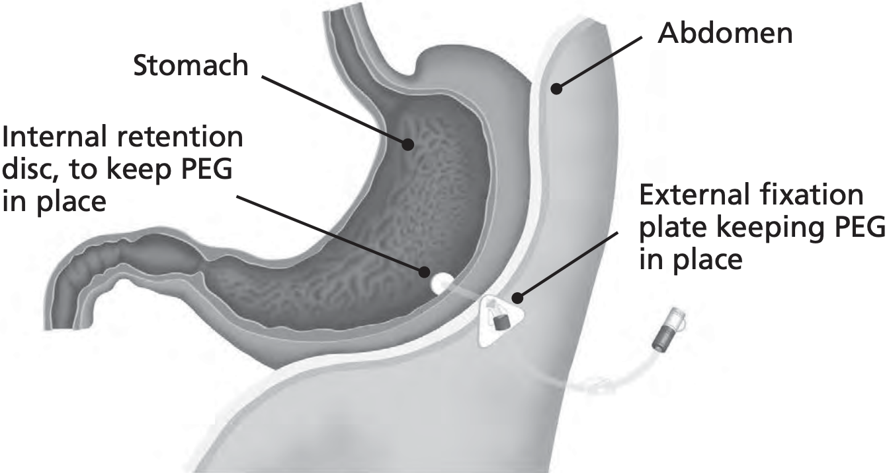
What are Percutaneous Endoscopic Gastrostomy (PEG) Feeding Tubes? (cont.)
Although there are different types of PEG feeding tube that may vary slightly in their structure, most PEG tubes have the following three components:
An internal bumper or retention device - a balloon, a bumper, a crossbar or disc that holds the tube in place internally and prevents it from moving.
A skin disc - a bumper, disc or flange at the external site of the tube to prevent movement of the tube externally.
A Y-port connector - a two-way port at the end of the tube externally that allows for the tube to be connected to giving sets for the administration of medications, foods and fluids. There may be caps or a small clamp here to keep the tube closed when feeding is not taking place.
The below image visually demonstrates how the internal bumper and external skin discs act to hold a PEG tube in place within someone's stomach.

Slide 6
Indications for PEG Feeding
Why might a PEG tube be necessary?
There are several reasons why some may require a PEG feeding tube. These are sometimes called 'indications' for PEG feeding. Someone may require a PEG feeding tube if:
They have difficulty swallowing, or they have been assessed as having an unsafe swallow. There are many reasons someone may have difficulty swallowing including chronic progressive neuromuscular diseases such as motor neurone disease, and following a stroke.
They have nutritional issues due to a 'failure of feeding'. This can be the case in Cystic Fibrosis patients, in patients receiving peritoneal dialysis, and in patients with cancer of the food pipe, or oesophagus.
They have severe Crohn's disease, a type of gastrointestinal disorder
They have severe burns preventing intake of food orally
When might placing a PEG tube be unsafe?
There are also several situations in which a PEG feeding tube is contra-indicated. Contra-indicated means that a PEG feeding tube should not be placed, as it would be unsafe to do so. It is not always clear cut in the following situations whether a PEG tube should be placed or not. These contra-indications should make you question whether it is safe to place a PEG tube. These situations include:
Issues with blood clotting. These should be corrected prior to PEG tube insertion.
Sepsis, which is the body's extreme response to a severe infection. This should be treated prior to insertion.
Any episode of acute, severe illness.
Anorexia.
Previous surgery of the stomach.

Slide 7
Anatomy and Physiology of the Digestive System
It is important to understand, in basic terms, the anatomy and physiology of the human digestive system, and appreciate how this relates to the placement and use of a PEG feeding tube. Simply put, anatomy refers to the structure of the human body, and physiology refers to how the human body works.
It is important that you are able to discuss the structure and function of:
The oesophagus
The stomach
The small intestine
The large bowel
It is also important that you are able to appreciate how each of these digestive organs relates to the purpose, placement, and use of a PEG feeding tube.

Slide 8
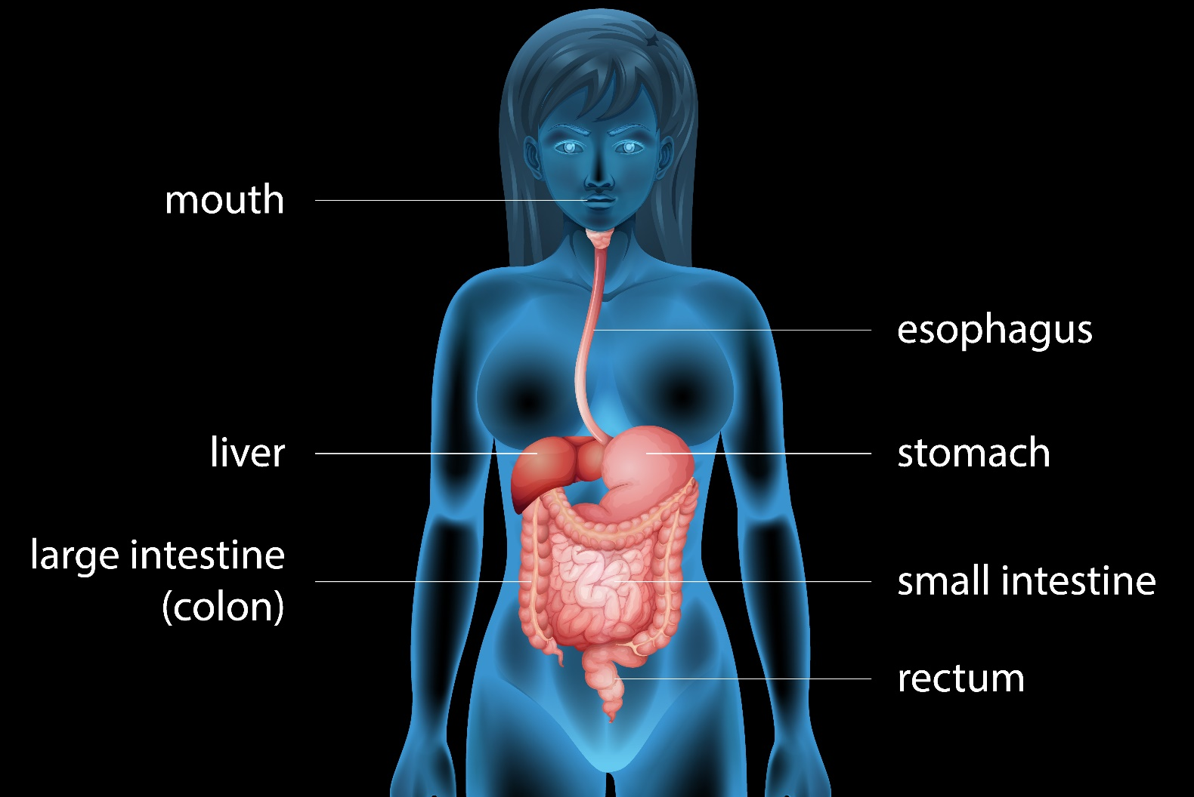
Anatomy and Physiology of the Digestive System (cont.)
It is also important that you are able to appreciate how each of these digestive organs relates to the purpose, placement, and use of a PEG feeding tube.
The below image offers an overview of the human digestive system, and how portions of the digestive system connect with one another. Esophagus is the American spelling of Oesophagus.

Slide 9
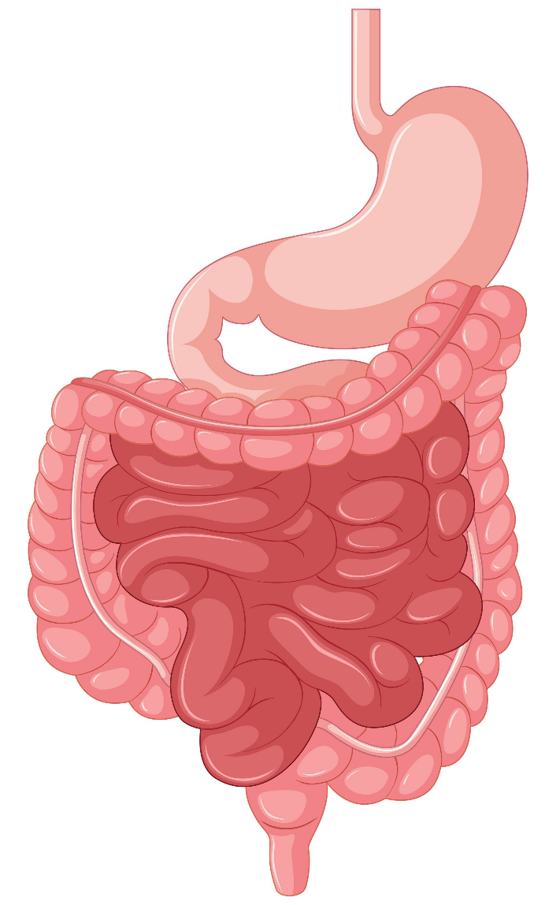
Anatomy and Physiology of the Digestive System (cont.)
The stomach
The below image shows the stomach, small intestine and large intestine. The cardia of the stomach surrounds the opening at the top of the stomach. The rounded portion at the top of the stomach and to the left of the cardia is the fundus. Below the fundus is the large central portion of the stomach, the body. The pyloric part of the stomach is the lower portion of the stomach, which connects the stomach to the duodenum, the first part of the small intestine.
When food reaches the stomach, food distends the stomach and nerves
are stimulated to cause waves of peristalsis (muscle contractions and
relaxations) which stimulates the flow of gastric juice from gastric glands.
The peristaltic waves mix the food with the gastric juice, and move the
food toward the small intestine.

Slide 10
Anatomy and Physiology of the Digestive System (cont.)
Relevance to PEG feed tube
The stomach is where a PEG tube is placed. PEG tubes connect the stomach to the abdominal wall. Anatomically speaking, PEG tubes are placed through the front, or anterior, wall of the stomach, into the central body of the stomach.
The Small Intestine
The small intestine, or small bowel, is the longest part of the digestive system. It extends from the end of the stomach to the start of the large intestine. It has three main sections:
The duodenum
The jejunum
The ileum
The intestinal phase of digestion begins once food enters the small intestine. The small intestine continues the digestion of foods that have passed through the stomach. Digestion in the small intestine is regulated by the nervous system, and by body hormones. In the small intestine, almost all nutrients from food are absorbed. The walls of the small intestine make digestive juices, or enzymes, which work together with enzymes from the liver and pancreas to absorb the nutrients from the food you eat.

Slide 11
Anatomy and Physiology of the Digestive System (cont.)
Relevance to PEG feed tube
The food, fluids and medication given through a PEG feeding tube still pass through the small intestine and are subject to the same processes as food taken by mouth.
The Large Intestine
The large intestine, or large bowel, extends from the end of the ileum to the anus. It is about 1.5 meters long. The large intestine is divided into the cecum, colon, rectum, and anal canal.
The purpose of the large intestine is to absorb water and salts from the material you have eaten that has not been digested as food, and to get rid of any waste products that are left over.
The food, fluids and medication given through a PEG feeding tube still pass through the large intestine and are subject to the same processes as food taken by mouth.

Slide 12
Caring for a PEG Feeding Tube: General Principles
It is important that PEG tubes are properly cared for. High quality care can avoid some of the potential complications associated with having a PEG feeding tube. This section of the module discusses the general principles underpinning care for a PEG feeding tube. Specific complications will be discussed in more detail in the 'potential complications' section later within this module.
Adhering to the principles of infection control
Feeding using a PEG tube can be a source for the growth of bacteria. This can lead to infection. The formula that is used for PEG feeding provides an ideal environment for bacterial growth. You should adhere to the principles of infection control when managing PEG feeding tubes, as you should in all areas of your practice.
In regard to PEG feeding tubes, this includes:
Washing your hands using soap and water, or decontaminating using hand sanitizer before and after handling equipment, and the preparation process.
Preparing equipment and the feed in a clean environment.
Using an aseptic, non-touch technique when preparing the feed and connecting it to the administration set/feeding tube.
Wherever possible, using commercially produced and pre-filled ready to hang feeds. These are less likely to become contaminated in preparation and use.
Your Trust will have local infection control guidelines, and you should adhere to local recommendations in your practice.

Slide 13
Caring for a PEG Feeding Tube: General Principles (cont.)
Storage and care of feed
It is important that feed that is to be given by a PEG tube is stored and cared for in a specific way. All formula should be stored in a cool, dry place at room temperature, away from direct sunlight. Once opened, feed should be stored in a refrigerator, and discarded after 24 hours. Formula should be administered at room temperature.
Administering Food, Fluids and Medication
Tube feeding
Feed can be administered through a PEG tube. The below sections discuss the importance of nutritional assessment prior to PEG feeding, tube feeding terminology, and methods of PEG tube feeding.
Nutritional assessment
So that feeding via a PEG tube meets a person's nutritional needs, their needs should be assessed by a dietician to determine which formula should be used for feeding. Formula will be prescribed for a patient by a dietician.
You may hear discussion of the term 'refeeding syndrome' in regard to someone's PEG feeding. Someone's risk of refeeding syndrome factors into their nutritional assessment. The term 'refeeding syndrome' refers to a range of complications that can occur from refeeding a malnourished person. The syndrome involves severe disturbances with someone's blood electrolytes, and can be fatal. People at risk of refeeding syndrome may need regular blood tests to monitor their electrolyte levels. In people at risk, feeding is usually introduced slowly and carefully.

Slide 14
Administering Food, Fluids and Medication (cont.)
Tube Feeding Equipment
There are several pieces of equipment used for PEG feeding. This section of the module offers descriptions of this equipment, and a summary of each of their functions.
You may encounter the following equipment:
Container/bottle/bag - these terms can be used to refer to the "reservoir" that holds someone's formula during administration of a PEG feed
Giving set - this is the tubing that connects the container/bottle/bag to the PEG feeding tube itself. This often has a 'drip chamber' to allow drips per minute to be counted, or detected by a pump. This allows for control over the rate of feed administration.
Extension tube - an extension tube is a piece of tubing that can be situated between the PEG feeding tube and the giving set.
Pump - a pump is an electronic device that regulates the rate at which formula is given.
Hanging device - this is used to hang the feed container above someone's head for gravity or pump feeds. It may be an IV pole or hook.
Feeding pump frame - a structure specifically designed to hold the feed and feeding pump
Syringe or funnel - syringes can be used without their plunger (as a funnel) to administer feeds, or with a plunger to flush a PEG tube with water.

Slide 15
Administering Food, Fluids and Medication (cont.)
Administering medications
Medications can also be administered by a PEG feeding tube. The below sections discuss the process of administering medication using a PEG tube, and highlight the do's and don'ts's of administering medications through a PEG tube.
Before Administering Medication
In order to administer a medication by a PEG feeding tube, a syringe, the prescribed medication, and sterile water (or cooled boiled water) is necessary. Where possible, medication should be requested in liquid or soluble form, since feeding tubes are designed to take liquids only.
Before administering a medication you should:
Check to see whether the prescribed medication should be given on a full or empty stomach
Give liquid medications wherever possible to prevent tube blockage. Liquid medications should usually be diluted with at least 30 mls of water, but make sure to check your local policies.
If a medication is only available in tablet form, check with a pharmacist before crushing it, as this greatly increases the risk of tube blockage. Crushing medications should be a last resort.
If a tablet can be safely crushed, use a pill crusher to grind the tablet to a fine powder, and mix it with 30-50mls of warm water.

Slide 16
Administering Food, Fluids and Medication (cont.)
Administering the Medication
To administer the medication you should:
Make sure your patient is lying at 45 degrees on the bed, or in their chair. Patients should stay in this position during the administration, and for 30 minutes after the medication has been administered.
Remove the cap at the end of the PEG tube, and attach a 30-60ml syringe. You may need to interrupt someone's continuous tube feed, if necessary.
Release the PEG tube clamp.
You need to verify the position of the tube. To do this, aspirate for gastric contents by pulling back on your syringe. Note the volume that is aspirated, and follow your local policy for reinstilling this volume. Clamp the tube, remove the syringe, and take the plunger out from the syringe.
Reattach the syringe, and unclamp the PEG tube. Pinch the tubing using your fingers to seal it, and add 30mls of water to the syringe. Release your pinch of the tubing, and let the water flow by gravity to flush the tube. Pinch the tube again before the syringe fully empties.
Pour the diluted medication into the syringe and release your pinch on the tubing to administer it.
If you are giving more than one drug, flush the tube between each dose with 15-30mls of water.
When finished, flush the tube with 30mls of water, clamp the PEG tube, and replace the cap.

Slide 17
Administering Food, Fluids and Medication (cont.)
After Administering Medication
After administer the medication you should:
Document your medication administration in the patient's notes
Document your medication administration on the patient's drug chart
Make a note of all liquids administered on the patient's fluid chart so that their input and output can be accurately calculated
DON'T'S
In regard to administrating medications by a PEG tube, there are a few key 'DON'T'S'.
Don't mix a medication with any formula, or with any another medication
Don't administer sublingual or buccal medications by a PEG
Don't administer sustained-release tablets or capsules by a PEG
Don't crush enteric-coated medications
Don't reclamp the tube after administering a medication without flushing the PEG tube

Slide 18
Administering Food, Fluids and Medication (cont.)
Flushing a PEG tube
The importance of flushing a PEG tube has been referred to several times throughout this section of the module. The below video clearly demonstrates how to flush a PEG feeding tube. Please watch this video carefully, and try to memorise the steps.
Potential Complications, and your Responsibilities
There are several complications that may be encountered when caring for someone's PEG tube. It is important that you understand the nature of these complications, how the risk of these complications can be lessened, and what to do if these complications occur.
Potential complications of PEG tube feeding include:
Tube Blockage
Causes of PEG tube blockage - A PEG tube may become blocked for several reasons. The tube may become kinked, the feeding formulae used may be very thick, the tube may not have been adequately flushed with water after feeding, and the patient may be experiencing gastric reflux.
Avoiding tube kinking - Kinking of a PEG tube can be avoided by correct placement of the person administering a feed, the PEG tube, and the tubing which is connected to the feeding container. Positioning all parties so there are no unnecessary turns or bends can help prevent kinking.
Thick formula - Thick formula may be prescribed by a dietician, as thick formula tends to be higher in calories. However, the risk of tube blockage is higher with thick formula. Shaking a container of formula well before use, if appropriate, can reduce the risk of blockage.
Inadequate PEG tube flushing - Flushing a PEG tube with water following feeding helps prevent the tube from blocking. PEG tubes should be flushed with water after confirming the tube is correctly placed, before and after administering medications, and after tube feeds. Many health professionals use 50mL of water to flush the tube, but opinion varies and you should adhere to local guidelines. Some feed pumps have automatic flush features to help prevent blockages.

Slide 19
Potential Complications, and your Responsibilities (cont.)
Reflux of gastric contents
Simply put, reflux is the movement of stomach contents up the oesophagus, or food pipe. Reflux of stomach contents into a PEG tube can increase the risk of blockages, as the gastric contents and formula in the tube react together, which can cause the formula to clump together and block the tube. There are several approaches that can help reduce the incidence of gastric reflux. These include ensuring that people receiving PEG feeds are placed in an upright position during and after feeding, using a pump-assisted device (if appropriate), slowing the rate of delivery, and using medication (again, if appropriate) to increase the speed of stomach emptying.
Tube Displacement
Although PEG tubes are internally and externally anchored, they can become displaced. Displaced PEG tubes can cause ulceration, burning of the skin from leaking gastric contents, and infections. To prevent these issues, PEG tubes must be well-secured. You can check for tube displacement by observing the length of the PEG tube to check the tube has not been pulled inwards.
Barrett outlines 9 steps that are involved in measuring the length of a PEG tube. This measurement will be made initially by someone trained to do so, and recorded within the patient's notes. Tube length is measured using the following steps:

Slide 20
Potential Complications, and your Responsibilities (cont.)
Tube length is measured using the following steps:
Hold the tube with one hand at the level of its exit site from the stomach
Slide the skin disc away from the exit site along the tube
Gently rotate the tube between your index finger and thumn
Gently pull the PEG tube away from the abdomen until a slight resistance is felt
Slide the skin disc back down to a position 1-2mm from the abdomen
Mark the tube at its exit site using an indelible pen
Measure the tube from its exit site on the abdomen to its external tip or end
Record the length in the person's notes
Check that the marking is visible each day
It is most likely that your role will be to check whether the marking made is visible each day. You should compare the measurement you make with the measurement in the patient's notes, and check they match.
If there is doubt regarding the position of someone's PEG tube, the patient's medical team should be notified as an abdominal X-ray may be necessary to check the positioning of the tube.

Slide 21
Potential Complications, and your Responsibilities (cont.)
Preventing tube displacement
To prevent tube displacement, it is important to ensure that the skin disc is positioned 1-2mm from the abdominal wall. The position of the skin disc should be checked and safeguarding after cleaning the PEG tube, flushing the tube, delivering food, fluids or medication. In addition to maintaining the position of the skin disc, it is important to make sure there is no traction placed on the tube by either yourself or the giving sets you attach to the PEG tube.
What to do if a tube is accidentally removed
Sometimes, a PEG tube can fall out or be accidentally removed. If this is the case, a new tube needs to be placed as soon as possible, as, otherwise, the stoma will start to heal. A new tube should be placed within 2 to 24 hours. Unless you have been trained to do so, do not attempt to place a new tube. Instead, place a clean gauze dressing over the stoma to prevent the leaking of stomach contents onto the patient's skin, and inform the on call doctor to escalate to the correct team to replace the PEG tube. If a patient is in pain, and it is safe to take oral medication, you should offer them their prescribed pain relief
'Buried Bumper' Syndrome
‘Buried bumper' syndrome refers to:
'The development of pressure necrosis and ulceration- either externally at the gastrostomy tube exit site or internally at the mucosal layer of the stomach wall‘
Barrett, Gastrostomy Care: A Guide to Practice

Slide 22
Potential Complications, and your Responsibilities (cont.)
'Buried Bumper' Syndrome
Simply put, ulceration is a break in the surface of the skin. Necrosis refers to the death of the skin, in this case, due to pressure.
This complication usually occurs when there has been excessive pressure between the internal bumper of the PEG tube, and the external skin disc. Signs of 'buried bumper' syndrome include:
Bleeding at the external site the PEG tube is placed at, or stoma
Leaking of feeding formula or gastric contents
Sudden intolerance to PEG feeding when this has not previously been an issue e.g. diarrhoea, nausea, vomiting
It is important to ensure there is no excess tension between the internal bumper and external skin disc. The skin disc should be positioned 1-2mm from the abdominal wall, and no bulky dressing should be applied under the external retention bumper.
'Buried bumper' syndrome is a serious complication. In these situations, a patient's PEG tube has to be removed and replaced at another site where the skin and/or stomach lining is not ulcerated or damaged.

Slide 23
Potential Complications, and your Responsibilities (cont.)
Spontaneous Balloon Deflation
Some PEG tubes have an internal bumper which is a balloon inflated with water. Tubes that have an internal balloon have a double lumen with two ports- one port is used to administer food/fluids/medications, and the other is used to inflate the internal balloon. The balloon port is designed for a 'Luer-lock' syringe to be attached, and often has the amount of water required to inflate the balloon printed somewhere on the port.
Over time, water can leak from the balloon. If the balloon deflates, the tube can become displaced and may be accidentally removed. Monitoring the volume of water in the balloon regularly is, therefore, important.
To check internal balloon volume, a Luer-lock syringe can be inserted into the balloon port of the PEG tube. The plunger of the syringe can be pulled back, removing water for the balloon. This volume can be compared with the amount of water that the balloon should hold. If the volume withdrawn by the syringe is less than the recommended quantity, additional water should be reinstilled in the balloon to meet the recommended amount.

Slide 24
Potential Complications, and your Responsibilities (cont.)
Build up of Gas
Sometimes, when people are fed using a PEG tube, gas can build up in the stomach. This can cause abdominal distention and be very uncomfortable for the person with a PEG tube. Abdominal distention can also cause gastric contents to leak into someone's PEG tube. To remove excess gases, a PEG tube can be 'vented'. Before venting a PEG tube, the patient and healthcare professional should both don protective clothing and eye protection to protect against potential splashes of gastric contents during venting. To vent a PEG tube, the tube should be held upright and the tube should be uncapped (the protective cap at the end of the port removed). This should allow the air to escape. Once the excess air has been released, the cap should be securely replaced. Some tubes may have one-way valves that are designed to prevent gastric contents from leaking. In these cases, decompression tubing is supplied with these PEG tubes, which can be attached to vent to the tube, if necessary.
Damage to the Tube
PEG tubes can degrade over time. It is important that you are able to recognise signs of tube deterioration. These include:
Blistered appearance of the tube
Small aneurysms along the walls of the tube
Visible cracks
PEG tubes should be inspected daily for signs of damage or deterioration. Damaged tubes can rupture, and should be replaced as soon as possible. To prevent deterioration, tubes should be flushed on a regular basis with water, devices should not be used to pinch PEG tubes, protective caps should be placed on the tube following use, and appropriately sized syringes should be used.

Slide 25
Effective Mouth Car
Oral hygiene is important, even if a patient is taking nothing by mouth. In addition to affecting the mouth, poor oral hygiene has been linked to respiratory infections, cardiovascular diseases and brain abscesses. Oral health and oral hygiene is also important for a patient's psychological wellbeing.
You should encourage patients, their families and carers to engage in mouth care. If you are looking after a patient, and they are unable to engage in mouth care themselves, you should actively assist them with their oral hygiene.
Many patients may have a mouth care plan. This will outline the gold standard of mouth care for the patient in your care. The plan will be based on principles of best practice, and the patient's preferences. You should follow each patient's individual mouth care plan. This section outlines some general potential approaches to mouth care.
The frequency of mouth care may differ depending on a patient's needs and preferences. In general terms, mouth care should be undertaken:
Every 4-6 hours for people at risk of infection
Every 2 hours for those who are semi-conscious or unable to control their oral secretions
Every hour for people also receiving oxygen therapy, those who are unconscious, or those with an active infection in their mouth

Slide 26
Effective Stomal Care
The site at which the PEG tube exits the abdominal wall (the stoma) should be cleaned daily following local protocols. The site should also be observed for tenderness, redness, irritation, and the presence of any discharge or leakage.
Caring for someone's PEG tube stoma involves:
Observing the stoma for signs of inflammation (e.g. redness, swelling, tenderness)
Lifting the external tube skin disc to check the skin beneath
Cleaning under the skin disc with a cotton bud
Ensuring the skin disc is positioned 1-2mm from the skin
Washing the stoma and surrounding skin with warm soapy water
Drying the area thoroughly after cleaning
Removing any discharge, or leakage of contents from the tube
Care may involve rotating the tube 360 degrees no more than once a day, but at least once a week to prevent the tube adhering to the stoma tract and becoming embedded in the stomach wall. Not all PEG tubes can be rotated, as some are stitched in place. Check the patient's notes and PEG history to see whether a tube should be rotated. To rotate a PEG tube, insert the PEG tube into the stoma tract by 2-3cm, and rotate 360 degrees. Once rotated, gently pull the tube back to it's original position. In newly placed tubes, rotation may not be recommended for 14 days.
Avoid using any creams, lotions or powders on or near the stoma site as they can damage the tube and give rise to infections. In newly placed PEG tubes, cleaning should be done with sterile water, or saline using sterile gauze. This should continue for the first 7 days.

Slide 27
Impact on Patients
Living with a PEG tube can be difficult. Having a PEG tube placed can influence someone's perception of their own autonomy, privacy and dignity, their wellbeing, body image, sexual expression, and the way they interact with the world. PEG tubes affect people differently. No two people will react the same way. For some, PEG feeding can be life-enhancing, and have positive outcomes that help them adjust to their PEG feeding tube. For others, the losses and adjustment associated with PEG feeding tubes can be profound.
What can healthcare professionals do to help?
You should always try to consider someone's psychosocial needs. They should be considered throughout the patient's PEG feeding tube journey. Psychosocial needs include emotional and mental wellbeing. Beginning discussion of psychosocial needs prior to tube placement, if possible, can help healthcare staff deliver care that best suits the needs of that individual patient. Making time to listen to a patient and their concerns, and answer questions they have about their PEG tube can help you to deliver sensitive care that attends to patient's psychosocial needs, as well as their physical needs.
You may find it helpful to ask the following questions when assessing a patient's psychosocial needs:
How do you feel about your PEG tube?
How has the PEG tube affected your life?
What benefits and burdens has the tube brought?
How do you feel about not being able to eat or drink?
Are there any aspects of eating that you miss?
How do you feel about your body now?
Once you have an idea of someone's psychosocial needs, you can develop a care plan with a patient, their carer or family to provide appropriate support for their psychosocial wellbeing. Counselling should be considered, if appropriate, as part of someone's psychosocial care plan. Care plans should be updated regularly, as psychosocial needs can change over time.

Slide 28
PEG Feeding Tube Documentation
When caring for someone's PEG feeding tube, it is important that you document the actions you take. The following should always be documented:
The reason why someone has a PEG tube placed
Information concerning insertion of someone's PEG tube, the make/size/length of the tube, how the procedure went, any information on complications
Whether or not a tube should be turned. Tubes which are stitched in place should not be turned, but not all tubes are stitched in place.
There should be information in the notes concerning the length of the PEG tube, so that this can be referred back to when checking the position and placement of the tube in future
Information concerning any tube changes that are made
All feeds must be prescribed by a dietician, and you should document on a patient's drug chart when these have been administered and sign your name against the administration
Fluids, including flushes that have been given, should be documented on a patient's input and output, or fluid, chart
You should document any concerns you have about the PEG stoma site or feeding tube in the patient's notes, document the actions you have taken, and document who you have escalated your concerns to. If in doubt, always consult a senior.

Slide 29
A Chance to Reflect
Before you finish this module, we'd like you to stop and reflect on what you have learned, and how this may change your day-to-day practice. We would really like you to reflect meaningfully on this module, and encourage you to spend a full five minutes considering your take home messages. To get you comfortable, we're sending you this virtual cake and coffee. Please feel free to grab a (real) drink or snack, find a comfortable space, and if now is not a good time, you can come back and complete this reflective section later. To save, you don't need to do anything special, your responses are saved automatically. Make sure you complete this reflective section before you move onto the post-module knowledge assessment.
Module reflection
Take a minute to note down two new things you have learnt as a result of this module.
Consider what you found surprising in this module. Did any content shock you, or make you feel surprised?
How do you think this new information, or your new perspective, will influence your clinical practice? Write your thoughts below.
Is there anything more you think you need to know to provide care for someone with a PEG feeding tube? If so, how will you go about finding this information?

Slide 30
TIME TO TAKE YOUR TEST
Good Luck!

