Slide 1

Psychological development during adolescence

Slide 2



BEFORE BEGINNING
If you are using a mobile device or laptop, please ensure that it is fully charged.
You should also have a pen and notepad ready.
Ensure you are in a quiet area with minimal distractions.
In addition to the above please make yourself familiar with some of the tools available above such as;
Resource Bank
Here you will find useful documents that will be relevant to the course you are undertaking but also you will have access to a CPD reflective learning template which you can download and complete to gain your points.
Highlighter/Pen tool
This feature allows to highlight, circle and write notes on parts of the material wherever you feel necessary.
Presenter Function
Selecting this function will give you instant access to our contact details without having to leave the course should you require support with the system or any assistance from one of our qualified trainers.
Audio Dictation
Please note this feature is auto-enabled. If this isn’t required simply select the mute function or decrease the volume.
Hyperlinks
Should you click on a hyperlink within the course material you will be required to click your back button on your browser or device once you are ready to resume.

Slide 3
INTRODUCTION
This session will review the reciprocal impact of changes in psychological development in adolescence including cognitive, emotional and behavioural development. The session will also consider what impact these developmental changes have on self-management of long-term illness during adolescence.

Slide 4
Learning objectives
By the end of this session you will be able to:
Explain the difference between concrete and abstract thinking
Describe components contributing to the development of self-concept
Identify factors that influence the development of self-esteem
Consider the reciprocal impact of psychological development and long-term illness

Slide 5
Introduction
Young people go through complicated psychological changes during adolescence. These changes influence their psychosexual development, their personal identity and the way they process information about themselves, their world and the future. This has an impact on their behaviour and choices they make about their health care.
Understanding where young people are in relation to these changes has important implications on how to communicate with them and on their ability to manage complex long-term illness regimens.
This session will review the reciprocal impact of changes in psychological development in adolescence including cognitive and emotional development. The session will also consider what impact these developmental changes have on self-management of long-term illness during adolescence.

Slide 6
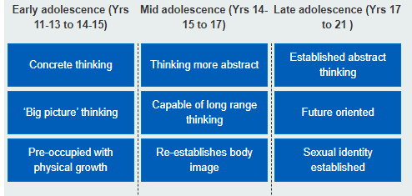
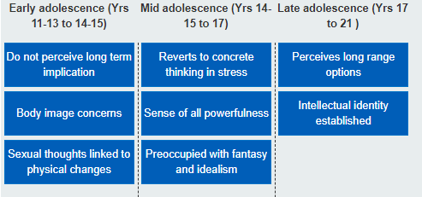
Cognitive Changes
A view of cognitive changes as they occur in early/mid/late adolescence

Slide 7
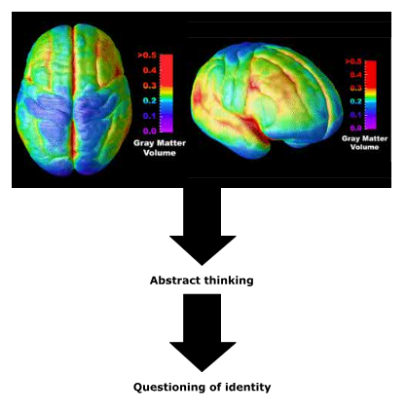
Brain development during adolescence
The development of abstract thinking capacities during adolescence is driven by waves of changes in the brain. These include:
Myelination – increasing the speed of nerve conduction
Synaptic pruning – the pruning out of unnecessary nerve connections (synapses). This makes the grey matter of the brain thinner, but makes thinking more efficient
These two processes allow the development of abstract thinking. It is the ability
to think abstractly about oneself and one’s family that leads to young people
starting to question their identity and their position in the world.
These changes in the brain span the whole of adolescence and continue into
young adulthood.

Slide 8
Self-concept and Self-esteem
Abstract thinking is essential in order to question identity, as well as imagine multiple possible selves which is at the core of the adolescent search for identity.
The development of a personal identity or self-concept requires the adolescent to develop a set of ideas that describes their:
Goals
Interests
Values
Religious beliefs
Political beliefs
Gender
Sexual identity
Ethnic identity
The extent to which these different beliefs are coherent with each other influences self-esteem.

Slide 9
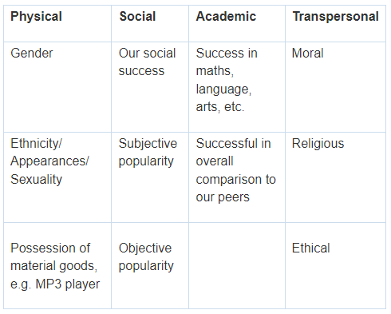
Self Concept
Self-concept describes how we think about (or describe) our ‘self’. It refers to the general idea we have of ourselves – our self-image.
There are four components of self-concept:
Physical: relates to concrete attributes
Acadaemic: relates to performance in school
Social: describes how we relate to other people
Transpersonal: describes how we relate to the supernatural or
unknowns
Self-concept is built over time by an individual as they develop in
relation to their family, peers and society. It can change over time
depending on the environment and different events. Self-concept
is especially fluid during adolescence due to the dramatic physical,
psychological and social changes that take place during this period
of development. For example, changing body shape in puberty,
emerging sexuality and increased importance of religious or political
perspectives.

Slide 10

Self Esteem
Self-esteem includes beliefs we have about our self e.g. ‘I am clever/stupid’ and emotions such as being sad or happy and feeling a sense of pride or shame.
How young people behave may be related to their self-esteem. Young people may evaluate themselves positively or negatively. How the self-concept is evaluated will influence behaviours. A young person with positive or high self-esteem may be confident, assertive and happy. A young person with low self-esteem may be shy, anxious or unhappy.
Self-esteem can be related to a specific aspect of the self-concept. For example:
“I believe I am good at sports and feel proud of that.”
It can also be related to a more global component of the self-concept. For example:
“I believe I am a bad person, and do not deserve good things to happen.”

Slide 11

Risk Factors
Self-esteem can be a generalised feeling about the self as well as judgement about value, worthiness and competence in a range of domains.
Research suggests that relatively low self-esteem is not a risk factor for delinquency, violence towards others (including child and partner abuse), and drug or alcohol abuse, educational under attainment or racism.
Low self-esteem is a risk factor for suicide, suicide attempts and depression, teenage pregnancy and victimisation by others although it is not the only risk factor. It is also associated with adolescent eating disorders and with economic outcomes in early adulthood although the causal mechanisms are unclear.
The strongest influence on self-esteem is parenting style, physical and particularly sexual abuse.

Slide 12
Long Term Conditions
Being diagnosed with a long-term condition can have an impact on the development of identity. Thinking skills can also influence how young people feel about health information.
John is 14 and has had diabetes since he was nine. His metabolic control has been poor for the last two years. He rarely checks his blood sugar and has had an HbA1c greater than 14 at the last two clinic visits. He says that he never misses any injections but his mum thinks he has extra snacks on the way home from school. He is the smallest in his class and hasn’t started puberty yet.
Question: Does poor metabolic control causes delayed puberty and delayed growth?
Answer: Yes, long term metabolic control can influence onset of puberty and affect growth hormone production.
John’s parents are divorced and his mum has had to give up her job because of her own ill health. He can be aggressive to his brother and sister and recently broke a window during an argument. He says that it is always other people who cause the fights.
Question: Does his delinquent behaviour suggest that John has low self-esteem?
Answer: Not necessarily. Contrary to many assumptions there is little evidence that delinquency is associated with low self-esteem.

Slide 13
Long Term Conditions (cont.)
John says he likes school but his teachers describe him as having limited concentration and say he is falling behind in lessons. They put this down to his disruptive behaviour and describe him as attention seeking. However, a cognitive assessment shows that he has learning difficulties which have been masked by his ‘bad behaviour’. He is functioning around the level of an 11 year old.
Question: Can poor control in diabetes result in cognitive difficulties?
Answer: Yes, high blood glucose levels are likely to exacerbate John’s poor concentration and behavioural difficulties whilst persistent hypos can cause memory and attentional difficulties. However, pre-existing cognitive difficulties may make it harder for him to understand information about how to manage diabetes.
As he begins to develop a relationship with the team, John is able to talk about how he is often quite sad and how he worries about not being tall and not having a girlfriend. He has been bullied at school and, as he can’t get a girlfriend, has been called gay, which has upset him.
Question: Is John likely to have low self-esteem?
Answer: Yes, low mood, anxiety about physical appearance and being bullied are associated with low self-esteem.

Slide 14
Session Key Points:
Adolescence is a time of complicated psychological and psychosexual change
The main psychological change during adolescent development is a move from concrete thinking to abstract thinking
Self-concept reflects the beliefs the adolescent holds about him or herself
The extent to which these different beliefs are coherent with each other influences self-esteem
Being diagnosed with a long-term condition can have an impact on the development of identity

Slide 15

TIME TO TAKE YOUR TEST
Good Luck!

