Slide 1

Sepsis Awareness

Slide 2
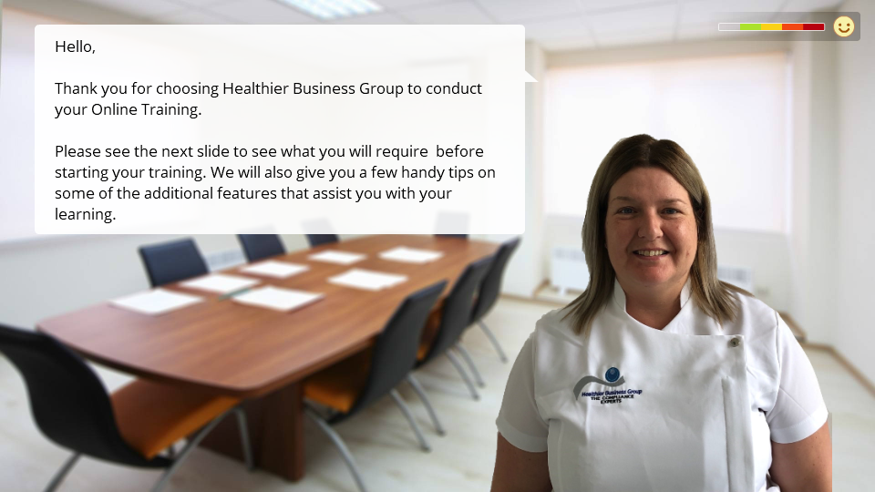

Slide 3



BEFORE BEGINNING
If you are using a mobile device or laptop, please ensure that it is fully charged.
You should also have a pen and notepad ready.
Ensure you are in a quiet area with minimal distractions.
In addition to the above please make yourself familiar with some of the tools available above such as;
Resource Bank
Here you will find useful documents that will be relevant to the course you are undertaking but also you will have access to a CPD reflective learning template which you can download and complete to gain your points.
Highlighter/Pen tool
This feature allows to highlight, circle and write notes on parts of the material wherever you feel necessary.
Presenter Function
Selecting this function will give you instant access to our contact details without having to leave the course should you require support with the system or any assistance from one of our qualified trainers.
Audio Dictation
Please note this feature is auto-enabled. If this isn’t required simply select the mute function or decrease the volume.
Hyperlinks
Should you click on a hyperlink within the course material you will be required to click your back button on your browser or device once you are ready to resume.

Slide 4
Welcome to this learning resource which explores the NICE guidelines (2016) for assessing and managing sepsis based on the care required in a fictional case study.
The NICE guidelines explored in this resource are applicable to the management of adults and young people with acute suspected sepsis.
AIMS AND OBJECTIVES
This learning resource provides opportunities to:
Define sepsis
Understand the physiological effects of sepsis
Examine the 2016 NICE sepsis care bundle guidelines using a case study approach to:
Explore the clinical assessment of sepsis
Investigate the management and treatment of a patient who has sepsis
INTRODUCTION
You are assigned care of the patient. There is a patient that is due to be admitted to your Admissions Ward from the Emergency Department (ED). You have been told the patient is called Mrs Radford. She is 81 years old and she is thought to be developing sepsis, from an unknown cause.
Before you look at the case study in detail, please refresh your knowledge and understanding on sepsis and the NICE guidelines in the next section.

Slide 5
WHAT IS SEPSIS?
The NICE guidelines (2016) view sepsis as:
"A clinical syndrome caused by the body's immune and coagulation systems being switched on by an infection. Sepsis with shock is a life-threatening condition that is characterised by low blood pressure despite adequate fluid replacement, and organ dysfunction or failure."
International Definition of Sepsis
The International debate on "what sepsis is" reflects the complexity of the physiological changes that occur in the body. Previous definitions have emphasised the issues of systemic inflammation and infection that occur, yet this does not fully address the complexity of sepsis. It also needs to include changes in the body's hormonal, metabolic, cardiovascular and neural responses.
Whilst the definition for sepsis has been refined over time, the 2016 consensus definition from 31 societies across the world is:
"Life-threatening organ dysfunction caused by a dysregulated host response to infection"
[Singer et al, 2016, p805]
This new definition, known as the 'Sepsis-3' iteration, emphasises the body's altered physiological responses as sepsis develops. It highlights infection as the cause but then incorporates the many responses generated with the potential development of life-threatening consequences for the body's organs. Following the publication of the Sepsis-3 definition, the NICE guidelines (2016) have included this definition.

Slide 6
CAUSES OF SEPSIS?
Sepsis can be triggered by an infection in any part of the body.
The most common sites of infection leading to sepsis are the lungs, urinary tract, abdomen and pelvis. If the sepsis is caused by a virus, antibiotics won't work however will be given straight away until tests can identify the specific cause of the condition. Where viral infection has been confirmed, you'll need to wait until your immune system starts to tackle the infection, although antiviral medication may be given in some cases.
Sepsis may develop when you're already in hospital. For example, you're more likely to develop sepsis if:
You've recently had surgery
You've had a urinary catheter fitted
You have to stay in hospital for a long time

Slide 7
SOURCES OF INFECTION
Types of infection associated with sepsis include:
Lung infection (pneumonia)
Appendicitis
An infection of the thin layer of tissue that lines the inside of the abdomen (peritonitis)
An infection of the bladder, urethra or kidneys (urinary tract infection)
An infection of the gallbladder (cholecystitis) or bile ducts (cholangitis)
Skin infections, such as cellulitis – this can be caused by an intravenous catheter that's been inserted through the skin to give fluids or medication
Infections after surgery
Infections of the brain and nervous system – such as meningitis or encephalitis
Flu (in some cases)
Bone infection (osteomyelitis)
Heart infection (endocarditis)
Sometimes the specific infection and source of sepsis can't be identified.

Slide 8
WHAT CAUSES THE SYMPTOMS OF SEPSIS?
Your immune system is what protects you from many illnesses. It’s your defence system. It recognizes dangers to the body and fights bacteria, viruses and other dangerous microorganisms, to keep you healthy.
The immune system is made up of cells, proteins, and organs. For most people, it works well, although they still may get sick or contract an infection from time to time. Your body produces white blood cells, which travel to the site of the infection to destroy the germs causing infection. This is known as a localised infection.
A series of biological processes occur, such as tissue swelling, which helps fight the infection and prevents it spreading. This process is known as inflammation.
If your immune system is weak or an infection is particularly severe, it can quickly spread through the blood into other parts of the body. This causes the immune system to go into overdrive, and the inflammation affects the entire body.
This can cause more problems than the initial infection, as widespread inflammation damages tissue and interferes with blood flow.
The interruption in blood flow leads to a dangerous drop in blood pressure, which stops oxygen reaching your organs and tissues.

Slide 9
PEOPLE AT RISK
Everybody is potentially at risk of developing sepsis from minor infections. However, some people are more vulnerable, including people who:
Have a medical condition that weakens their immune system – such as HIV or leukaemia
Are receiving medical treatment that weakens their immune system – such as chemotherapy or long-term steroids
Are very young or very old
Are pregnant
Have a long-term health condition – such as diabetes
Have just had surgery, or have wounds or injuries as a result of an accident
Are on mechanical ventilation – where a machine is used to help you breathe
Have drips or catheters attached to their skin
Are genetically prone to infections
Sepsis is a particular risk for people already in hospital because of another serious illness.
Bacterial infections that can be caught in hospital, such as MRSA, tend to be more serious, as these bacteria have often developed a resistance to many commonly used antibiotics. Sepsis and septic shock can develop as a complication of antibiotic resistance. Sepsis and septic shock can be fatal where it is estimated one-third of people who develop sepsis die. Many who do survive are left with life-changing effects, such as post-traumatic stress disorder (PTSD), chronic pain and fatigue, organ dysfunction (organs don’t work properly) and/or amputations.

Slide 10
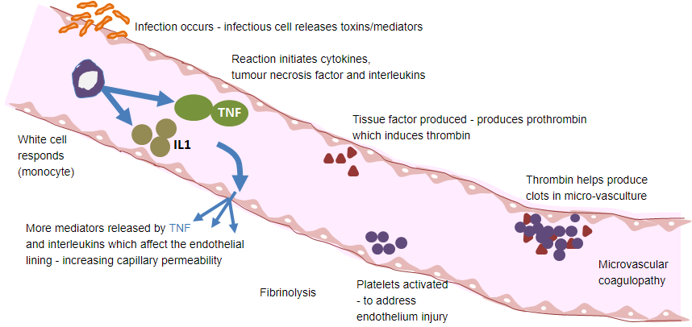
PHYSIOLOGICAL PROCESS OF SEPSIS

Slide 11
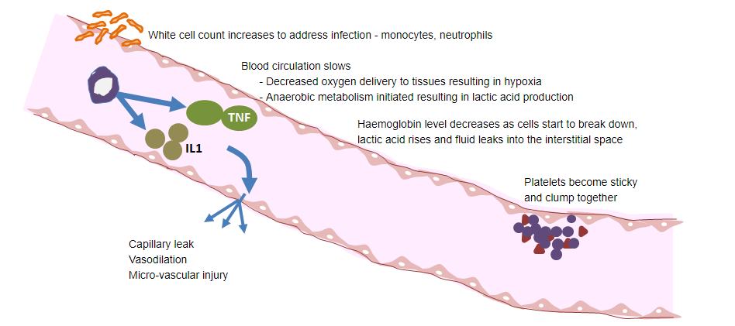
MACRO PHYSIOLOGICAL EFFECTS ON THE BODY

Slide 12
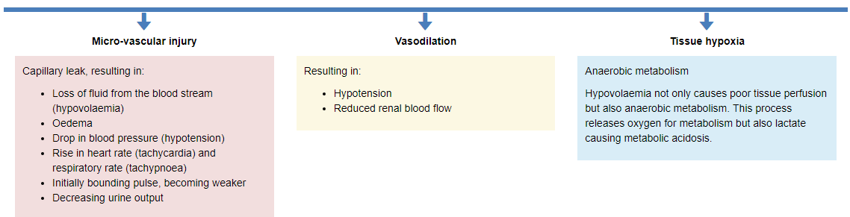
PHYSIOLOGICAL EFFECTS OF SEPSIS
Inflammatory Response and Coagulation Cascade

Slide 13
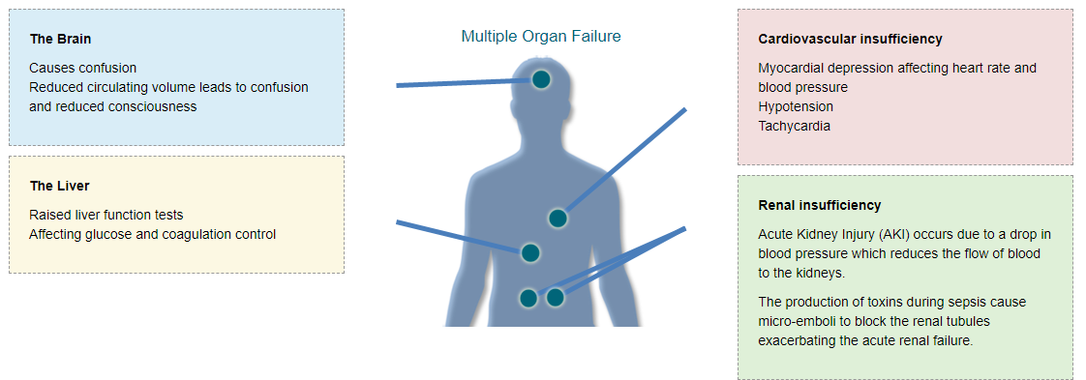

Slide 14
NICE GUIDELINES (2016)
Understanding the physiology of what occurs when sepsis starts is essential in starting to understand the signs and symptoms that the person will present with.
The NICE sepsis bundle guidelines (2016) were produced in response to the difficulties in recognising and treating sepsis. There are a number of immediate actions that need to occur to provide your patient with the best possible treatment when a person has sepsis. The guidelines aim to standardise the approach to recognising and then ensuring appropriate treatment utilising the best available evidence.
RECOGNITION OF SEPSIS
Patient 12 years and over with infection / fever / feeling unwell
Identifying the person developing sepsis is difficult as symptoms can initially be vague, but always ask the question, "Could this be sepsis?" Take into account that sepsis can present as someone feeling unwell and who has no fever with very non-specific symptoms.
ASSESS HISTORY FOR RISK FACTORS OF SEPSIS
Particular attention should be paid to the concerns expressed by the patient and especially changes in behaviour that are noted by the patient or often by relatives. Has this person a risk factor for developing sepsis? These include:
Lowered immunity (including having chemotherapy or taking steroids or immunosuppressant medication)
Recent surgery or an invasive procedure
Breach of skin integrity
Intravenous drug user
Recent or current pregnancy
The older person (over 75 years old)

Slide 15
ASSESS HISTORY FOR RISK FACTORS OF SEPSIS
Outside hospital:
Recognition of sepsis is dependent on assessing the general health of the patient, specifically including the feeling of being unwell, fever and signs or symptoms of infection. Sepsis should be considered when signs and symptoms suggest infection, even when the body temperature is not raised. People with sepsis can feel unwell initially with few other symptoms.
Groups where extra care needs to be taken in the assessment include:
People > 75 years old
People with co-morbidities / multiple other health issues, e.g. recent injuries, surgery or invasive procedures; people with a lowered immunity, e.g. following a cancer diagnosis or receiving steroids.
Women who are pregnant or have recently given birth, miscarried or had a termination in the last 6 weeks.
Where English is not the first language or it is difficult to get a good history, e.g. where there are communication issues
Anyone unable to give a good explanation of their reason for accessing healthcare
In hospital:
Recognition of sepsis is dependent on assessing the general health of the patient, specifically including the feeling of being unwell, fever and signs or symptoms of infection. Sepsis should be considered when signs and symptoms suggest infection, even when the body temperature is not raised. People with sepsis can feel unwell initially with few other symptoms.

Slide 16
CLINICAL ASSESSMENT
Clinical assessment taking account of known baseline physiology, behaviour and mental state if possible. Measure heart rate, blood pressure, oxygen saturation, and respiratory rate. Examine skin. Assess behaviour and mental state. Ask about frequency of urination.
Please use a structured algorithm to assess your patient, e.g. A-E assessment:
Airway
Breathing
Circulation
Disability
Exposure
STRATIFY RISK OF SEVERE ILLNESS AND DEATH FROM SEPSIS
Start assessing the high (red) risk initially before moving down the risk ladder to low (green) risk. This ensures a fast, correct identification of the appropriate risk of death from sepsis.
E.g. If your patient has just one of the high (red) risk criteria, then the care and treatment required needs to follow the high (red) risk management strategy.

Slide 17
HIGH (RED FLAG) RISK
One or more of the following criteria:
Objective, new evidence of altered mental state; assess any changes in the patient's current mental state (e.g. becoming confused, agitated or drowsy).
Increasing changes in vital signs to abnormal levels.
Breathing:
High Respiratory rate ≥ 25 bpm
FiO2 0.4 to maintain SaO2 > 92% or 88% in known COPD
Cardio-vascular:
Tachycardia (fast heart rate) ≥ 130 bpm
Blood Pressure (systolic) ≤ 90 mmHg or ≥ 40mmHg below normal for patient
Urine Output:
Not passed urine in the previous 18 hours or for catheterised patients, passed < 0.5 mL/kg/hr
Colour/skin:
Mottled, ashen or cyanosis of skin, lips or tongue
Non-blanching rash
Raised lactate (> 2mmol/L) or new AKI in the presence of two or more moderate (amber) risk criteria.

Slide 18
MODERATE (AMBER) RISK
Either two or more of the following criteria or SBP of 91-100 mmHg.
History of recent change in behaviour and/or mental state.
Acute deterioration of functional ability.
History of rigors.
Impaired immune response (e.g. on oral steroids, chemotherapy, illness or other medicines).
Trauma, surgery or invasive procedure in last 6 weeks.
Breathing:
Respiratory rate: 21-24 bpm; increased work of breathing
Cardio-vascular:
Heart rate: 91-130 bpm (100-130 bpm if pregnant) or new onset arrhythmia
Blood Pressure (systolic):
91-100 mmHg
Urine Output:
Not passed urine in previous 12-18 hours
If catheterised: 0.5 to 1 mL/kg/hr
Wounds/skin:
Tympanic temperature < 36 °C
Signs of potential infection: swelling increased redness, discharge/breakdown at a wound (including surgical wounds)

Slide 19
LOW (GREEN) RISK
Normal behaviour.
No high (red) risk or moderate (amber) risk criteria met

Slide 20
IMMEDIATE AND ONGOING CARE
HIGH (RED) RISK
The review should include consideration of alternative diagnoses to sepsis and venous bloods to assess:
Blood gas (including glucose and lactate levels)
Blood cultures
Full blood count
C-reactive protein
Urea and electrolyte measurements (including creatinine)
Blood clotting screen
Administration of a broad-spectrum antimicrobial medicine (within one hour of recognition of a high risk in an acute hospital setting), and discussion with a consultant (admitting consultant, consultant covering medicine or anaesthetics) is required.
In accordance with the NICE guidelines (2016), intravenous fluid boluses may need to be given immediately and the person referred to the critical care team for further review.
Observation of the person's mental state and vital signs should be started and recorded every 30 minutes.

Slide 21
MODERATE (AMBER) RISK
The review should include venous bloods to assess:
Blood gas (including glucose and lactate levels)
Blood cultures
Full blood count
C-reactive protein
Urea and electrolyte measurements (including creatinine)
The person's condition needs to be reviewed within one hour (of meeting the criteria for moderate to high risk), by a doctor/clinical decision maker able to prescribe antimicrobial medication, and within 3 hours by a senior clinical decision maker (e.g. doctor or advanced nurse practitioner).
Observation of the person's mental state and vital signs should be started and recorded every 60 minutes unless the condition of the patient changes.
Start SMART: Do not start antibiotics in the absence of clinical evidence of bacterial infection. Once a clear diagnosis is made, targeted antibiotics can be prescribed in line with local guidelines.
LOW (GREEN) RISK
Management needs to proceed in line with the clinical judgement of the patient's situation and diagnosis.

Slide 22
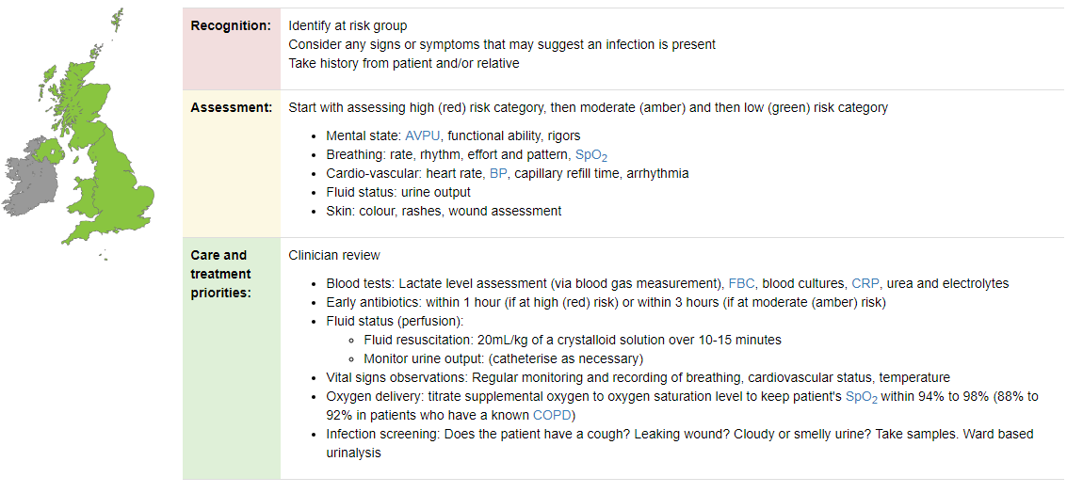
PRIORITIES OF SEPSIS TREATMENT AND CARE: NICE GUIDELINES (2016)

Slide 23
PATIENT PRIORITIES FOR TREATMENT AND CARE
The priorities of care need to be addressed for each patient. When sepsis is suspected from the initial assessment, these priorities of care need to be addressed to ensure care is appropriate and timely.
Blood Tests
Blood tests need to be assessed. Urea and electrolytes and FBC will assess the different components and chemicals found in blood. The physiological effects of sepsis will be seen in the blood results, e.g. haemoglobin level falls, CRP and serum lactate levels rise. Blood cultures are taken to help to identify the pathogen causing the infection and therefore help to narrow down antibiotic choice.
Serum lactate
Serum lactate is the main blood test that indicates the level of severity in sepsis. High (red) risk sepsis is diagnosed when the lactate level is above 2 mmol/L in the presence of two or more moderate (amber) risk criteria. A moderately high level of 1.8 mmol/L means this test will need repeating. Where the serum lactate level is high, a further intravenous fluid bolus needs to be started.
Infection screening and early intravenous antibiotics
Depending on the potential cause, antimicrobial medication may need to be given quickly, but should be regularly reviewed to ensure SMART use of targeted antimicrobial medications. A full patient examination, chasing results of tests completed and further investigations to establish the cause of the sepsis should continue (e.g. swabs, specimens, x-ray).

Slide 24
Intravenous fluids
An assessment of the person's level of hydration needs to be undertaken. Patients with sepsis easily become dehydrated as fluid moves out of the blood stream into the interstitial space as the infections cause capillaries to become leaky. Dehydration often leads to one of the initial signs - a reduced urine output.
Ongoing Monitoring
It is vital to monitor the respiratory and cardiovascular stability of the patient. As haemoglobin is affected in sepsis, the oxygen carrying capacity of the red blood cells falls. Consequently, respiratory and heart rates rise. The BP will fall usually in response to the drop in blood circulating volume. Lowered oxygen levels will require oxygen therapy to be titrated to maintain SaO2 94-98% or 88-92% in known COPD.
Monitoring closely is necessary in patients in the moderate (amber) risk group as they are at risk of deteriorating and developing a high (red) risk of death from sepsis.
Escalation of care
If the risk of sepsis is increasing, more invasive monitoring and cardiovascular support using inotropes and vasopressors may be required. Early escalation to appropriately experienced healthcare professionals (e.g. Registrar, consultant, or Critical Care team) is essential.

Slide 25
CASE STUDY: MRS RADFORD
The questions relating to this course are based on the case study so please study this section carefully taking notes were required.
Current situation
Mrs Radford is self-ventilating on air. She is also attached to a cardiac monitor on transfer, which shows:
Heart rate: 115 beats per minute
Last BP: 95/50 mmHg
SpO2: 94%
Respiratory rate: 24 breaths per minute
History of situation
The nurse states that Mrs Radford was found collapsed, having fallen on the floor at home, at 17:00 by her daughter Alice who was dropping off her mother's shopping.
Feeling unwell for last 3 days, started on oral antibiotics by GP for a possible Urinary Tract Infection (UTI) but has been feeling worse.
Past medical history
Mrs Radford is a smoker and uses inhalers.
She has arthritis in her knees, which limits the distance she can walk and is on regular analgesia.
Ability to be independent
Mrs Radford manages independently around the house but struggles to do activities like food shopping.

Slide 26
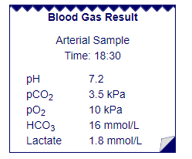
Treatment given in Accident and Emergency Dept.
Mrs Radford was admitted to the department at 17:50. She required 500 mL of Hartman's stat and is currently having a second
fluid bolus of 500 mL. This is running over 4 hours through a pink cannula sited in her left wrist.
Chest x-ray and arterial blood gas (ABG) undertaken in ED.
Urinalysis undertaken; nothing abnormal detected (NAD).
Sputum specimen sent to labs for analysis.
Effect of treatment in Accident and Emergency Department
Her systolic BP has increased and she is not as tachycardic now.
Temp 38.4°C - blood cultures have been taken. Tazocin is given. Nebulisers salbutamol and atrovent administered
for a slight wheeze with good effect.
Mrs Radford is aware of what is happening and was incontinent once when she first arrived in ED.

Slide 27
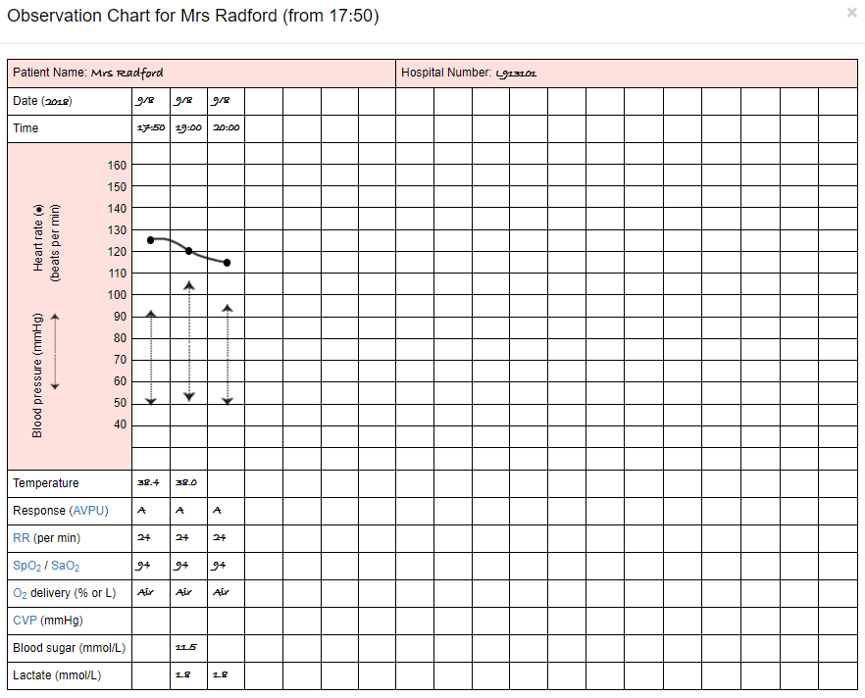

Slide 28
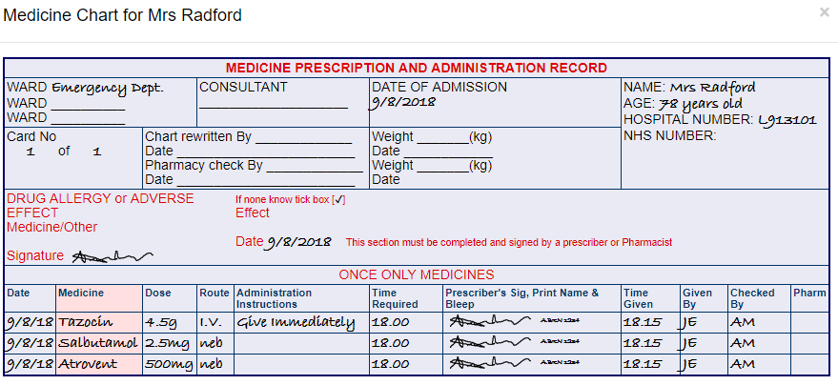

Slide 29
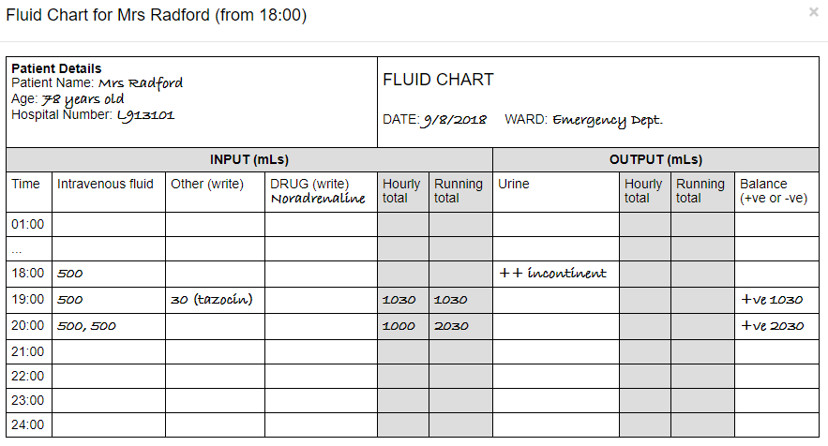

Slide 30
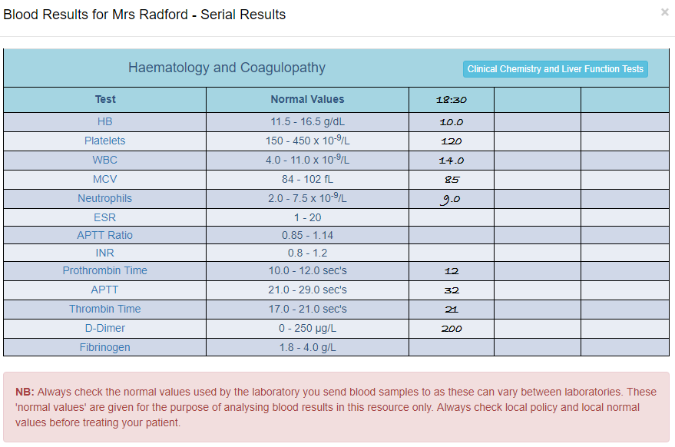

Slide 31
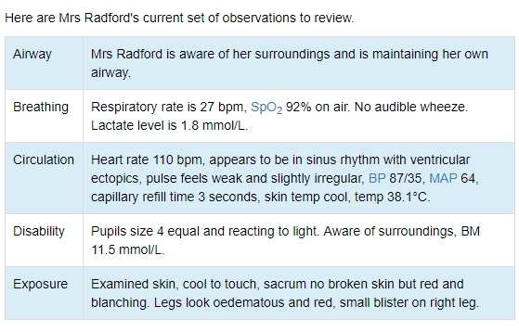
Assessing Mrs Radford after Accident and Emergency handover

Slide 32
SBAR COMMUNICATION TOOL –SITUATION, BACKGROUND, ASSESMENT , RECOMMENDATION
SBAR is an easy to use, structured form of communication that enables information to be transferred accurately between individuals. SBAR was originally developed by the United States military for communication on nuclear submarines but has been successfully used in many different healthcare settings, particularly relating to improving patient safety.
SBAR consists of standardised prompt questions in four sections to ensure that staff are sharing concise and focused information. It allows staff to communicate assertively and effectively, reducing the need for repetition and the likelihood for errors. As the structure is shared, it also helps staff anticipate the information needed by colleagues and encourages assessment skills. Using SBAR prompts staff to formulate information with the right level of detail.
WHEN TO USE IT
Communication can be defined as ‘a two-way process of reaching mutual understanding, in which participants not only exchange information but also create and share meaning’.
SBAR helps to provide a structure for an interaction that helps both the giver of the information and the receiver of it. It helps the giver by ensuring they have formulated their thinking before trying to communicate it to someone else. The receiver knows what to expect and it helps to ensure the giver of information is not interrupted by the receiver with questions that will be answered later on in the conversation.
SBAR can be used in any setting but can be particularly effective in reducing the barrier to effective communication across different disciplines and between different levels of staff.

Slide 33
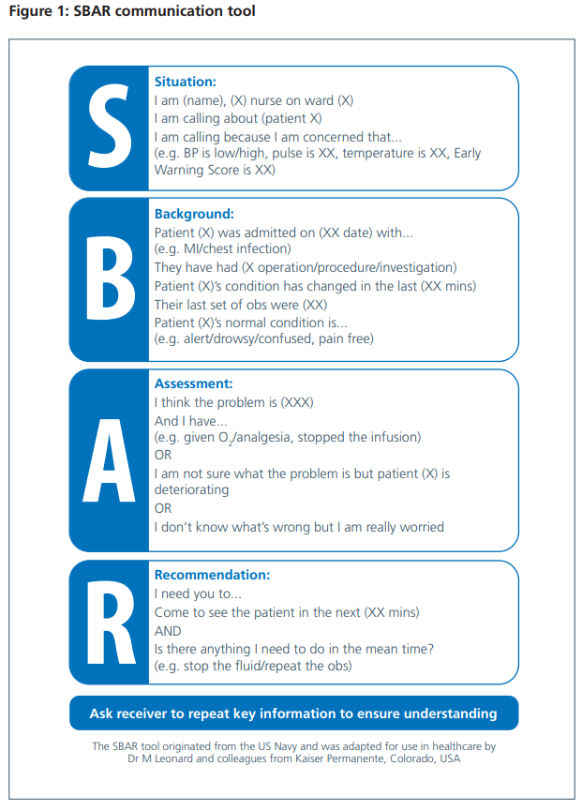
With Mrs Radford’s Case the following information should be provided via the SBAR communication Tool when informing medical staff:
Situation: Mrs Radford has just been admitted from ED. She is 78 years old and meets the criteria of moderate (amber) risk of death from sepsis. Her lactate level is 1.8 mmol/L and her BP is now low (Systolic = 85). Blood tests show an increased White Cell Count and raised CRP, also pyrexic. She is currently having replacement fluids and IV antibiotics have commenced. She now meets two criteria for high risk of death from sepsis.
Background: She was found collapsed at home.
Assessment: Show observations chart.
Recommendation: She needs further fluids. A replacement large bore venflon is required and a review by a senior doctor to assess the need for further escalation of treatment and care.

Slide 34
PRIORITIES OF CARE
The priorities of care that should be included are:
Blood tests: A full set of bloods should be sent for testing, including blood cultures, urea and electrolytes, FBC and CRP.
Serum lactate: This blood test is essential either as an urgent venous sample or with an arterial/venous blood gas. This is the main blood test that indicates the level of severity in sepsis. High (red) risk sepsis is diagnosed when the lactate level is above 2 mmol/L. If the serum lactate level is high, an intravenous fluid bolus needs to be started.
Infection screening and antimicrobial therapy: The antibiotic chosen needs to be specific to the infection, however a broad-spectrum antibiotic should be given quickly where this is not known. Every hour antibiotic therapy is delayed, the risk of mortality increases by 7.8% in septic shock. If prescribed as a single dose, a continued course of antibiotics should then be prescribed and reviewed along with the microbiology results. This needs to be done within 72 hours of admission. A full patient examination, chasing results of tests completed and further investigations to establish the cause of the sepsis should continue (e.g. swabs, specimens, x-ray).
Intravenous fluids: Multiple fluid boluses to address the dehydration, potential hypotension and/or high serum lactate levels are usually required. Urine output needs to be monitored which may require catheterisation as patients with high (red) risk sepsis are at risk of developing AKI.
On-going monitoring: Using oxygen therapy needs to be titrated to maintain the SaO₂ 94-98% or 88-92% in known COPD.
Escalation of care: If the risk of sepsis is increasing to high (red) risk of death from sepsis, more invasive monitoring and cardiovascular support using inotropes and vasopressors may be required. Early escalation to appropriately experienced Healthcare professionals (e.g. Registrar, consultant, or the Critical Care team) is vital. These experienced doctors and healthcare professionals can offer advice on the assessment of and need for escalation for reduced organ perfusion.

Slide 35
COURSE OF ACTION:
Considerations in treatment
It is essential to consider what the next course of treatment and care should be. In addition to identifying the priorities of treatment, the issues here need to be considered.
Repeat blood test
Repeat blood gas (lactate)
Infection screening and commence antibiotic therapy.
Intravenous fluids
Close observations
Escalation of care to senior medical staff if condition deteriorates
Patients who don’t reach the escalation, the following actions need to be followed to ensure they are provided with the treatment and care required.
NEXT 12 HOURS
In any patient deteriorating with either moderate (amber) or high (red) risk of death from sepsis, it is vital to assess the effectiveness of any intervention. Ensure that close monitoring continues as, although initial response may be observed, it is important to review whether that improvement has continued.
You would need to continue to investigate the cause of the problem, establishing an appropriate diagnosis, continuing the infection screening: requesting investigations, (e.g. radiology chest x-ray, etc.), sending samples, (e.g. urine, wound swabs) and chasing results in order to analyse these.
Fluid status: Where a patient has responded to a fluid challenge, it is important to continue assessing this and ensure that ideally oral fluids can be used to maintain hydration level.

Slide 36
FOLLOWING 24 HOURS
Results from the swabs and cultures taken may be starting to return depending on the tests undertaken. So, antibiotics can be reviewed in light of the sensitive organisms, ensuring these are targeted.
Microbiology concerns are on going. Whilst the tazocin was given early in this case study, there is a need to review all antibiotic use. Antibiotic usage is essential in minimising the problems of infection, however inappropriate usage needs to be minimised.
Hydration assessment needs to continue.
FOLLOWING 24- 72 HOURS
Sepsis "must be treated promptly with effective antibiotics. This is another important reason why we must tackle and reduce antibiotic resistance so that the first choice antibiotics can work in those who need them".

Slide 37
REFERRING FURTHER
Further management of Mrs Radford will depend on additional clinical assessment, the findings from investigations undertaken, her response to the treatments already given and the clinical judgement of the medically qualified practitioner undertaking the review
In identifying the deterioration in Mrs Radford's condition, and the change to high (red) risk of death from sepsis, the decision is taken to call the senior doctor who comes as soon as is realistically possible. What could you be doing or what are you expecting to be done to support Mrs Radford's care whilst the senior doctor is on their way to the ward?
You may want to think about ensuring:
Blood tests and lactate level: All blood results currently available are available to review; haematology and clinical chemistry, blood gas and lactate levels. Chase any outstanding results of investigations that should be returning - lactate level, blood tests. Check two sets (according to local policy) of blood cultures have been taken.
Infection screening: Chase any outstanding investigation results that may be available, e.g. chest x-ray, ward urinalysis, blood cultures. Take wound swabs of blister on leg and undertake MRSA screening. Assess for pneumococcal and legionella antigens.
Intravenous fluids: Continue adequate fluid resuscitation and ensure fluid balance is being completed accurately. Check viability of the other venflon, potentially re-cannulate if necessary.
Monitoring: Continue with the regular observations of BP and HR, RR. Consider need for 12-lead ECG recording.
Further cannulation
Catheterisation (accurate ongoing fluid balance)
Transfer to HDU for close monitoring and more invasive treatment

Slide 38
MEDICAL HISTORY DISCUSSION WITH SENIOR DOCTOR
The ongoing issues with perfusion for Mrs Radford continue. Her BP remains low despite multiple fluid challenges indicating a low tissue perfusion and the potential for organ dysfunction to develop. Together with an increased lactate level and the suggestion of an underlying infection, she is potentially developing sepsis. The impression, in this case, is 'high (red) risk' of sepsis
Medical history
Risk of Sepsis
Fluid Status
Infection screening
Antimicrobial Review
Transfer to HDU
TRANSFER TO HDU
Whilst transferring Mrs Radford to HDU, it is vital that she remains under close observation and medical equipment is provided en route:
Cardiac Monitor for continuous ECG monitoring
Emergency Equipment in the ventilation and intubation are necessary
All clinical records and documentation/ observation charts
Medications
Oxygen Cylinder
Appropriate level of trained staff

Slide 39

TIME TO TAKE YOUR TEST
Please click on the button below to begin.
Good Luck!
TAKE TEST

