Slide 1

Therapeutic Boundaries

Slide 2



BEFORE BEGINNING
If you are using a mobile device or laptop, please ensure that it is fully charged.
You should also have a pen and notepad ready.
Ensure you are in a quiet area with minimal distractions.
In addition to the above please make yourself familiar with some of the tools available above such as;
Resource Bank
Here you will find useful documents that will be relevant to the course you are undertaking but also you will have access to a CPD reflective learning template which you can download and complete to gain your points.
Highlighter/Pen tool
This feature allows to highlight, circle and write notes on parts of the material wherever you feel necessary.
Presenter Function
Selecting this function will give you instant access to our contact details without having to leave the course should you require support with the system or any assistance from one of our qualified trainers.
Audio Dictation
Please note this feature is auto-enabled. If this isn’t required simply select the mute function or decrease the volume.
Hyperlinks
Should you click on a hyperlink within the course material you will be required to click your back button on your browser or device once you are ready to resume.

Slide 3
INTRODUCTION
This session is aimed at a specialist audience: trainee and practising counsellors. It looks at the importance of self-awareness in counselling children and young people, and how this might inform and shape the development and maintenance of a sound therapeutic relationship.

Slide 4
Learning Objectives
By the end of this session you will be able to:
Recognise potential judgements that you may hold towards children and young people
Explain the importance of being self-aware in counselling with children and young people
Describe how self-awareness can help the development of a counselling relationship with children and young people
This session uses self assessments that help you check what you have learnt. You do not have to use them and your answers are not seen by anyone else.

Slide 5
Introduction
'Know thyself' may well be an ancient truth of unknown origin however, it is as important today as it ever was. This is particularly significant in the context of counselling and psychotherapy with children and young people.
Developing self-awareness is an ongoing process not a fixed point in our learning experience.
Sometimes it can be empowering and sometimes it can be challenging; however, it is always essential and never more so than in our work with children and young people.
This session will provide you with opportunities to explore your thoughts, feelings and assumptions when counselling children and young people.
Defining self-awareness
The value of self-awareness on learning and practice has long since been recognised by the counselling community.
Broadly self-awareness is defined as:
A state of being conscious of one's thoughts, feelings, beliefs, behaviours and attitudes, and knowing how these factors are shaped by important aspects of one’s developmental and social history

Slide 6
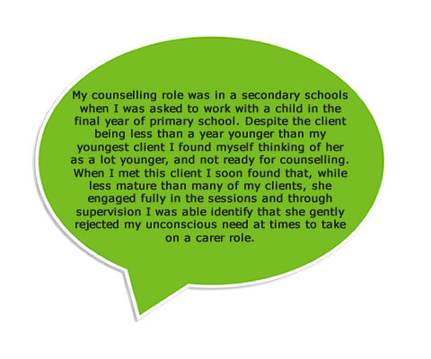

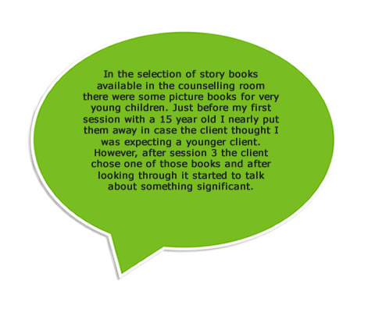

Examples from Practitioners

Slide 7
Self-awareness
There are two key areas of self-awareness that impact in counselling:
The practitioner
The relationship
Self-awareness and the practitioner
The practitioner's own awareness of self is the foundation to the meaningful awareness of others.
“If I am to be acceptant of another's feelings and experiences and to be open to the possible expression of material long since blocked off from awareness I must feel a deep level of acceptance for myself. If I cannot trust myself to acknowledge and accept my own feelings without adverse judgement or incapacitating self-recrimination it is unlikely that I shall appear sufficiently trustworthy to a client who may have much deeper cause to feel ashamed or.”
Self-awareness and the relationship
Through the process of self-awareness, comes an understanding of who we are in relationship with other individuals.
Enhancing self-awareness is pivotal for counsellors and psychotherapists who work in relationship with children and young people.

Slide 8
Self-awareness as a Professional and Ethical Requirement
Within the 'Humanistic Psychological Therapies: Specific Metacompetences', a key expectation is that the counsellor has the ability to:
Maintain a sense of their own separate reality and experience while maintaining an awareness of the ways in which clients may draw them into particular patterns of relating.
There are many examples of professional counselling and psychotherapy organisations whose ethical guidelines support the view that practioner's self-awareness is imperative.
Regardless of the practitioners' theoretical model, clear guidance suggests that self-awareness is crucial to maintaining safe practice.

Slide 9
British Association for Counselling and Psychotherapy
The British Association for Counselling and Psychotherapy (BACP) Ethical Framework for Good Practice in Counselling and Psychotherapy recognise the importance of working with children and young people. It also reminds counsellors to be aware of any limits of training and experience. This is clearly significant for those who are considering embarking on work with children and young people.
BACP guidance on ethical responsibilities requires careful consideration is given to working with children and young people. This means that ‘the practitioner has the particular knowledge and skills appropriate for work with this client group and is informed of current culture and customs that affect care-giving in families’.
The BACP Counselling Children and Young People (4-18 years) Training Curriculum is the foundation guidance for practitioners and training providers.

Slide 10
Awareness
Awareness of motivations helps avoid pitfalls when working with children and young people. It can be helpful to recognise relationship patterns and how it might influence the counselling relationship with children and young people.
For example:
Reparative experience
Care seeking
Care giving
Reparative experience
Unaware – The client reminds me of myself at their age. I am here to make sure they get the help they need that I never got.
Care seeking
Unaware – The client seemed really disappointed that there wasn’t any silver paint for her artwork. I know she managed without it but I must make sure to find some before the next session.
Care giving
Unaware – I spent half of that session thinking I just wanted to brush the child’s hair and give them a good square meal.

Slide 11
While the relationship between child and practitioner in counselling is in many ways reciprocal, in other ways it is unequal. This is a pivotal and significant factor in all work with children and young people. Where self-awareness is present the practitioner can be alert to potential challenges that may arise as a result of the imbalance of power between the children and young people, and the practitioner.
Case Study
I was working with an 8-year-old girl named Alice who was referred for counselling after the death of her mum. I immediately recognised that there were some similarities with Alice's circumstance and my own experience as a child. As I was aware of the situation I felt that I could still offer counselling to Alice without my own experience interrupting the counselling process. The first couple of sessions seemed to go well as Alice and I began our work together.
However, as I was writing up my notes after the third session I realised that when Alice had played a scenario of symbolic loss my own feelings had come to the fore. This had prevented me from responding to the story that she had shared. I had not been attuned to what Alice had expressed, and I felt as if I had possibly denied her the opportunity to explore her feelings more deeply.
Self-awareness was crucial to helping me as a practitioner and enabled me to identify an issue that I had not anticipated. As a result of this I decided to explore this further through:
Option 1 - supervision
Option 2 - training
Option 3 - personal development

Slide 12
Case Study (cont.)
Option 1 - supervision:
I met with my supervisor and explained what had taken place. I was able to use creative materials to explore my responses to Alice's needs and the story she told. This experience enabled me to think about other responses that would have been more attuned and receptive to Alice's needs. Having had this time and space to reflect, I felt I would be more able to really hear what Alice had to say to me without my own feelings contaminating the process.
Option 2 - training:
I researched possible relevant courses and programmes specifically to develop practitioners' expertise when working creatively with young children around the issue of loss. I attended a 4-day programme with a national charity specialising in this work. This gave me opportunities to think about my own experiences as well as how I would respond to clients' experiences. I found it particularly helpful to hear about the experiences of the other practitioners in the group.
Option 3 - personal development:
I felt that re-accessing my own counselling would be beneficial. After the initial session with my counsellor I imagined that I would be resolving my feelings about my own experience of loss. However, in the second session I was somewhat taken aback to find I was talking about my fears for my own children rather than my own experience in childhood. I was able to identify a previously unspoken desire to protect my children from loss and recognise how I had often avoided talking to them about my own mother. Having an opportunity to increase self-awareness and make changes felt really enabling as a person and a practitioner.

Slide 13
Session Key Points:
Self-awareness can be located at a personal and professional level
Self-awareness is an ethical requirement for many therapy professional organisations
A greater awareness of self can be actively used to inform the counselling relationship
Self-awareness can further help the counsellor to be aware of judgements they may hold that might impair the counselling relationship

Slide 14

TIME TO TAKE YOUR TEST
Good Luck!

